Slide 1
Train Your Brain - Learn How to Learn
Dr. E. R. Latifee
Monday, October 5, 2020
Notes:
NOTE:
To change the image on this slide, select the picture and delete it. Then click the Pictures icon in the placeholder to insert your own image.

Slide 2
Contents
Introduction
Creation of Memory and Types of Memory
Memory Techniques-How Can We Improve Memory
Know Your Enemies

Slide 3
Introduction

Slide 4
1. Introduction
Brain is the jelly-like material weighing around three pounds or 1.4 kilograms found within our skulls. Maybe it is the most complex living machine on Earth and in the whole universe.
It is made of approximately 100 billion nerve cells or neurons!
Neurons, or brain cells, reach out to other neurons (Link up) through connectors called synapses to form memories.
When neurons fire off together, a pattern (sometimes called an “engram”) is formed. Recall (Remembering) of the memory will light up the pattern again.

Slide 5
1. Introduction (cont.)
Each neuron may be connected to hundreds of other cells by as many as 10,000 connections/synapses.
A typical brain has about 100 trillion synapses. (1 Trillion=10^12 or, 1,000,000,000,000!)
A lot of memory consolidation process happens while we’re sleeping. Our brains recreate that same pattern of brain activity to strengthen the synapses we created earlier.
A sharp mind and strong memory depend on the strength of your brain's network of interconnecting neurons through the synapses.

Slide 6
Neurons and Synapses (specialized junctions between neurons)

Slide 7
2.1 The creation of a memory
If you know how memory works, you will understand the science behind the memorization techniques.

Slide 8
2.1 The creation of a memory (cont.)

Slide 9
2.2 Memory: Sensory, Short-term and Long-term
The creation of a memory begins with perception, lasts only a fraction of a second.
It's your Sensory memory that allows a perception (raw data) such as a visual pattern, a sound, etc. linger for a brief moment after the stimulation is over.
Short-term memory, working memory, has a fairly limited capacity; it can hold about seven items (7+/-2 items), readily available state for no more than 20 or 30 seconds at a time.
Important information (your perception) is gradually transferred from short-term memory into Long-term memory. The more the information is repeated or used, the more likely it is to eventually end up in long-term memory which is thought to be Unlimited.

Slide 10
Stage of Memory-Flow diagram

Slide 11
2.3. Encoding
Although a memory begins with perception, it is encoded and stored using the language of electricity and chemicals.
Nerve cells connect with other cells at a point called a synapse.
All the action in your brain occurs at these synapses, where electrical pulses carrying messages leap across gaps between cells.
The electrical firing of a pulse across the gap triggers the release of chemical messengers called neurotransmitters.
Stronger Synapses gives improved memory!

Slide 12
Synapses: point of communication between neurons
Courtesy: https://www.newswise.com/articles/media-article/526385

Slide 13
3. Memory Techniques-How Can We Improve Memory
Memory formation is like the formation of foot way traffic path in the grass

Slide 14
3.1 Prior Knowledge, Making Connection
We need prior knowledge and a system for organizing the information.
Try to link what you want to learn with previous experience, prior knowledge.
Did you have prior experience, similar knowledge before? Ask yourself, i.e., self-talk, if you can relate the new material to your earlier long-time memory.

Slide 15
3.2 Association- We remember things by association.
Do most of us have a bad memory?
Experts say, most of us don’t. Most of us have a really good memory, but we just don’t have the practice to use it.
Our memory works by association. If there is no association between things, it’s very difficult to remember them.
Why association works? Because it attaches a string with something familiar, such as Mr. Hill with a hill to remember the name!

Slide 16
3.3 Chunking or clustering
It is as an efficient approach for utilizing limited working (short time) memory. It breaks up long strings of information into units or chunks
Research suggests that on average the human brain can hold 4 to 7 different items in its working (short-term) memory. Some say 7+/-2 chunks.
Exercise 1:
Try to look at the number, 7458793107, for 5 seconds and then recall(remember).
Could you recall it?

Slide 17
3.3. Chunking or clustering (-cont.)
If you could chunk this number 7458793107, as
745 879 3107, now it’s easy!
Try to remember this now.
It is as an efficient approach for utilizing limited working (short time) memory

Slide 18
3.4 Practice makes permanent.
Repeated retrieval during learning is the key to long-term retention.
Each time you review that knowledge, this mental manipulation increases activity along the connections between nerve cells (Synapses).
Repeated stimulation—for example, studying the times tables many times—makes the network stronger, just like muscles become stronger when you exercise them. And that makes the memory stay in your brain. Practice makes permanent.

Slide 19
3.5 Draw Pictures: A Picture Worth a Thousand Words
There is a wise saying, “If you listen, you forget; if you see, you remember, if you do, you understand”
Hear a piece of information, and three days later you’ll remember 10 percent of it. Add (Make) a picture pf the information and you’ll remember 65 percent.
Make /Create Images.
You can remember if you see the map with direction, but it is difficult to remember if you listen to the directions.

Slide 20
3.6 Recall is better than Rereading the Text
The practice of remembering things without rereading the text can improve brain function.
Active recall involves retrieving information from memory. It’s a Close book exercise!
“When neurons fire off together, a pattern (sometimes called an “engram”) is formed. Recall (remembering) of the memory will light up the pattern again.” (Dr. Megan Sumeracki and Dr. Yana Weinstein, the Learning Scientists’ book)

Slide 21
Neural activity
Neural activity refers to the constant flicker of electrical currents and transmissions in the brain.
Pictured is an artist’s interpretation of neurons firing in sporadic, coordinated bursts. (courtesy: https://news.mit.edu/2016/bursts-neural-activity-brain-working-memory-0317)

Slide 22
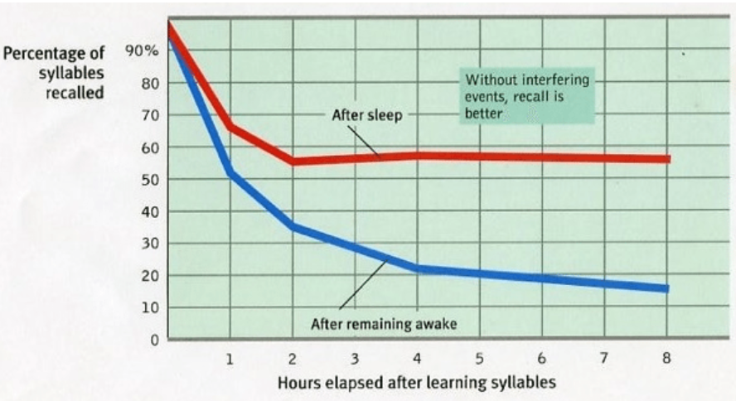
3.7 Sleep Well: It will Clean Your Brain
Your brain flushes out toxins that have accumulated during the day. It is also important for consolidating short-term memories into long-term memories
Deep Sleep Gives Your Brain a Deep Clean.
Naps improve your brain’s day to day performance

Slide 23
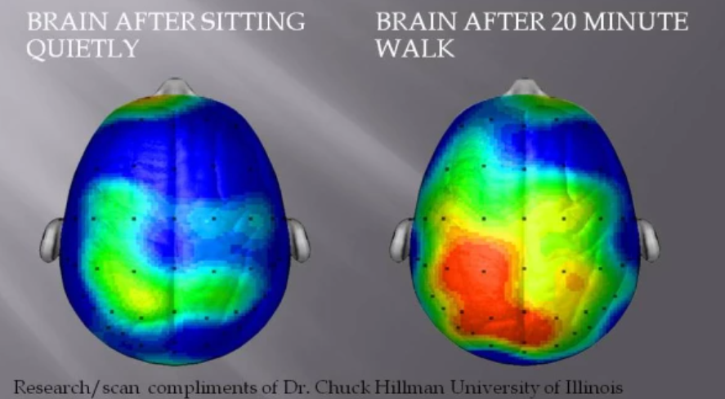
3.8 Exercise daily.
Exercising as little as 20 minutes a day can increase your brain function. Exercise helps you learn faster and retain information better.

Slide 24
3.9 Eat a Healthy Diet: Fruits and Vegetable
What a person puts into their body directly affects how they think and feel, and certain foods can help improve memory. Omega-3 fatty acids, vitamins, unsaturated fats, and fiber are particularly important for your brain.
Drink lots of water as well to stay hydrated.
Harvard Health Publishing suggests that maintaining a healthy diet that includes green, leafy vegetables (e.g., spinach and broccoli) and fatty fish (e.g., salmon and light tuna), as well as berries, walnuts, tea and coffee, can help to improve memory. Healthline also recommends pumpkin seeds, dark chocolate, oranges and eggs as foods that can improve and maintain memory.

Slide 25
3.10 Meditate to improve Your Memory
Mindfulness meditation, teaches you to focus your mind. When you're able to focus better, you're also better able to solidify concepts in your short-term memory.
The authors of a 2018 research paper note that many studies show meditation improves brain function, reduces markers of brain degeneration, and improves both working memory and long term memory. The researchers observed the brains of people who regularly practiced meditation and those who did not.

Slide 26
3.11 Maintain social relationships.
Interaction with friends and family can help reduce stress levels, enhance intellectual stimulation, combat depression, and potentially slow the rate of memory decline
Psychology Today writer Angela K. Troyer, PhD, explains, “People who connect with others generally perform better on tests of memory and other cognitive skills. And, in the long run, people with active social lives are less likely to develop dementia than those who are more socially isolated.”

Slide 27
3. 12 Use Acronyms
Try to use it always. Let us try this one: Order of operation: Parentheses, Exponents, Multiplication ,Division, Addition, Subtraction- PEMDAS::"Please Excuse My Dear Aunt Sally” : PEMDAS.

Slide 28
3.13 Use both Focused and the Diffuse modes
We have two different modes of thinking: the focused mode and diffuse mode. We are in either in one mode or the other. Both these modes are highly important for learning.
To learn something new – go back and forth between the FOCUS and DIFFUSE Modes
The focused mode is when we concentrate on solving an issue or to make a decision.
Diffuse mode is associated with “big picture” perspectives, and happens when you relax and let your mind wander. If you are trying to understand or figure out something new, turn off your focused thinking and turn on your diffuse mode-Take a walk, etc.

Slide 29
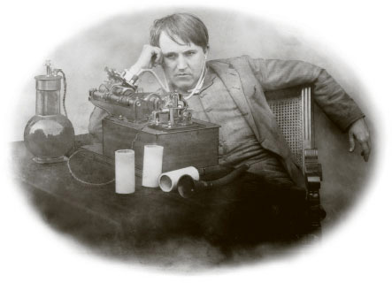
Inventor of Light Bulb-Thomas Edison used diffuse mode
Thomas Edison — used diffuse mode –he could often be found taking a break from his experiments to sit and relax with ball bearings in his hands. When he fell asleep, the sound of the ball bearings dropping to the ground would wake him up.”
courtesy- Coursera lecture series 'Learning How to Learn’-Dr. Barbara Oakley
Edison and his team of researchers in Edison's laboratory in Menlo Park, N.J., USA, tested more than 3,000 designs for bulbs between 1878 and 1880 to come up with the first Light bulb.

Slide 30
3.14 Read every day.
Reading a book of your interest can actually enhance your cognitive(thinking/perception) function. Reading also helps to develop language skills and increase attention spans. Benefits:
Mental Stimulation
Memory Improvement
Stronger Analytical Thinking Skills
Improved Focus and Concentration
Better Writing Skills
calmness/tranquility

Slide 31
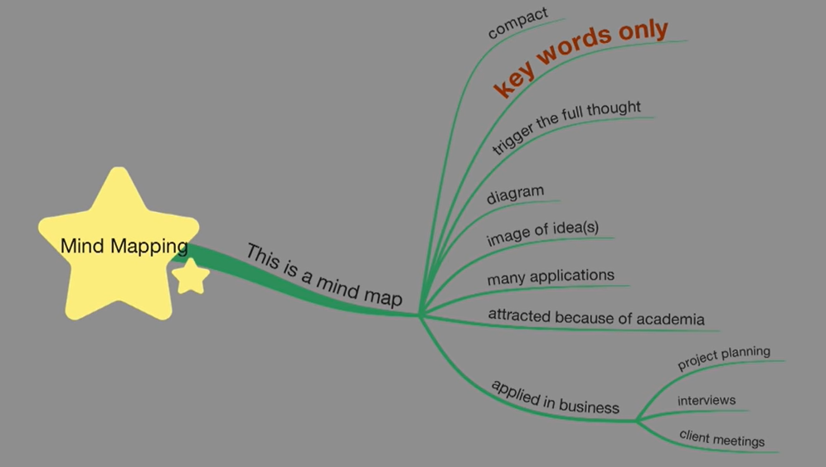
3.15 Mind Mapping
Mind maps are diagrams used to visually organize information hierarchically. It is a highly effective way of note-taking and note-making that literally "maps out" your ideas.

Slide 32
Mind Mapping (cont.)
Four Essential Characteristics of Mind Mapping:
The main idea or focus or subject is placed in a central image
For Each idea/concept create a branch. These 'branches' radiate from the central image
The branches comprise a key image or key word drawn on its associated line
Topics of lesser importance are represented as 'twigs' (2nd and 3rd level branch, from thick to thin) of the relevant branch

Slide 33
Mind Mapping Example-1

Slide 34
Mind Mapping Example-2

Slide 35
4. Know Your Enemies
4.1 Distractions Make Learning Harder
Two major types of distractions:
Internal: Like hunger, fatigue, illness, stress, worries, other distracting thoughts -things you should be doing instead, things you’d rather be doing, etc.
External: External distractions can include things like general noise, other peoples' conversations, TV or movies, music, phone alerts, app alerts, and anything else that diverts your attention from the task at hand. Fix a time say 25 minutes-use stop watch.
4.2 Anxiety, Worries -the Hidden Enemy- Anxiety and stress affect working memory
4.3 Depression, Sadness -affects your ability to think hold information
4.4 Procrastination- “Procrastination” is derived from the Latin verb “procrastinare “— to put off until tomorrow. The problem is not doing the work, it’s the starting of the work!
So, Start NOW!

Slide 36
Questions
Contact: erlatifee@gmail.com

Slide 37
Annex: How Much Sleep Do I Need? (Content source: National Center for Chronic Disease Prevention and Health Promotion, Division of Population Health, U.S.A.)
Age Group |  | Recommended Hours of Sleep Per Day
Newborn | 0–3 months | 14–17 hours (National Sleep Foundation)¹ No recommendation (American Academy of Sleep Medicine)²
Infant | 4–12 months | 12–16 hours per 24 hours (including naps)²
Toddler | 1–2 years | 11–14 hours per 24 hours (including naps)²
Preschool | 3–5 years | 10–13 hours per 24 hours (including naps)²
School Age | 6–12 years | 9–12 hours per 24 hours²
Teen | 13–18 years | 8–10 hours per 24 hours²
Adult | 18–60 years | 7 or more hours per night³
 | 61–64 years | 7–9 hours¹
 | 65 years and older | 7–8 hours¹

