Slide 1
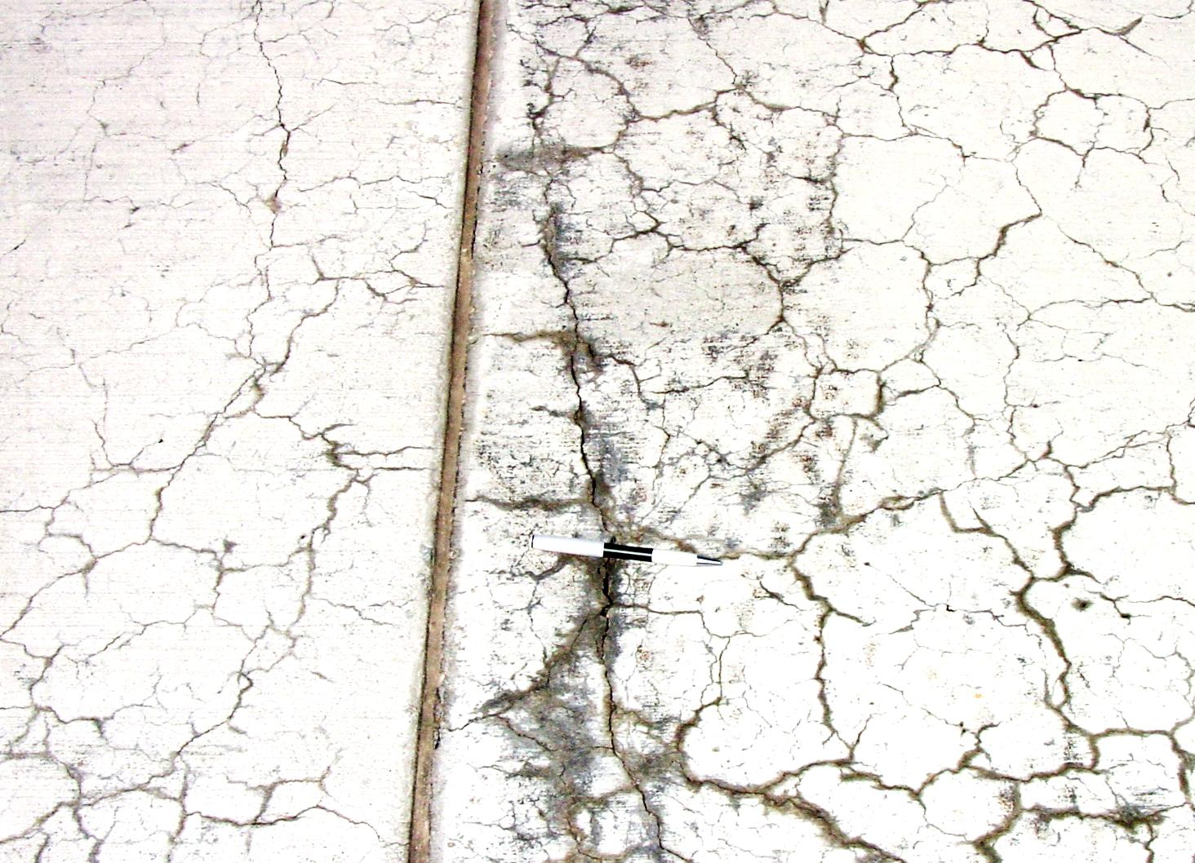
Miniature Concrete Prism Test – A New Test Method for Evaluating the ASR Potential of Aggregates and the Effectiveness of ASR Mitigation Measures
Brief Description of Doctoral Research
Glenn Department of Civil Engineering
Clemson University, SC, U.S.A.
E. R. Latifee, PhD
29th November, 2014
Ahsanullah University of Science and Technology

Slide 2
Acknowledgement
Dr. Prasad Rangaraju, Clemson University
Dr. Paul Virmani, FHWA

Slide 3
Presentation Outline
Introduction
ASR Distress in Concrete
Review of Past ASR Test Methods,
Research Significance
Experimental Program, Materials, Methods, Results and Conclusions

Slide 4
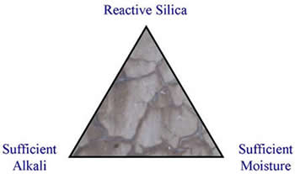
ASR - Alkali Silica Reaction
Alkalis
+
Reactive Silica
+
Moisture
ASR Gel which expands
Concrete expansion and
cracking
What is Alkali Silica Reaction?
Alkali-silica reaction (ASR) is a heterogeneous chemical reaction between alkali ions (Na+ and K+) and hydroxide ions (OH-) in the concrete pore solution, generally derived from the Portland cement, and forms of reactive silica (SiO₂) in the aggregate (eg: chert, quartzite, opal, strained quartz crystals).

Slide 5
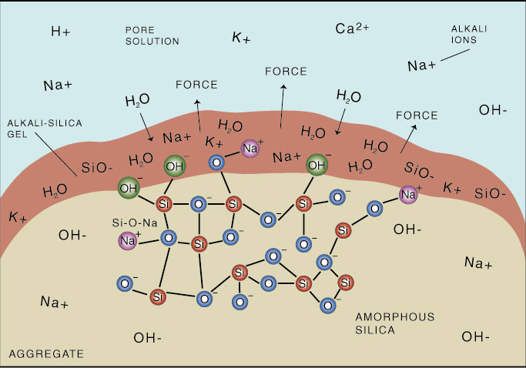
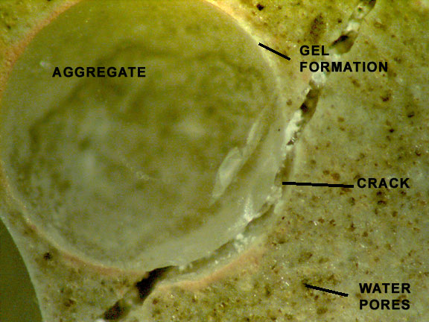
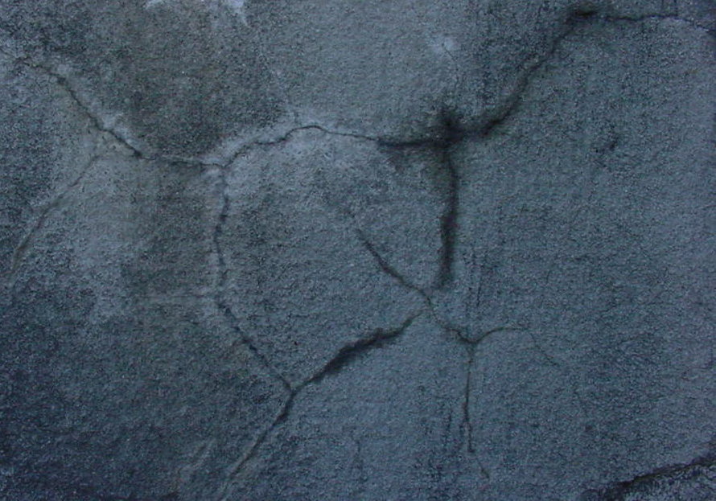
Creation of alkali-silica gel and cracking of concrete

Slide 6
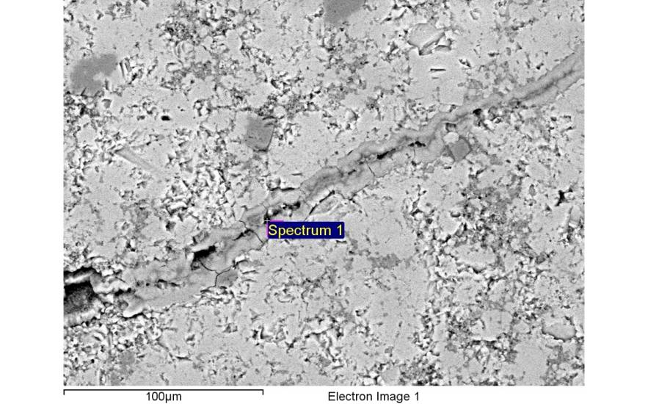
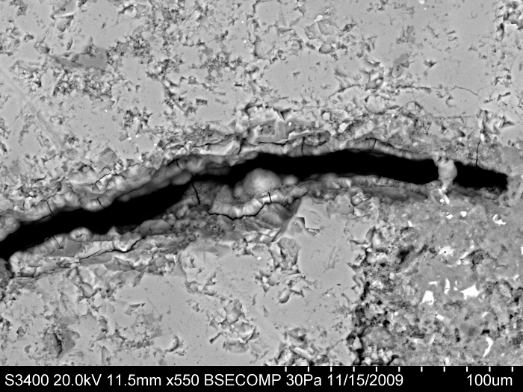
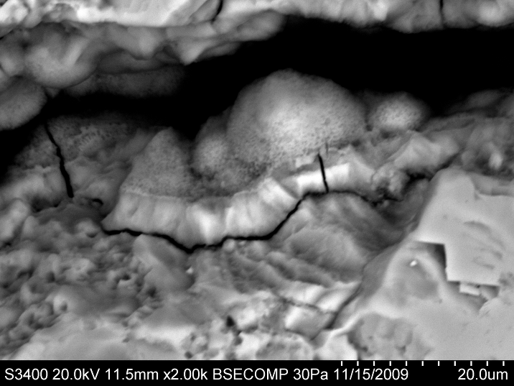
SEM images of ASR gel within Spratt Limestone

Slide 7
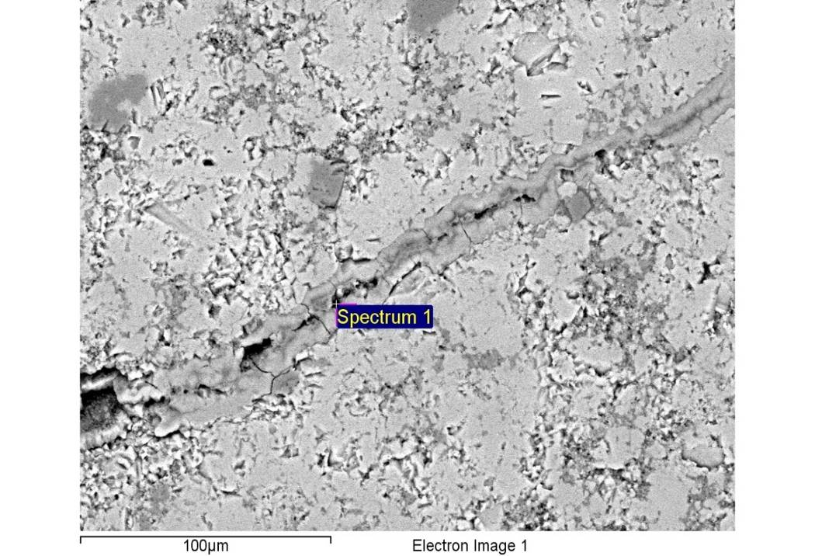
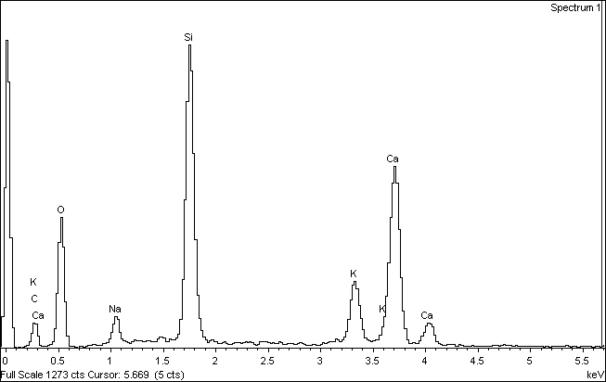
Microstructure of Spratt MC Prism (100% RH)

Slide 8
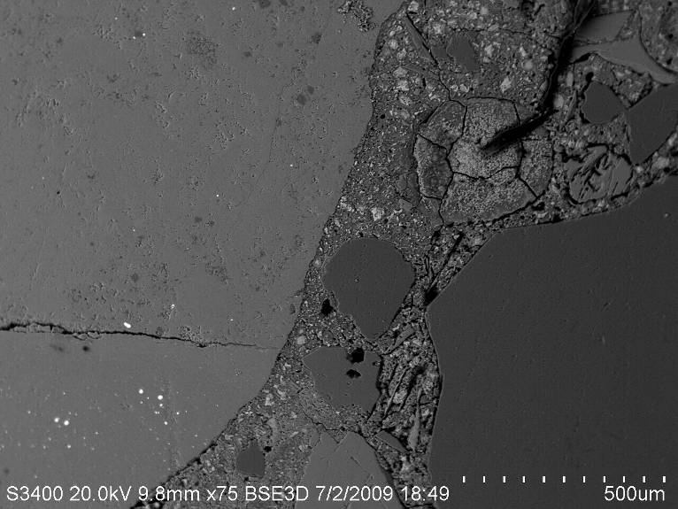
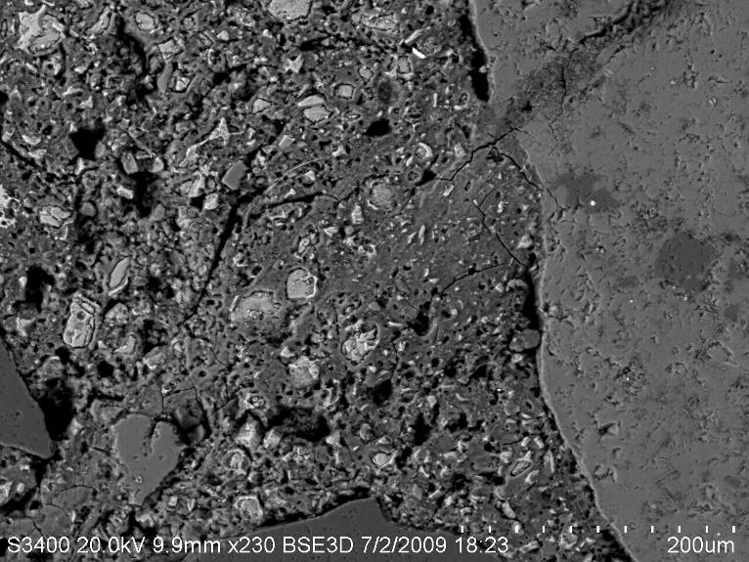
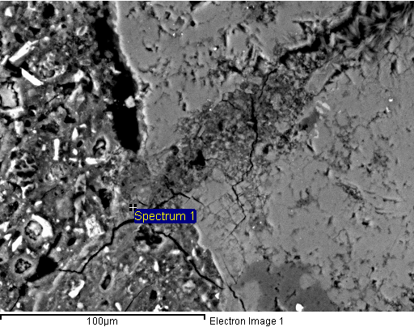
Microstructure of Spratt MC Prisms Soaked in1N NaOH

Slide 9
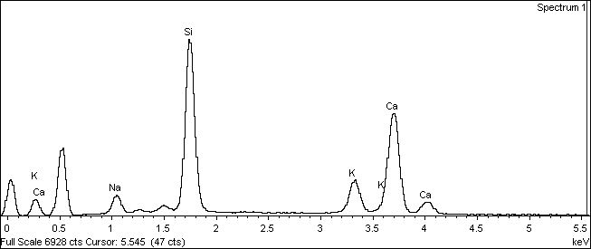
Microstructure of Spratt Limestone Prism (1N NaOH)

Slide 10
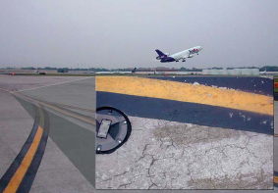
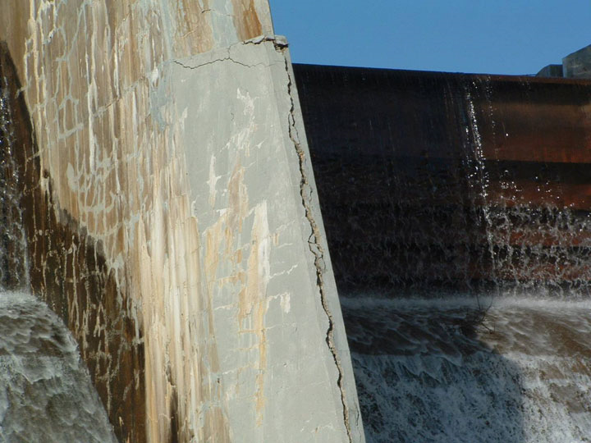
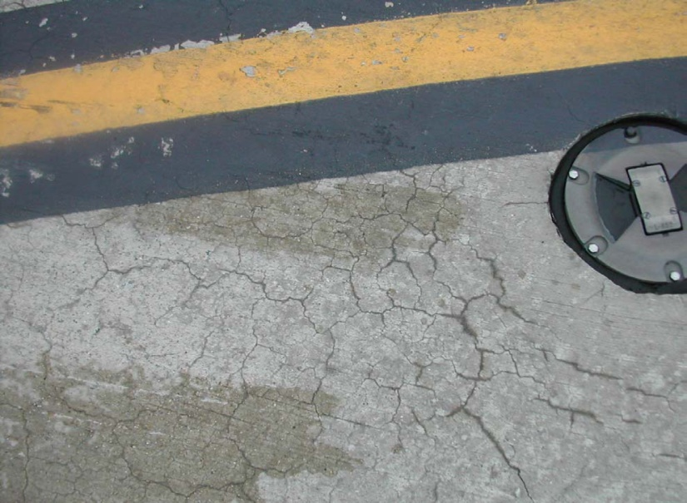
Alkali-Silica Reaction Distresses in the field
Notes:
Delete

Slide 11
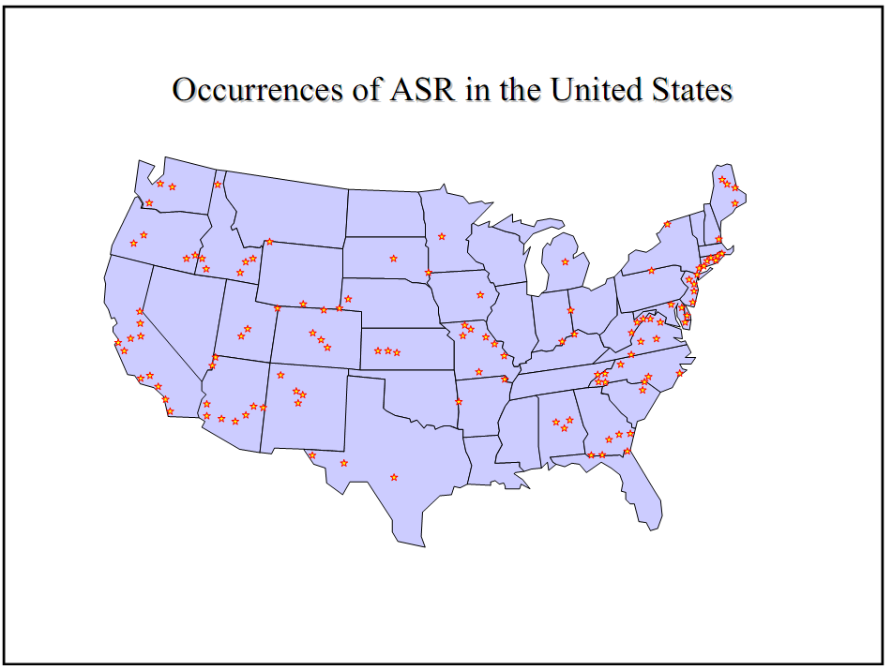

Slide 12
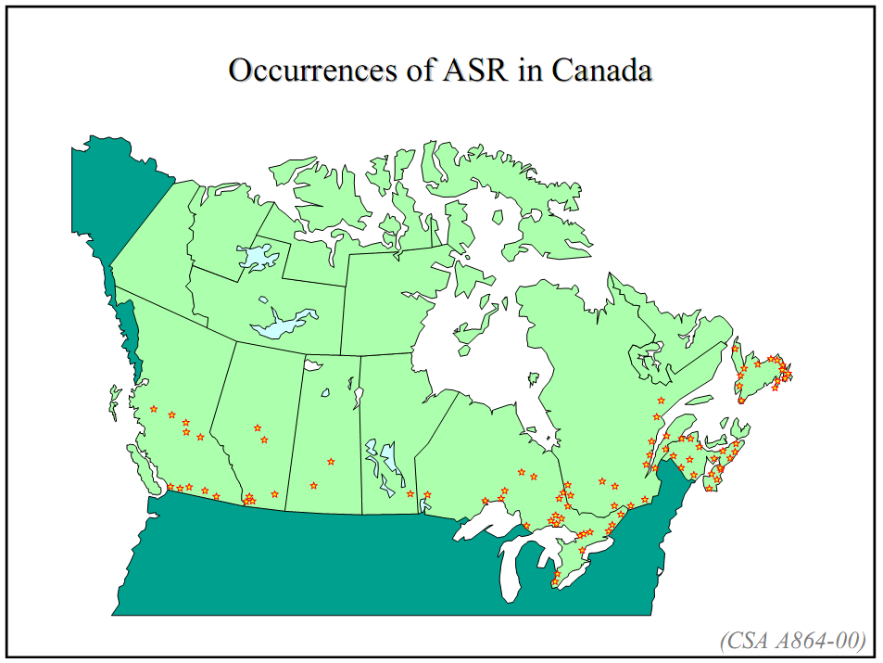

Slide 13
ASR reported locations around the globe
1 | AUSTRALIA
2 | CANADA
3 | CHINA
4 | DENMARK
5 | FRANCE
6 | HONG KONG
7 | ICELAND
8 | ITALY
9 | JAPAN
10 | KOREA
11 | NETHERLANDS
12 | NEW ZEALAND
13 | NORWAY
14 | ROMANIA
15 | RUSSIA
16 | PORTUGAL
17 | SOUTH AFRICA
18 | SWITZERLAND
19 | TAIWAN
20 | UK
21 | U.S.A.
Note: Map is based on reported countries
Courtesy: Editable world map
http://free-editable-worldmap-for-powerpoint.en.softonic.com/

Slide 14
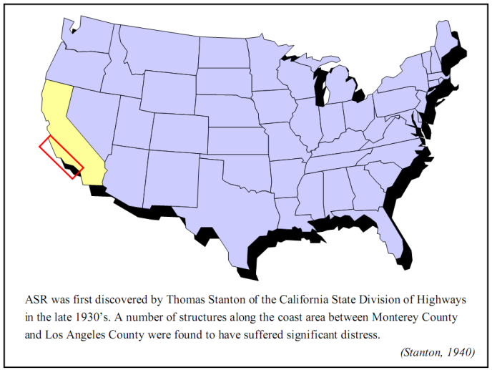
Beginning of ASR Research

Slide 15
ASR Research Time Line

Slide 16
1940-1960
1. Stanton, 1940, California Division of Highway
2. Mather, 1941, Concrete Laboratory of the Corps of Engineers
3. ASTM C 227-10, 1950, Standard Test Method for Potential Alkali Reactivity of Cement-Aggregate Combinations
4. ASTM C 289, Quick chemical method, 1952
5. The Conrow test, 1952, ASTM C 342, 1954- withdrawn -2001
6. ASTM C 295, Petrographic Examination of Aggregates, 1954
7. ASTM C1293, Concrete Prism Test, 1950s, Swenson and Gillott,
8. Gel pat test, Jones and Tarleton, 1958

Slide 17
1960 -1990
9. ROCK CYLINDER METHOD, 1966
10. Nordtest accelerated alkali-silica reactivity test, Saturated NaCl bath method Chatterji , 1978
11. JIS A1146, Mortar bar test method, Japanese Industrial Standard (JIS)
12. Accelerated Danish mortar bar test, Jensen 1982
13. Evaluation of the state of alkali-silica reactivity in hardened concrete, Stark, 1985
14. ASTM C 1260, Accelerated mortar bar test (AMBT); South African mortar-bar test- Oberholster and Davies, 1986,
15. Uranyl acetate gel fluorescence test, Natesaiyer and Hover, 1988

Slide 18
1991 -2010
16. Autoclave mortar bar test, Fournier et al. (1991)
17. Accelerated concrete prism test, Ranc and Debray, 1992
18. Modified gel pat test, Fournier, 1993
19. Chinese concrete microbar test (RILEM AAR-5)
20. Chinese autoclave test (CES 48:93), Japanese autoclave test, JIS A 1804
21. Chinese accelerated mortar bar method—CAMBT, 1998
22. Chinese concrete microbar test (RILEM AAR-5), 1999
23. Modified versions of ASTM C 1260 and ASTM C 1293,Gress, 2001
24. Universal accelerated test for alkali-silica and alkali-carbonate reactivity of concrete aggregates, modified CAMBT, Duyou et al., 2008

Slide 19
ASTM C 1260 (AMBT) and ASTM C 1293 (CPT)
ASTM C 1260 (AMBT) drawbacks
ASTM C 1260 tends to be overly severe, resulting in expansions exceeding the failure limit, even though these aggregates pass the concrete prism test and perform well in field applications (false positive). On the other hand, it also gives false negatives.
ASTM C 1293 (CPT) ) drawbacks
The major drawback to ASTM C 1293 is its long duration (1 or 2 years).
It has been criticized for leaching out of alkali

Slide 20
Why do we need MCPT?
From Industry perspective, 1 or 2 year test duration (CPT) is not practical, and false positives can lead to unnecessary exclusion and false negatives creates potential ASR risk
MCPT has been developed to determine aggregate reactivity, with:
- Similar reliability as ASTM C 1293 test but shorter test duration (56 days vs. 1 year)
- Less aggressive exposure conditions than ASTM C 1260 test but better reliability

Slide 21
Development of MCPT method
Variable test conditions
Storage environment
Exposure condition
1N NaOH
100% RH
100% RH (Towel Wrapped)
Temperature
38 °C
60 °C
80 °C
Sample Shape
Prism (2” x 2” x 11.25”)
Cylinder (2” dia x 11.25” long)
Soak Solution Alkalinity (0.5N, 1.0N, and 1.5N NaOH solutions)

Slide 22
Aggregates used in the Variables
Four known different reactive aggregates were used for these variables. These are as follows:
Spratt Limestone of Ontario, Canada,
New Mexico, Las Placitas-Rhyolite,
North Carolina, Gold Hill -Argillite,
South Dakota, Dell Rapids – Quartzite

Slide 23
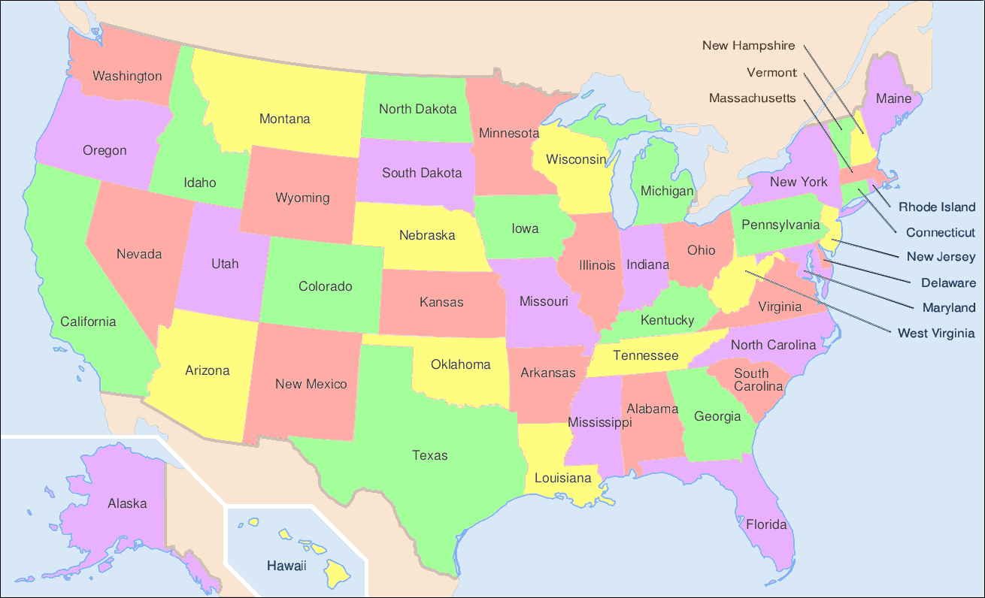
NC, SD, NM

Slide 24
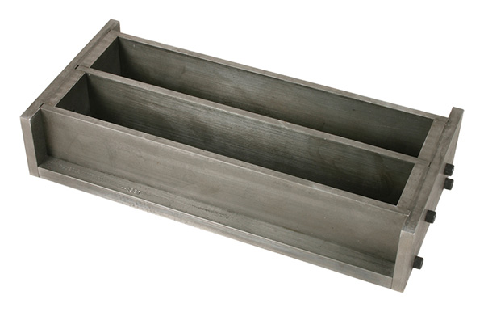
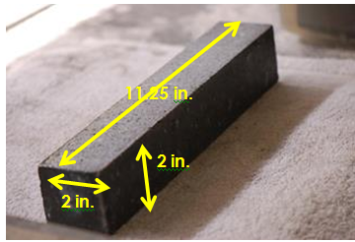
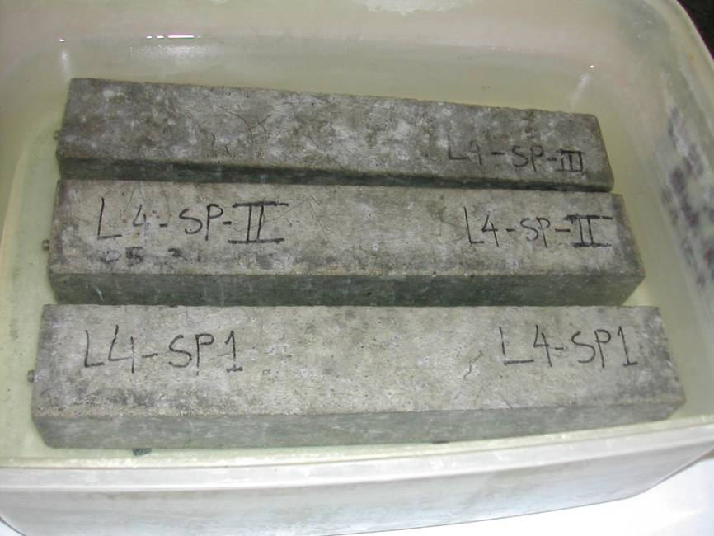
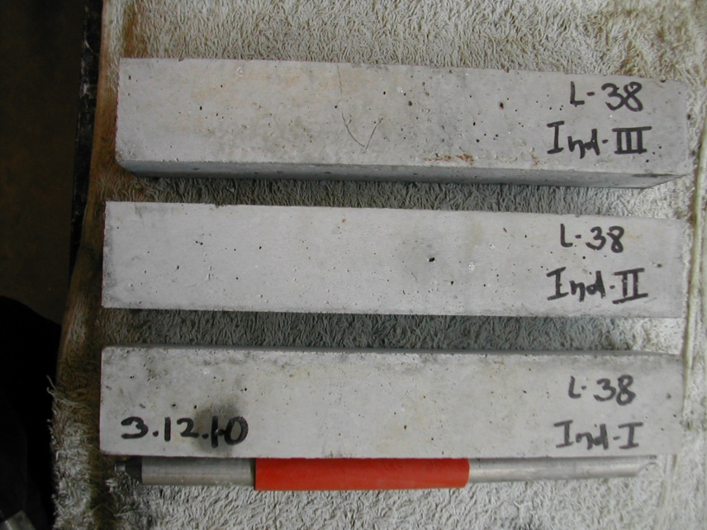
MCPT Samples

Slide 25
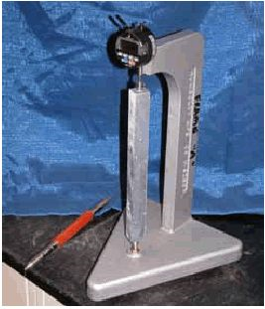
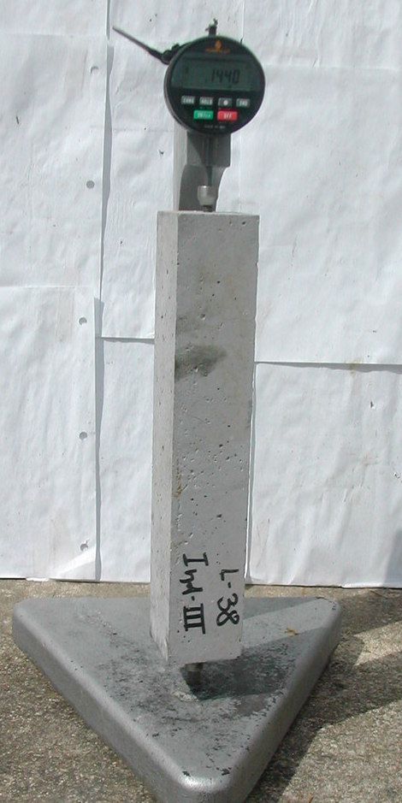
Reference bar and MCPT specimen reading in the comparator

Slide 26
Flow Chart of MCPT
Cure at moist room, 20 ± 1°C and RH >90% | Water Curing in oven at 60 ± 2 °C | Zero Day reading, then transfer to 1 N NaOH solution Take readings at specified days from zero day
24 ± 2 hrs | 24 hrs | 1 day | 2 day | 3 day
24± 2 hours
Demold
0 Day
48 hours
Casting
3 Day
3 days
26

Slide 27
Flow Chart of MCPT (continued)
Immersed 1 N NaOH solution
Take readings at 3, 7, 10, 14, 21, 28, 42, 56, 70, 84 days from zero day
0 Day
3 Day
7 Day
10 Day
14 Day
21 Day
28 Day
42 Day
42 Days
56 Day
56 Days
70 Day
70 Days
84 Day
84 Days
27

Slide 28
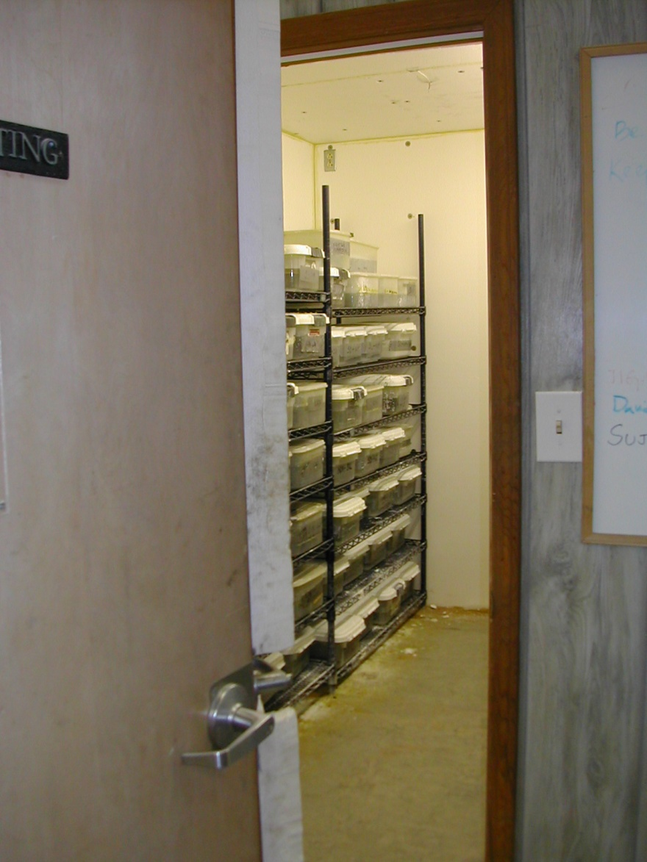
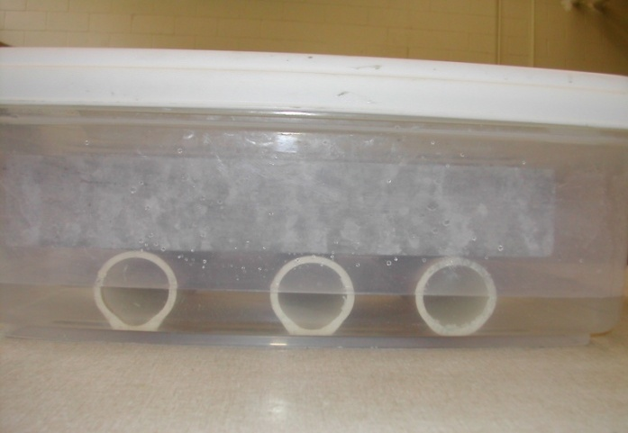
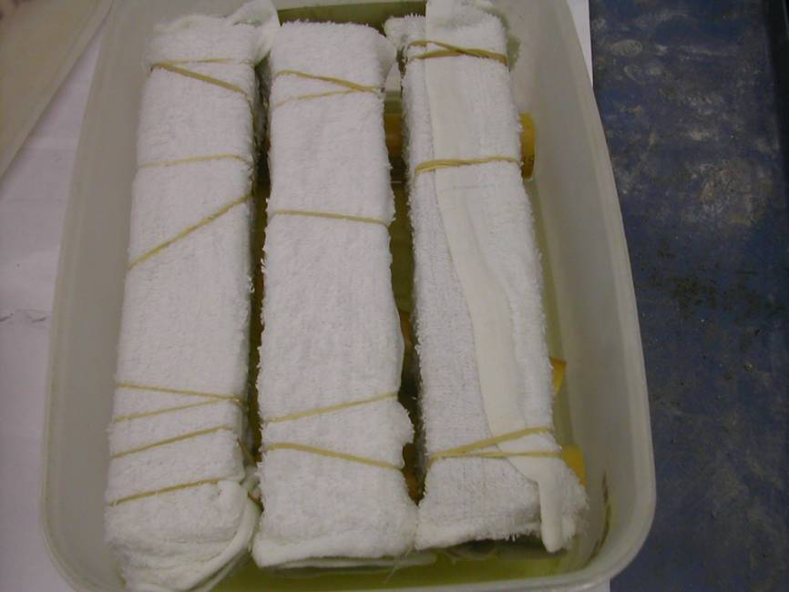
Effect of Storage Condition
1N NaOH Soak Solution
100% RH, Free standing
60 deg. C Storage Room
100% RH, Towel Wrapped
28

Slide 29
Effect of Storage Condition on Expansion in MCPT

Slide 30
Soak Solution Alkalinity (0.5N, 1.0N, and 1.5N NaOH solutions)
1.5 N

Slide 31
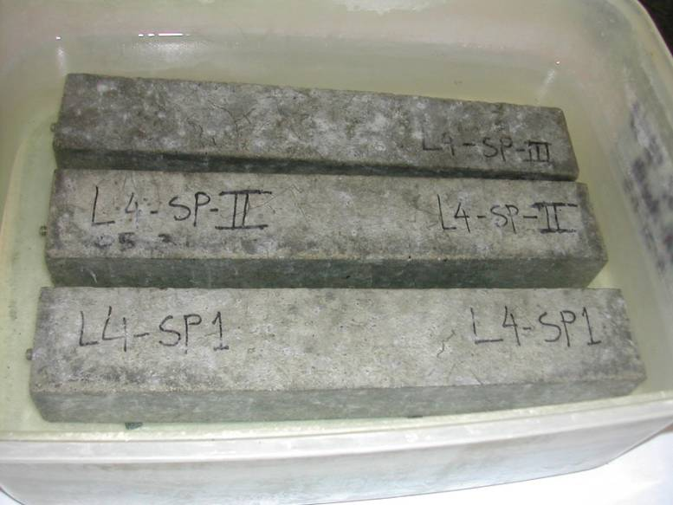
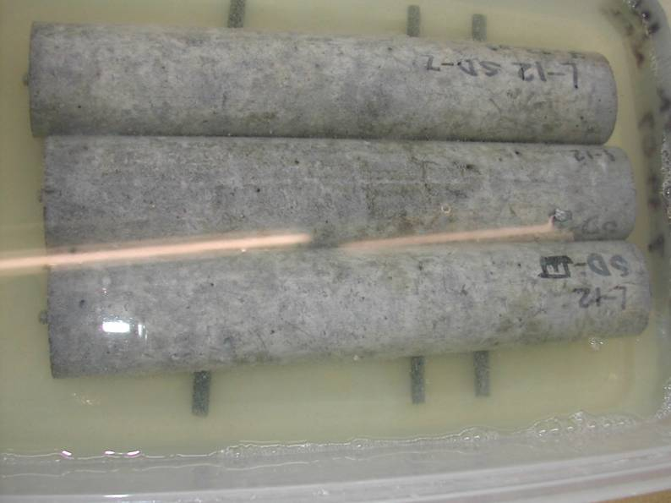
Prisms vs. Cylinders
31

Slide 32
Effect of Sample Shape on Expansion in MCPT Spratt Limestone

Slide 33
Effect of Temperature on Expansion in MCPT Spratt Limestone

Slide 34
MCPT Method Parameters
Mixture Proportions and Specimen Dimensions
Specimen size = 2 in. x 2 in. x 11.25 in.
Max. Size of Aggregate = ½ in. (12.5 mm)
Volume Fraction of = 0.65
Dry Rodded Coarse Aggregate
in Unit Volume of Concrete
Coarse Aggregate Grading Requirement:
Sieve Size, mm |  | Mass, %
Passing | Retained
12.5 | 9.5 | 57.5
9.5 | 4.75 | 42.5
34

Slide 35
MCPT Method (continued)
Test Procedure
Cement Content (same as C1293) = 420 kg/m³
Cement Alkali Content = 0.9% ± 0.1% Na₂O_{eq.}
Alkali Boost, (Total Alkali Content) = 1.25% Na₂O_{eq.} by mass of cement
Water-to-cement ratio = 0.45
Storage Environment = 1N NaOH Solution
Storage Temperature = 60⁰C
Initial Pass/Fail Criteria = Exp. limit of 0.04% at 56 days
35

Slide 36
MCPT Method (continued)
Use non-reactive fine aggregate, when evaluating coarse aggregate
Use non-reactive coarse aggregate, when evaluating fine aggregate

Slide 37
List of Aggregates Tested in MCPT Protocol
Sl. no. | Coarse Aggregate | Fine Aggregate
1 | Adairsville, GA | Cemex Sand, SC
2 | Big Bend, PA | Cullom, NE
3 | Blacksburg, SC | Foster Dixiana
4 | Dolomite, IL | Galena , IL
5 | Griffin, GA | Gateway S&G, IL
6 | Kayce, SC | Georgetown, PA
7 | Liberty, SC | Grand Island, NE
8 | Minneapolis, MN | Indianola, NE
9 | New Jersey(CA), NJ | Jobe ,TX
10 | New Mexico | Scotts Bluff, NE
11 | North Carolina | Stocker Sand, OH
12 | Oxford Quarry, MA | Ogallala, NE
13 | Quality Princeton , PA | Columbus, NE
14 | Red Oak, GA | NJ Sand
15 | Salt Lake City (CA), UT
16 | South Dakota
17 | Spratt, CANADA
18 | Swampscott, MA
19 | Taunton, MA
37

Slide 38
MCPT 56-expansions for coarse aggregates

Slide 39
MCPT 56-expansions for fine aggregates

Slide 40
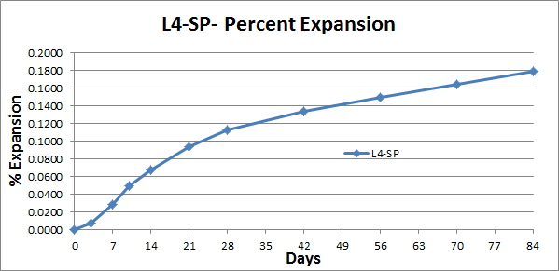
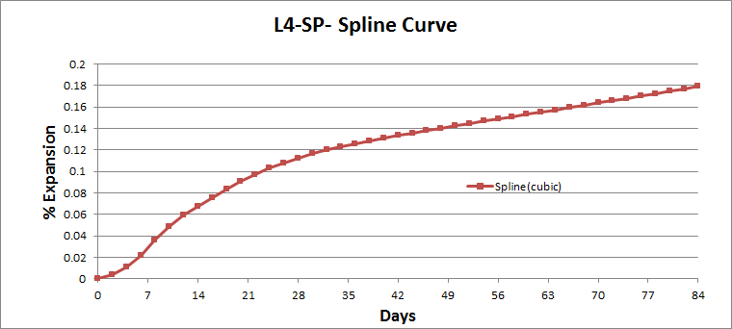
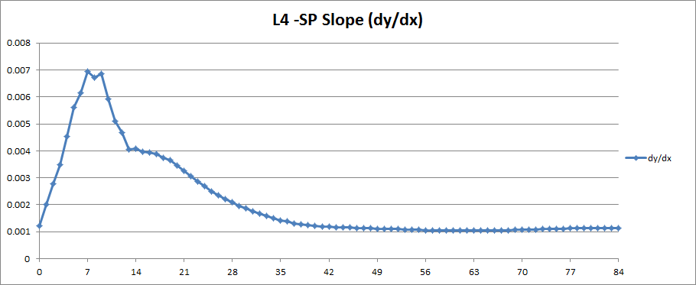
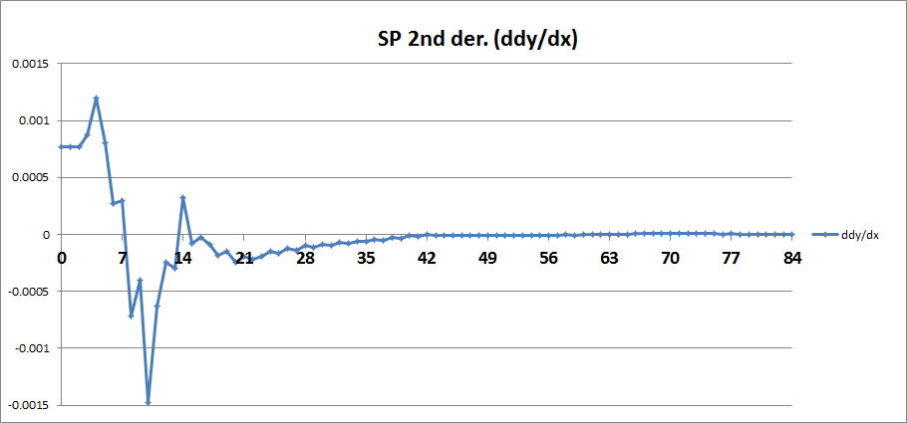
MCPT Curves Rate of Expansion becomes Steady after 42 Days for Spratt
Days
Days
40

Slide 41
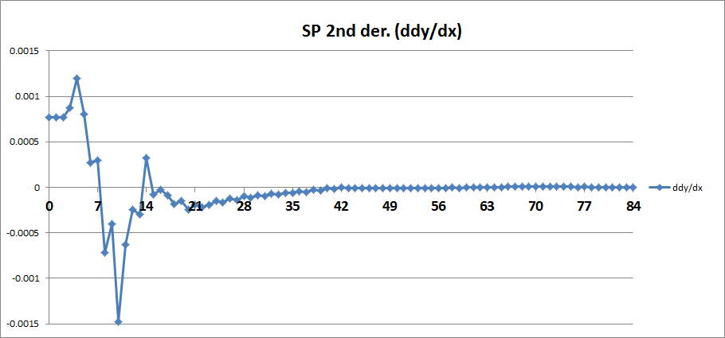
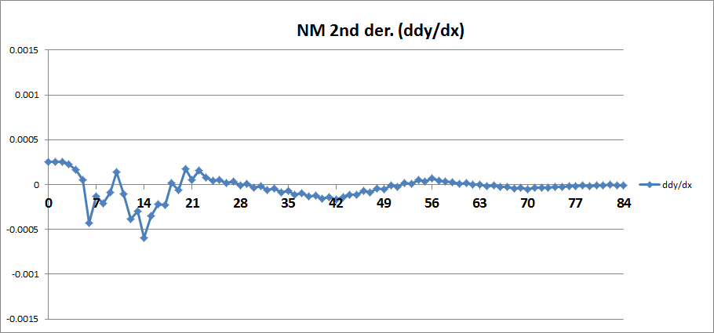
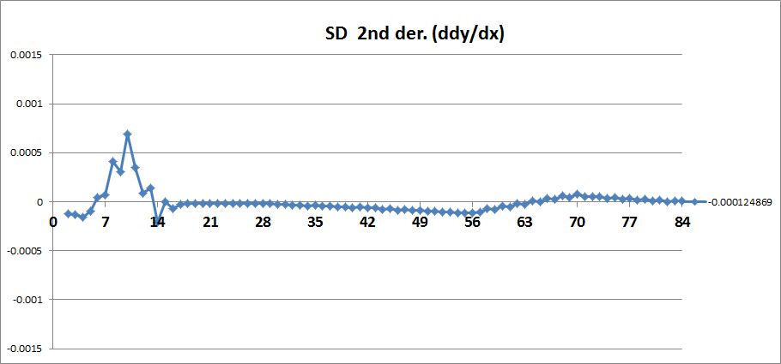
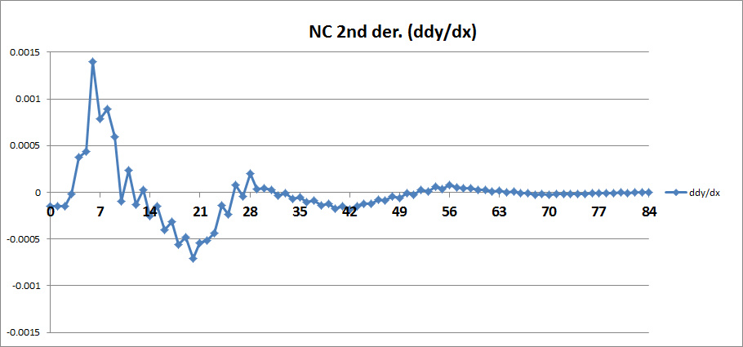
SP, NM, SD, NC- 2nd Derivative Curves
Days
Days
Days
Days

Slide 42
Expansion Data of Test Specimens Containing Selected Aggregates in Different Test Methods (Note: red:- reactive, green:- non-reactive)
Aggregate Identity | % Expansion |  |  | Average % Rate of Expansion in MCPT (8-12 wks)
 | MCPT, 56 Days | ASTM C 1293, 365 days | ASTM C 1260, 14 days
L4-SP | 0.149 | 0.181 | 0.350 | 0.0152
L11-SD | 0.099 | 0.109 | 0.220 | 0.0043
L15-NM | 0.185 | 0.251 | 0.900 | 0.0231
L19-NC | 0.149 | 0.192 | 0.530 | 0.0092
L23-BB | 0.017 | 0.032 | 0.042 | 0.0047
L54-Galena-IL | 0.046 | 0.050 | 0.235 | 0.0122
L32-QP | 0.070 | 0.070 | 0.080* | 0.0193
L34-SLC | 0.039 | 0.030 | 0.190** | 0.0102
L59-MSP | 0.023 | 0.030 | 0.100** | 0.0070
L56-TX | 0.440 | 0.590 | 0.640 | 0.0250
L35-GI | 0.091 | 0.090 | 0.260 | 0.0288
L36-SB | 0.115 | 0.150 | 0.460 | 0.0320

Slide 43
Choosing Age Limit for MCPT Comparison of MCPT-56 day with CPT-365-day
MCPT
0.04% limit at 56 days
CPT
0.04% limit at 365 days

Slide 44
Proposed Criteria for Characterizing Aggregate Reactivity in MCPT Protocol
Degree of Reactivity | % Expansion at 56 Days (8 Weeks) | Average Rate of Expansion from 8 to 12 weeks
Non-reactive | ≤ 0.030 % | N/A*
Non-reactive | 0.031% - 0.040% | < 0.010% per two weeks
Low/Slow Reactive | 0.031% – 0.040% | > 0.010% per two weeks
Moderate Reactive | 0.041% – 0.120% | N/A*
High Reactive | > 0.121%-0.240% | N/A*
Very Highly Reactive | ≥ 0.241% | N/A*

Slide 45
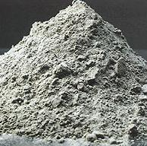
Evaluating SCMs in the MCPT
Three fly ashes used
Low-lime fly ash
intermediate-lime fly ash, and
high-lime fly ash
All were used at a dosage of 25% by mass replacement of cement
Later nine different fly ashes (3 high-lime -HL, 3 low-lime-LL and 3 intermediate-lime- IL fly ashes) at 25% cement replacement levels were investigated
45

Slide 46
Nine different fly ashes (3 high-lime, 3 low-lime and 3 intermediate-lime fly ashes) at 25% cement replacement levels
46

Slide 47
Lime Content vs. % Expansion at 56 Days at 25% replacement levels for nine fly ashes

Slide 48
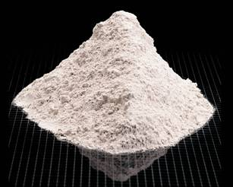
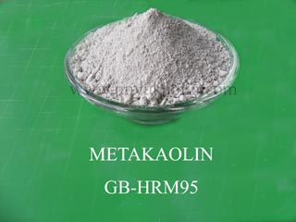
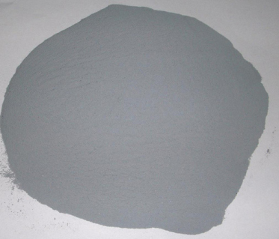
Effectiveness of Slag, Meta-kaolin, Silica fume and LiNO₃ in mitigating ASR
Spratt limestone as reactive aggregate
Mass replacement of cement
Slag was used at a dosage of 40%
Metakaolin was used at a dosage of 10%
Silica Fume was used at a dosage of 10%
Additionally LiNO₃ was used at a dosage of 100%

Slide 49
Effectiveness of Slag, Meta-kaolin, Silica fume and LiNO₃ in mitigating ASR in MCPT
49

Slide 50
Implementation of MCPT Method and AASHTO Code
Round Robin Testing of MCPT -conducted across six labs:
Nebraska DOT( Department of Transportation)
Delaware DOT
Turner-Fairbanks Highway Research Center, FHWA
Purdue University
Bowser Morner, Inc.
Clemson University
AASHTO adopted Miniature Concrete Prism Test as a provisional test standard AASHTO TP 111 in 2014.

Slide 51
Questions?
elatife@g.clemson.edu

