Slide 1
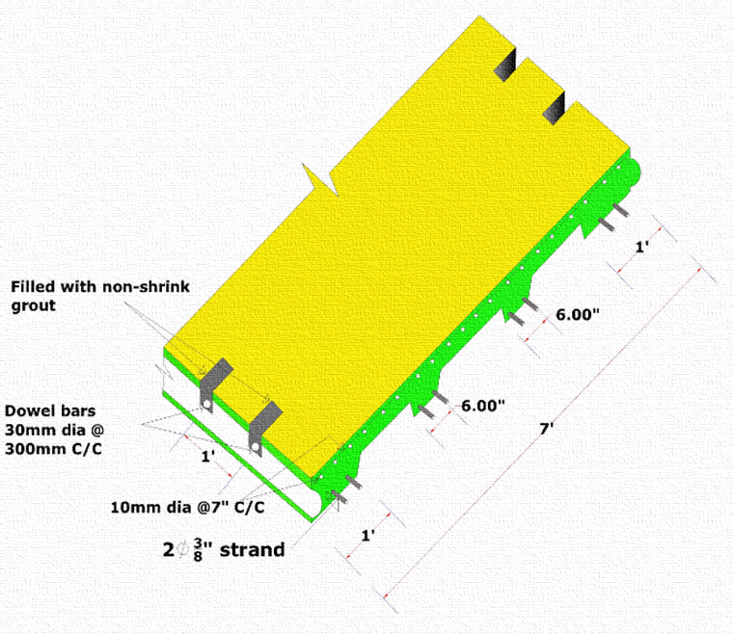
BD DECK 1:
A New Precast, Pre-stressed Bridge Deck System
Dr. E.R. Latifee
Avishek Chowdhury
Nusrat Jahan
Sama Ahmed
International Conference on Engineering Research, Innovation and Education (ICERIE 2017)
Shahjalal University of Science & Technology (SUST)
Sylhet, Bangladesh.
13th - 15th January, 2017.

Slide 2
Overview of Bridges in Bangladesh

Slide 3
Number of Structures (By Type) Road Transport & Highways Division Last Update : 2017-01-05
Box Culvert | 9441
Slab Culvert | 3991
RCC Girder Bridge | 2387
PC Girder Bridge | 405
RCC Bridge | 244
Arch Masonry | 318
Truss with RCC Slab | 30
Truss with Steel Deck | 204
Truss with Timber Deck | 6
Baily with Steel Deck | 973
Baily with Timber Deck | 23
Steel Beam & RCC Slab | 230
PC Box | 5
Source:http://www.rthd.gov.bd/bridge_maintenance.php

Slide 4
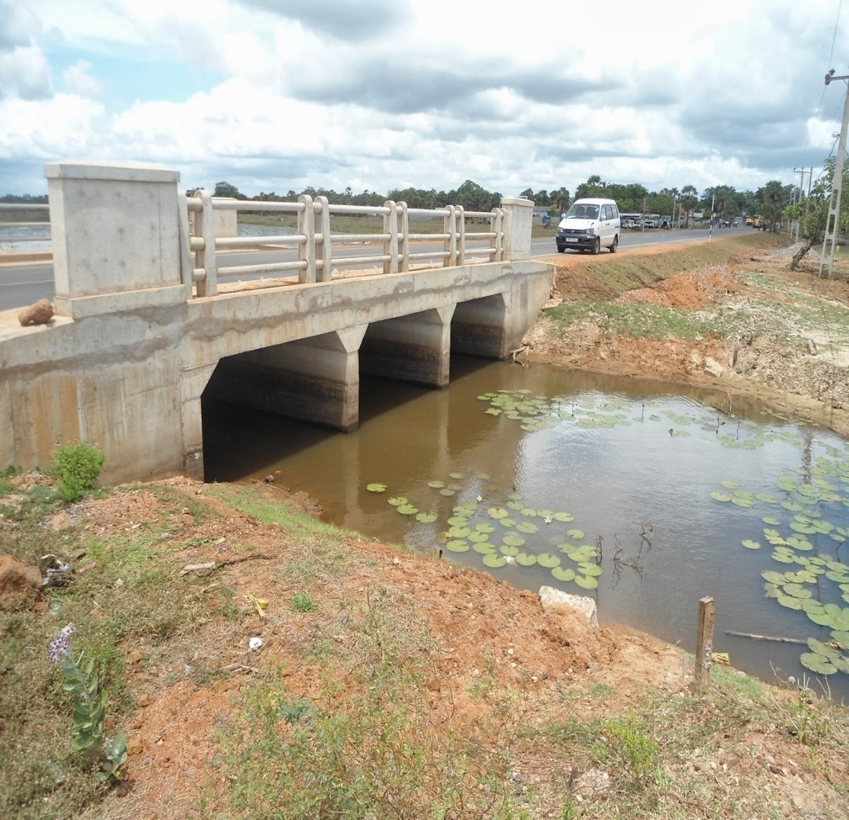
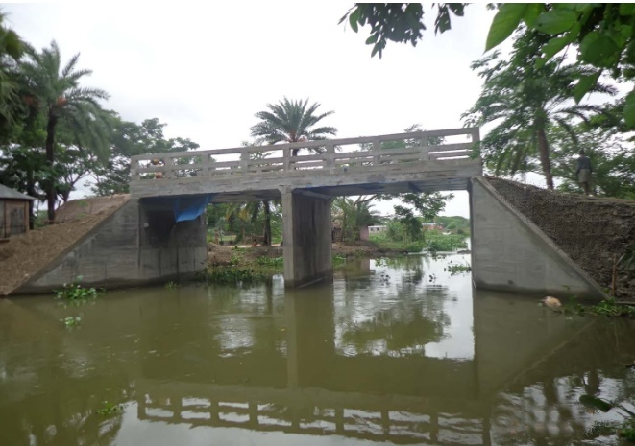
Fig: Box Culvert

Slide 5
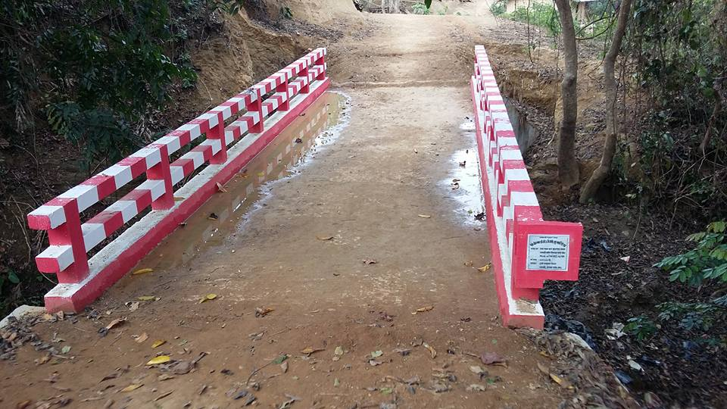
Fig: Slab Culvert

Slide 6
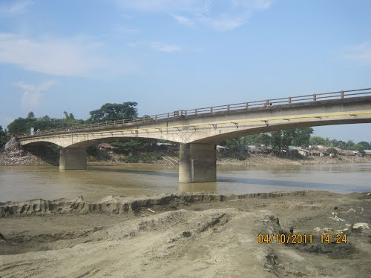
Fig: Reinforced Cement Concrete(RCC) Girder, Sangu Bridge, Bandarban.

Slide 7
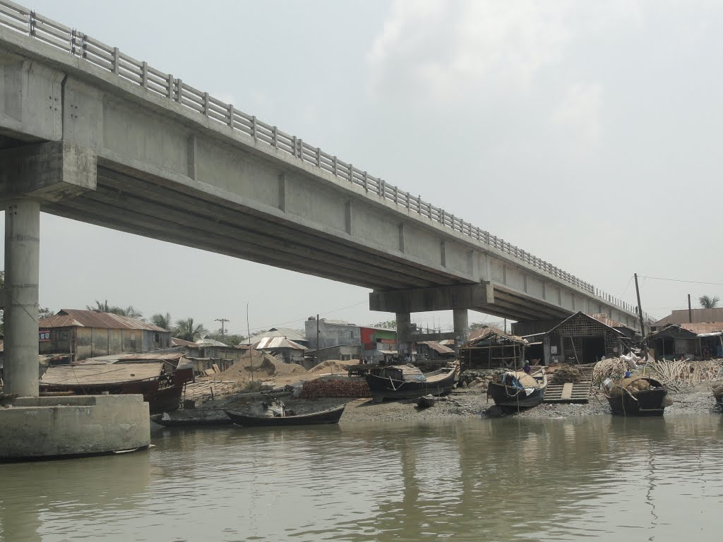
Fig: Pre-stressed Concrete (PC) Girder Bridge, Mohipur-Alipur, Patuakhali.

Slide 8
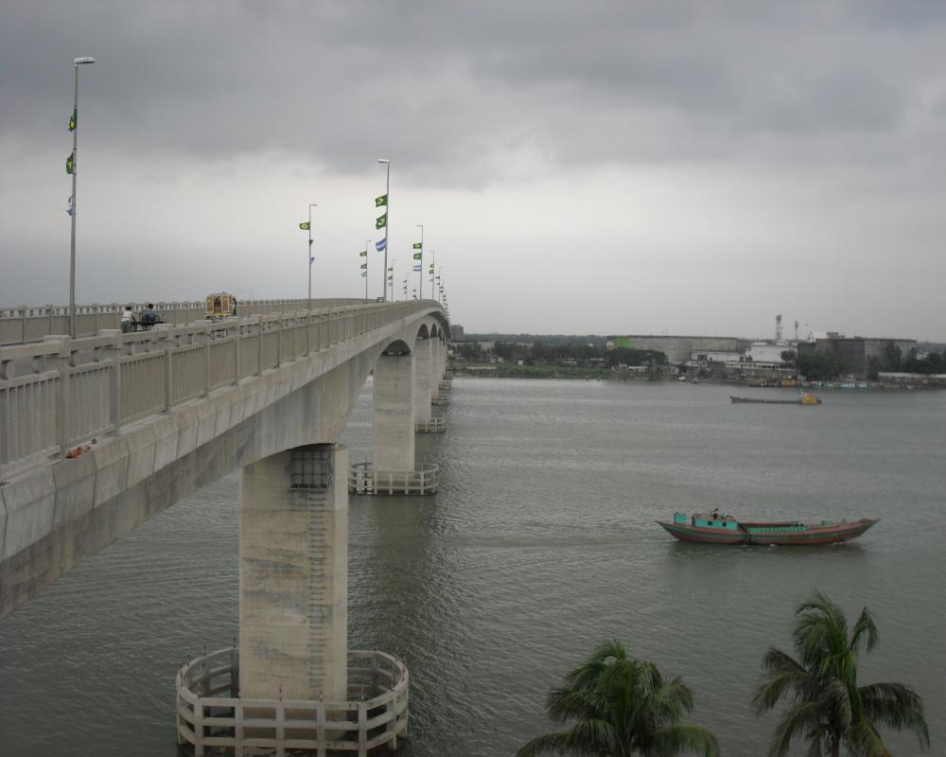
Fig: Reinforced Cement Concrete(RCC) Bridge, Dhaleswari River Bridge, Munshiganj.

Slide 9
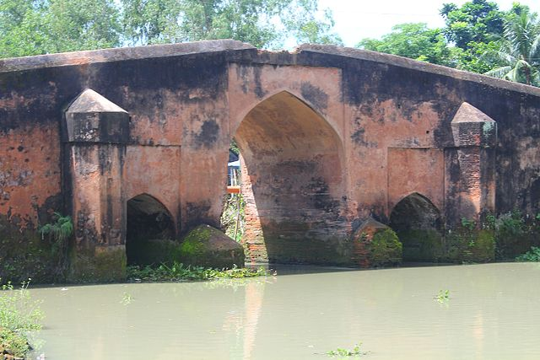
Fig: Arch Masonry, Mir Kadim Bridge (17th century), Munshiganj.

Slide 10
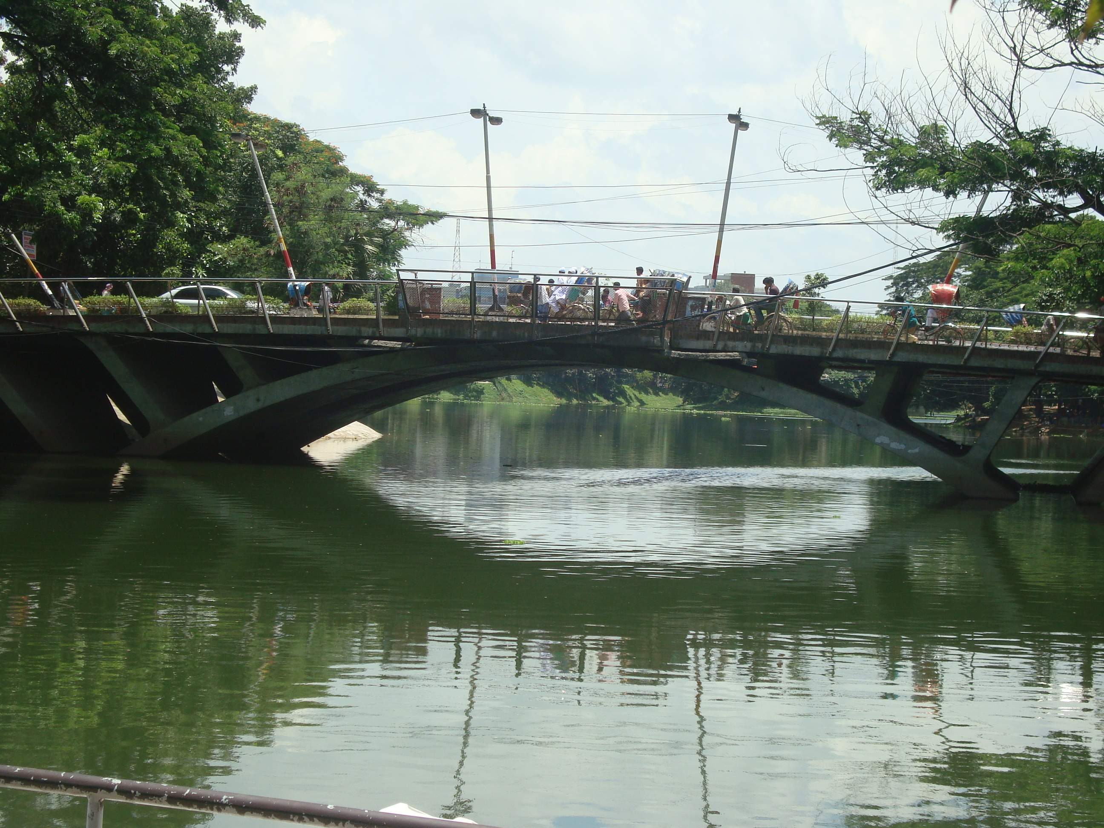
Fig: Arch Bridge over Dhanmondi Lake.

Slide 11
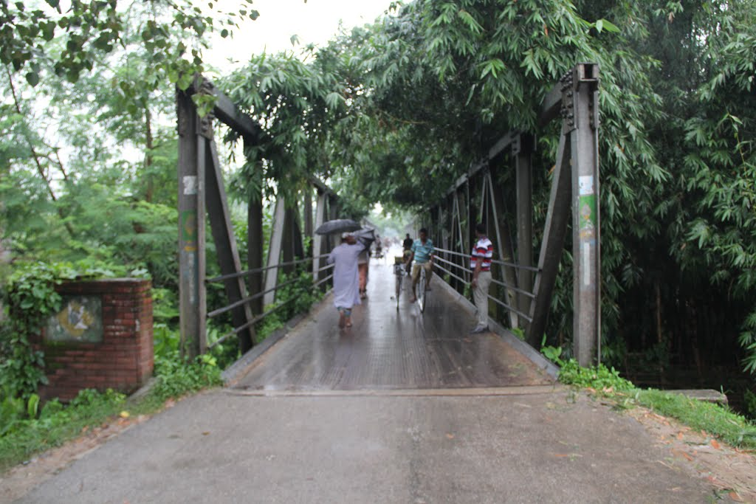
Fig: Truss with Steel Deck, Boalia Bazar, Nalchiti, Barisal.

Slide 12
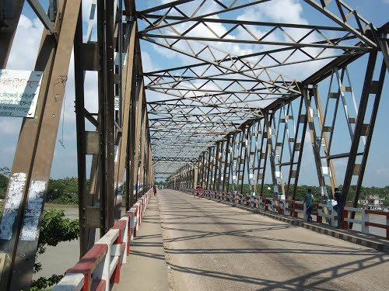
Fig: Truss with Reinforced Cement Concrete (RCC) Slab, Sherpur.

Slide 13
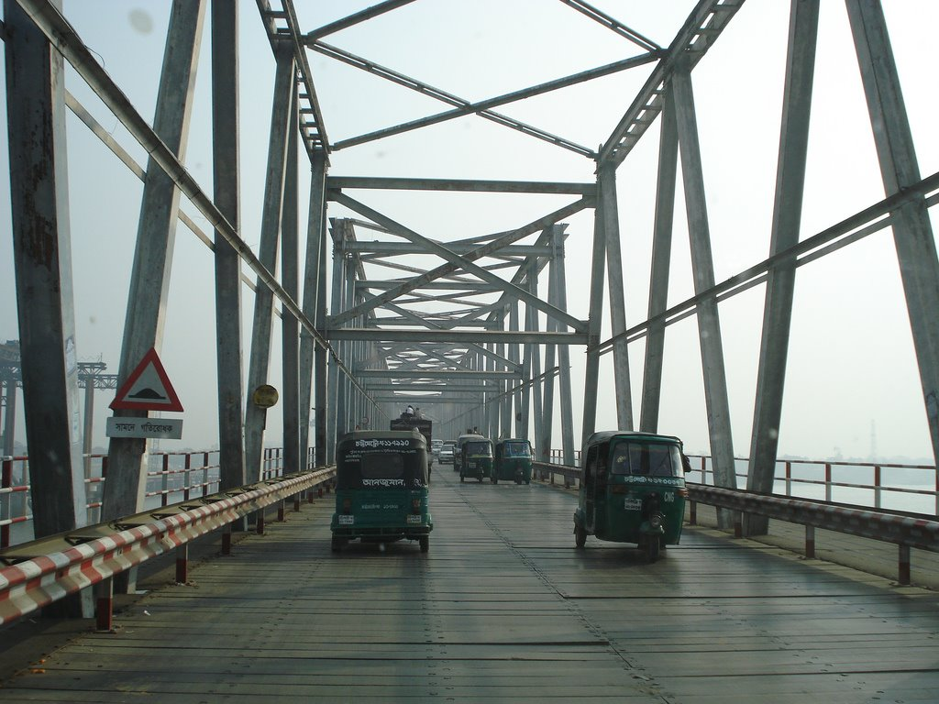
Fig: Truss with Timber deck, Shah Amanat Bridge, Chittagong.

Slide 14
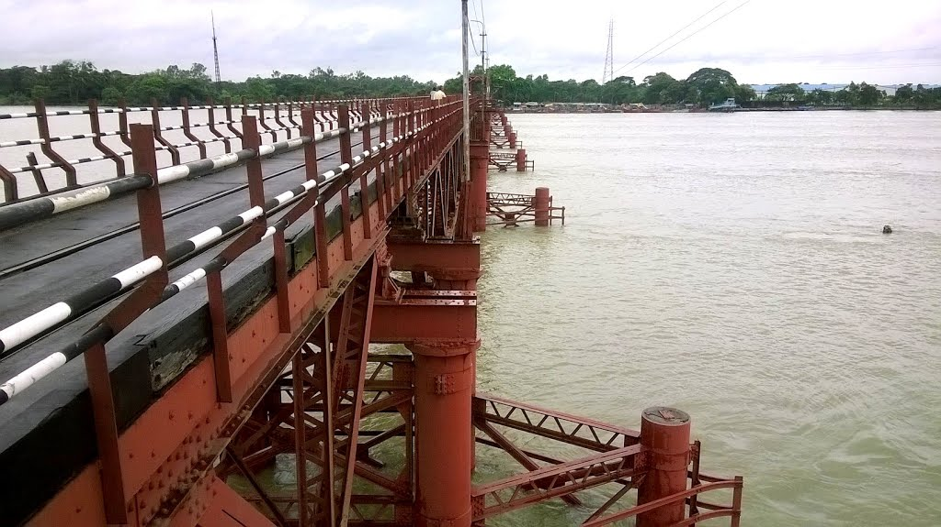
Fig: Baily Bridge with Steel Deck, Kalurghat Bridge, Chittagong.

Slide 15
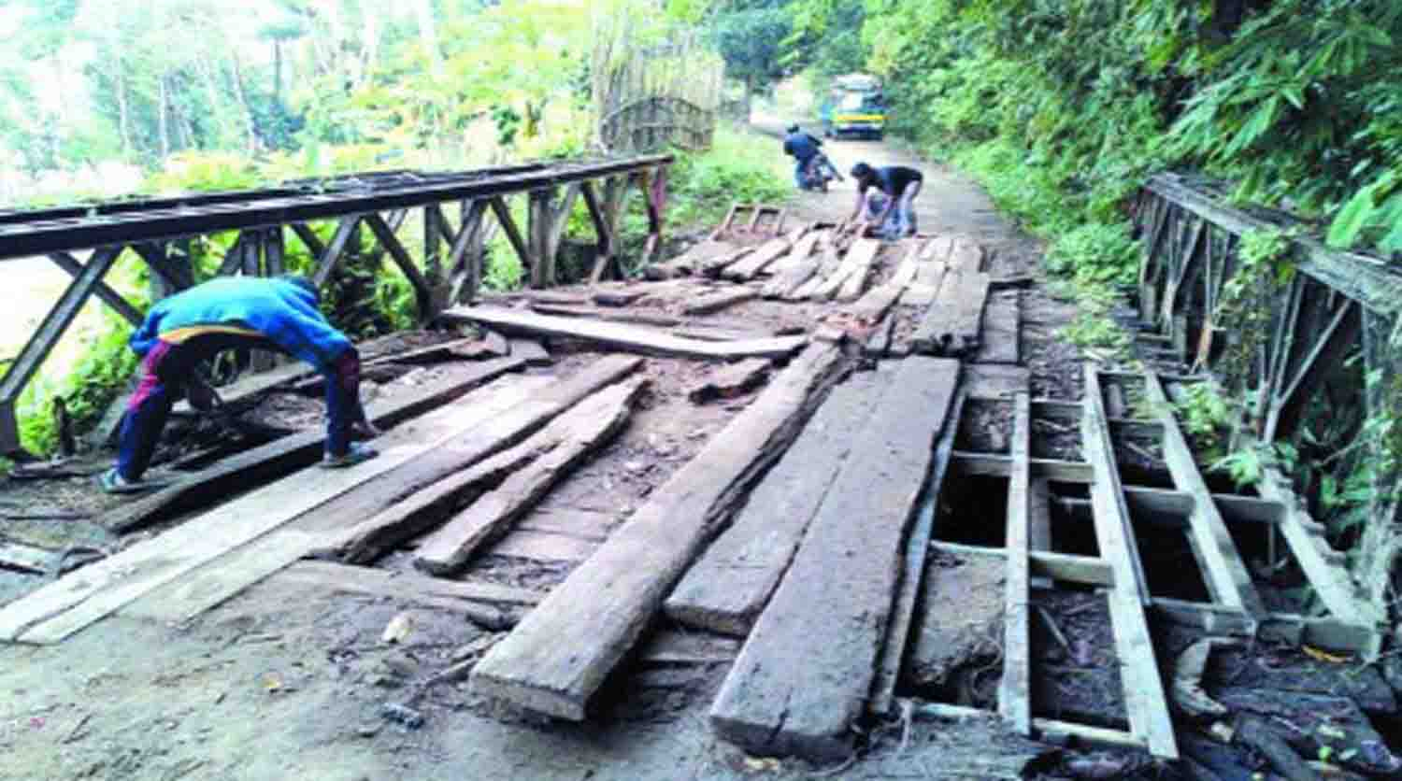
Fig: Baily Bridge with Timber Deck, Koikhongjhiri, Bandarban.

Slide 16
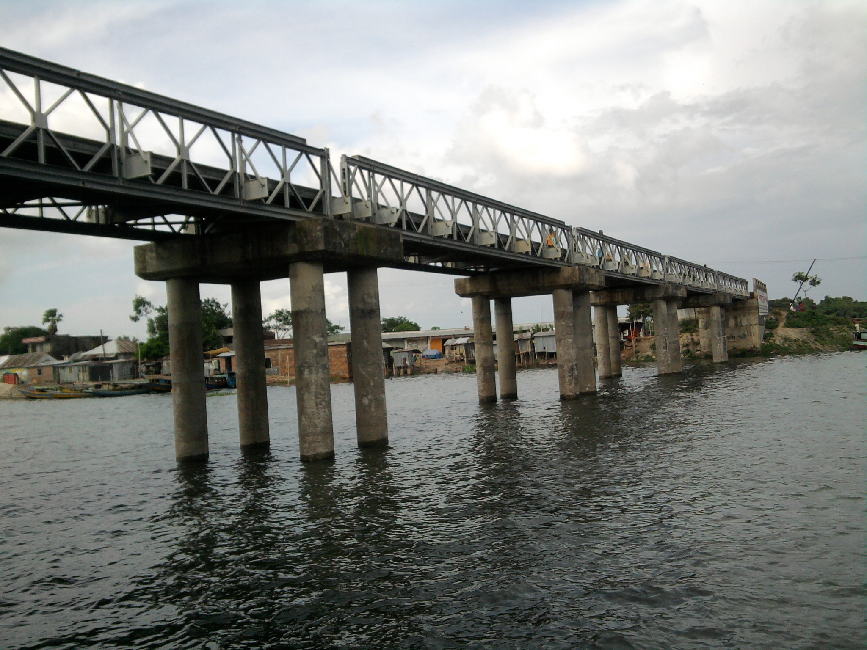
Fig: Steel Beam and Reinforced Cement Concrete (RCC) Slab, Isapur Bridge, Purbachal.

Slide 17
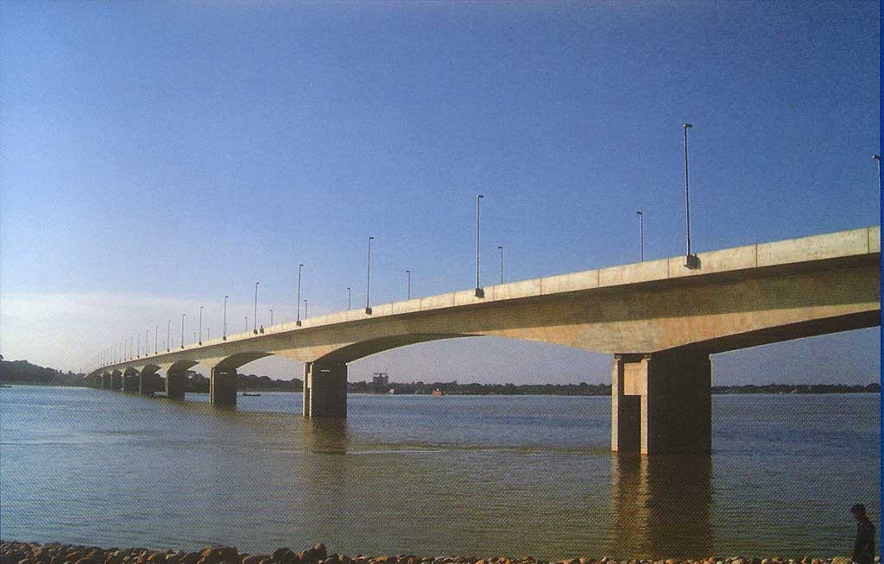
Fig: Pre-stressed Concrete (PC) Box Girder, Bhairab Bridge.

Slide 18
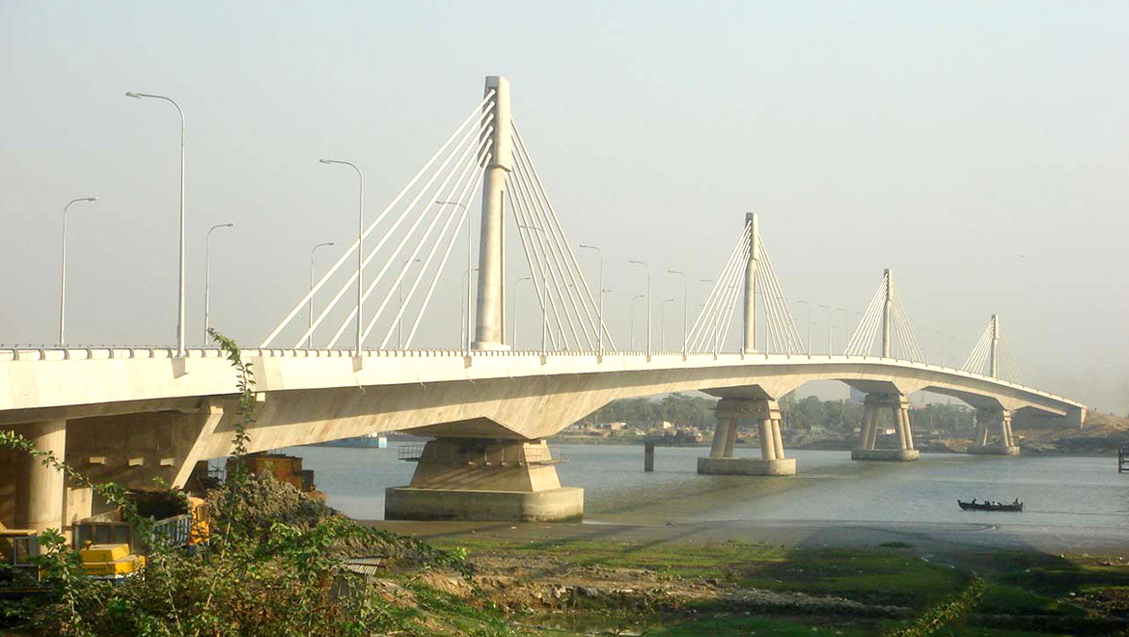
Fig: Cable Stayed Bridge, Shah Amanat , Chittagong (2006-2010).

Slide 19
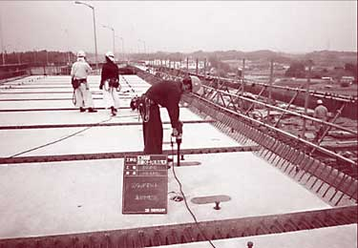
Early History of PCP
In the early 1950s the Illinois Department of Transportation (DOT) developed precast pre-stressed concrete panels (PCP) to act as stay-in-place (SIP) deck forms, topped over by cast-in-place (CIP) concrete.
The first such full-scale prototype bridge was load tested in Illinois in 1956 and was the Beverly Road Bridge located at the intersection of Northern Illinois Toll Highway and Beverly Road in Cook County.

Slide 20
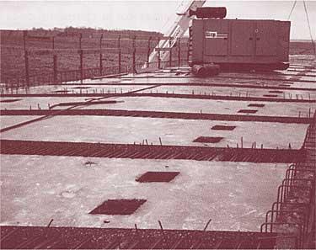
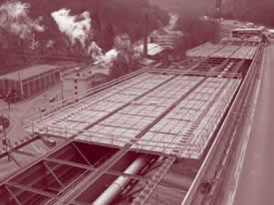
Precast, pre-stressed deck panels have also been used as full depth deck replacements. An early example of the use of PCP-FD is in the “Pintala Creek Bridge” in Alabama in the 1960s.
Later this method was extended in 1990’s for Maryland’s rural highways.

Slide 21
Proposed BD DECK 1
Proposed design consists of full-depth precast, pre-stressed concrete panels.
The panel depth is 8 inches with ribs- where the upper depth of 4.5 inches is the continuous solid and the lower depth of 3.5 inches is the rib depth.
The ribs are 2 feet C/C and they span from girder to girder. In the proposed design, the panel width is 7 feet.
Higher strength concrete of and higher strength steel of 270,000psi (1862MPa) are considered 6000psi (42MPa) red for pre-tensioning.
The pre-stressing strands are of 3/8 inches diameter.
The transverse dimension of the panels will depend on the girders’ C/C distance.
The shrinkage reinforcements are 10 mm bars provided at the top.
The strength of the distribution reinforcement is taken as 60,000 psi (414 Mpa)

Slide 22
Proposed BD DECK 1
Fig: Typical cross section of BD Deck 1

Slide 23
Proposed BD DECK 1
The crown can be achieved by the base support under the panels.
At the top, a 0.5 inch gap is provided between two panels, which is filled with bitumen filler. This will prevent concrete expansion and contraction cracking.
Fig : Contraction Joint with Dowel Bar

Slide 24
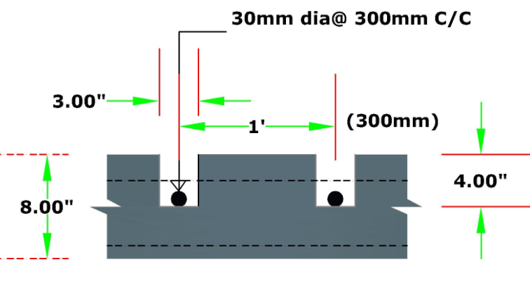
Proposed BD DECK 1
The deck panels will be joined by using dowel bars. These dowel bars will be placed within the shear pockets and then filled by non-shrink grout.
If needed, a bitumen overlay for a smoother surface, with approximately 3 inches at the crown and 1 inch near the curbs can be provided.
Fig : Section A-A

Slide 25
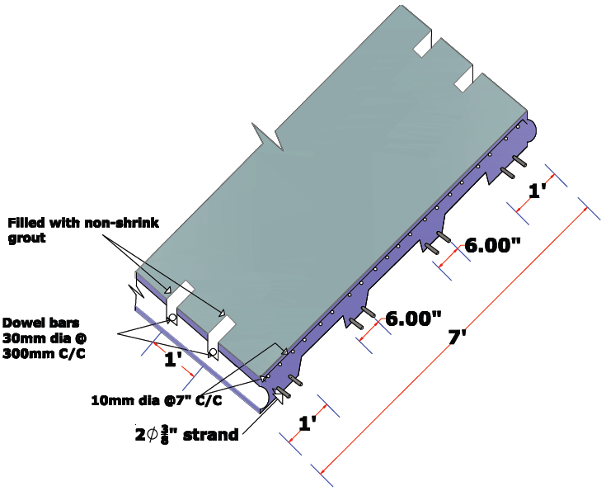
Figure : BD Deck 1

Slide 26
Lifting of the Deck Slab

Slide 27
Lifting of the Deck Slab

Slide 35
Filling with non shrink grout

Slide 50
What are the problems with the present situation in Bangladesh?

Slide 51
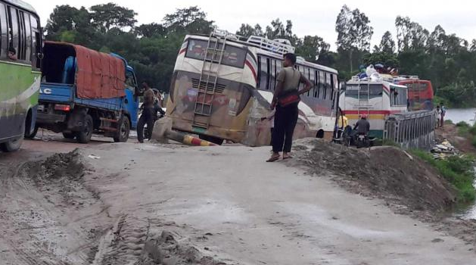
Risky journey on weak Bailey Bridge
Source: http://dev.thedailystar.net/country/risky-journey-weak-bailey-bridge-1253860

Slide 52
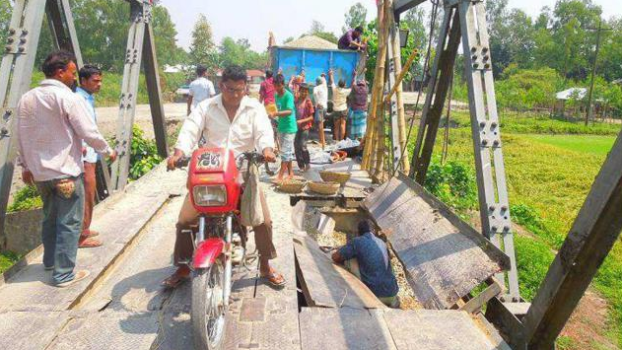
Weak Bailey Bridge put commuters at risk
Source : http://www.thedailystar.net/country/weak-bailey-bridges-put-commuters-risk-87892

Slide 53
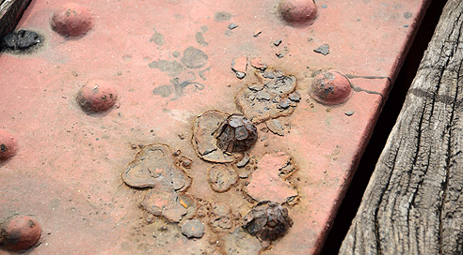
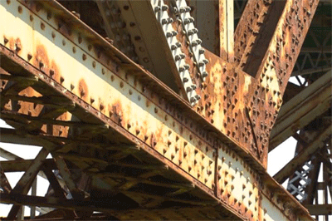
Corrosion in Steel Bridges

Slide 54
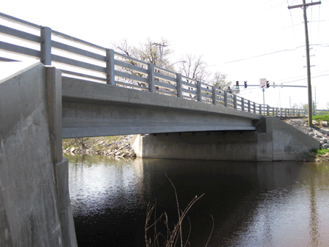
Advantages
of proposed BD DECK 1
Aesthetic
Greater flexure moment capacity
Saves construction time
Lightweight
Easily transportable
Reduces cost

Slide 55
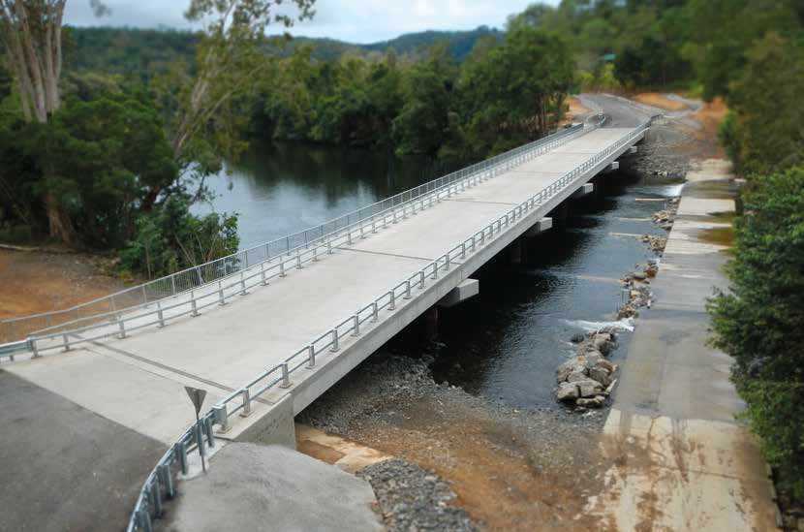
Aesthetically
Beautiful
Fig: Precast, Pre-stressed Concrete Bridge, Bloomfield, North Queensland, Australia.

Slide 56
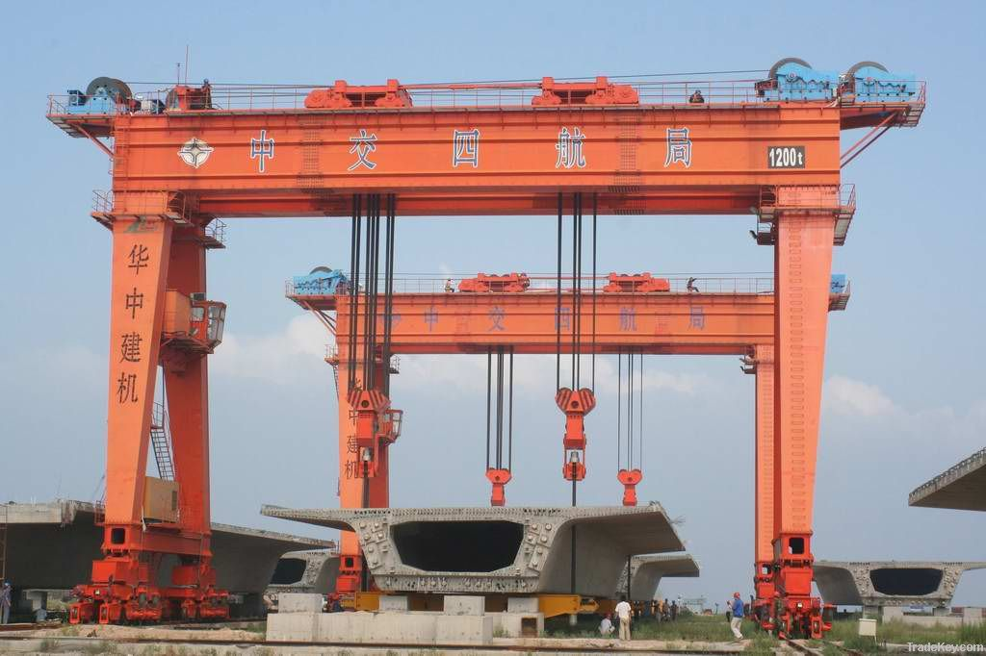
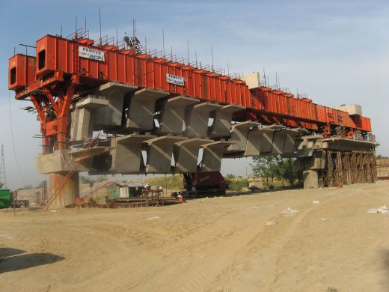

Slide 57
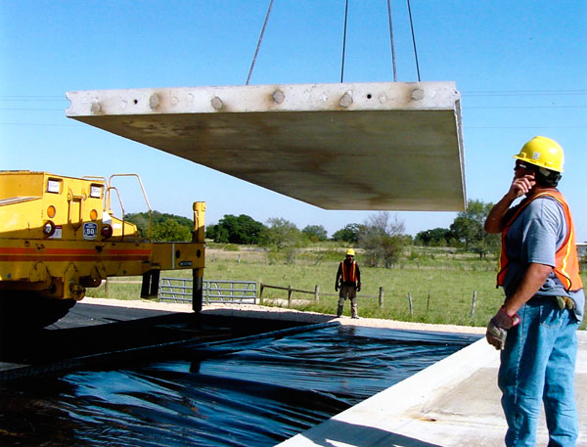
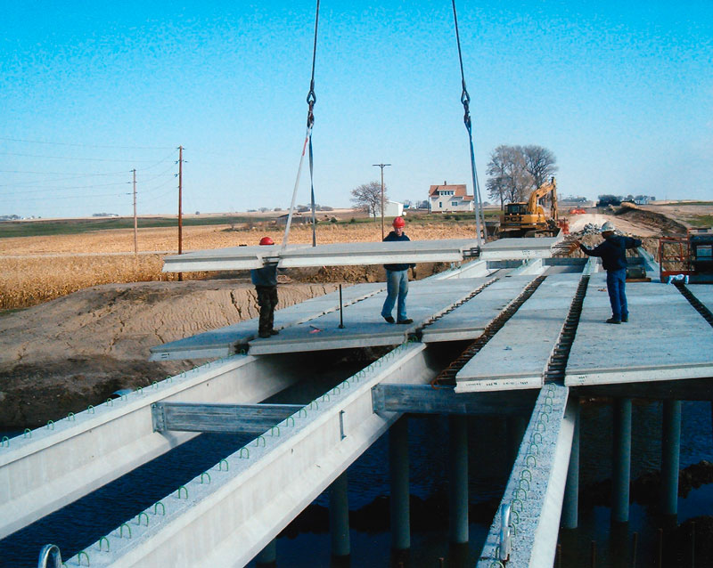
Due to light weight,
implementation
&
lifting
easier.

Slide 58
Transportation of the deck slabs is easy cost effective reduces time

Slide 59
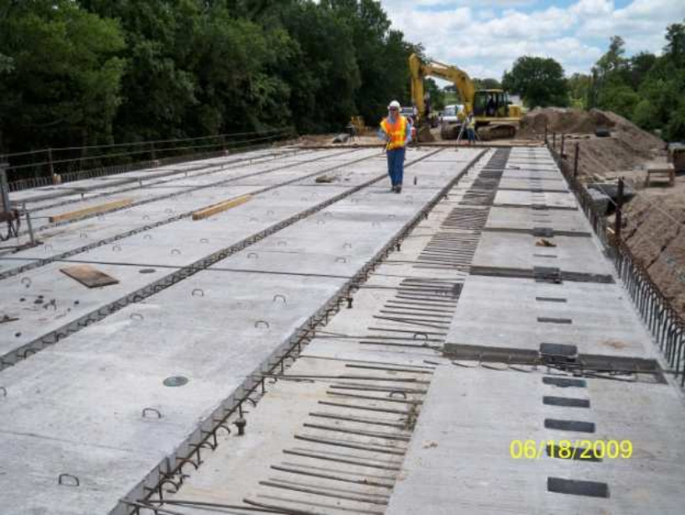
Saves
Construction Time

Slide 60
reduces
Cost
Life Cycle Cost =
Initial Construction Cost
+
Total Operating Costs
+
Maintenance

Slide 61
THANK YOU. Questions?
for further query Contact: drlatifee@gmail.com

