Slide 1
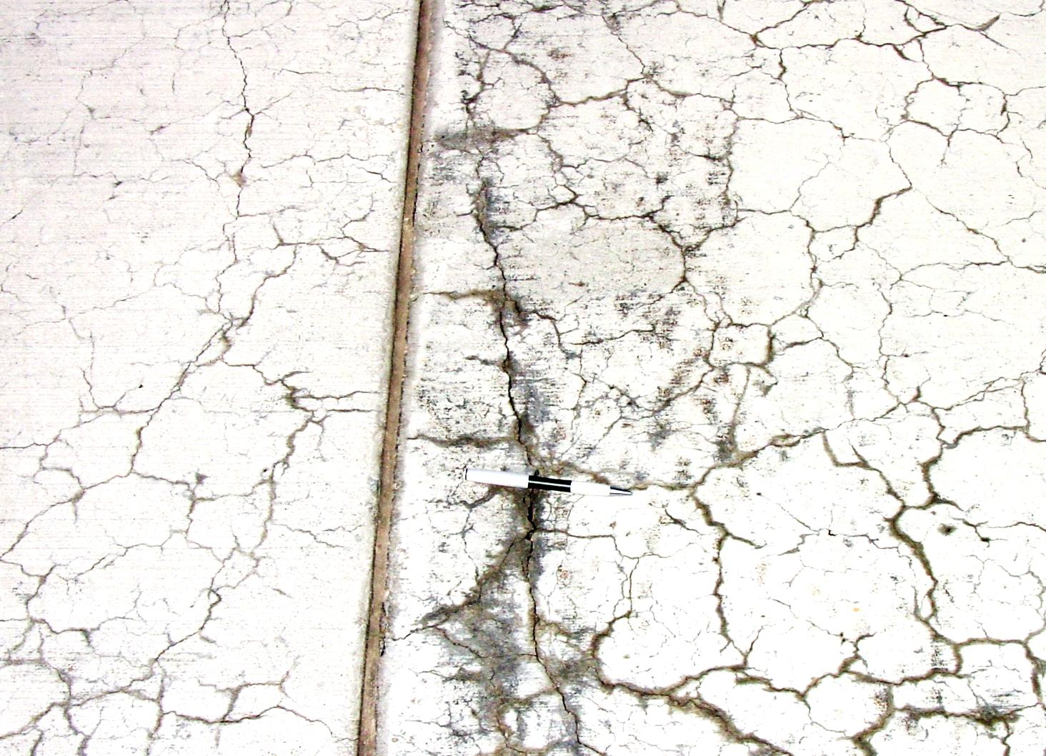
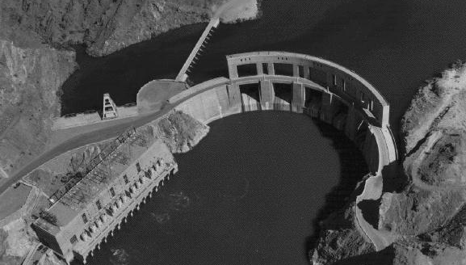
Investigation of ASR expansion due to total alkali and internal alkali (concentration) in the concrete
E. R. Latifee, PhD
10th Global Engineering, Science and Technology Conference
January 2, 2015, BIAM Foundation,
63 Eskaton, Dhaka, Bangladesh

Slide 2
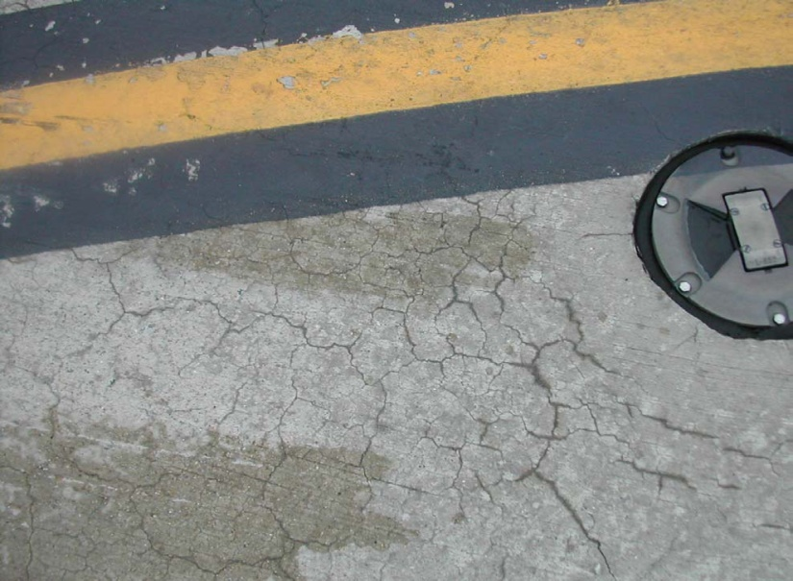
Acknowledgement
Dr. Prasad Rangaraju, Clemson University, U.S.A.
Dr. Paul Virmani, FHWA,U.S.A.

Slide 3
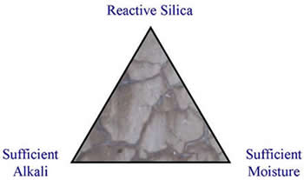
ASR - Alkali Silica Reaction
Alkalis
+
Reactive Silica
+
Moisture
ASR Gel which expands
Concrete expansion and
cracking
What is Alkali Silica Reaction?
Alkali-silica reaction (ASR) is a heterogeneous chemical reaction between alkali ions (Na+ and K+) and hydroxide ions (OH-) in the concrete pore solution, generally derived from the Portland cement, and forms of reactive silica (SiO₂) in the aggregate (eg: chert, quartzite, opal, strained quartz crystals).

Slide 4
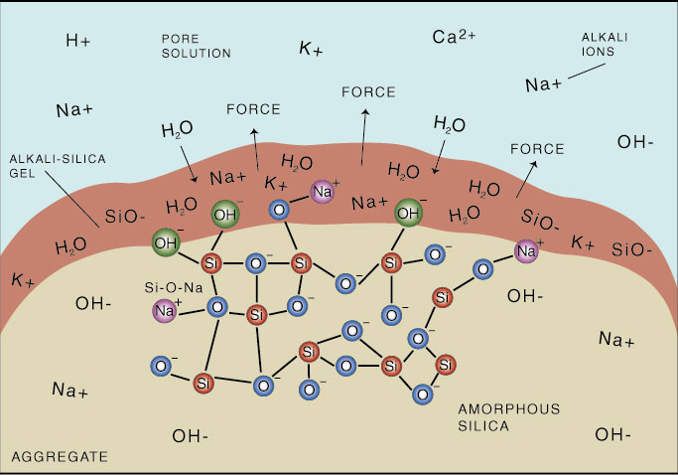
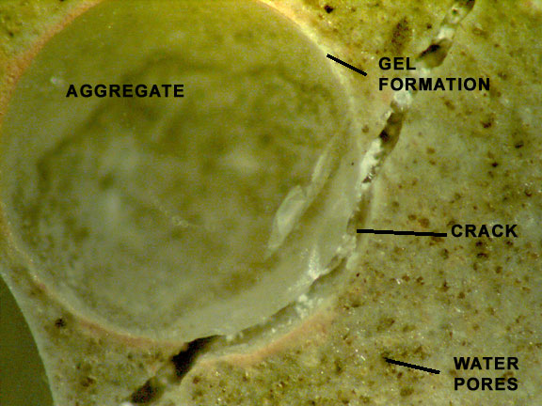
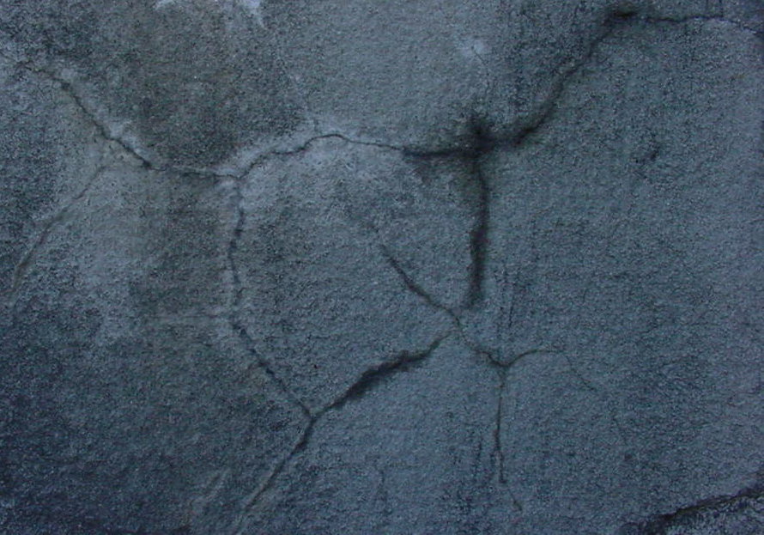
Creation of alkali-silica gel and cracking of concrete

Slide 5
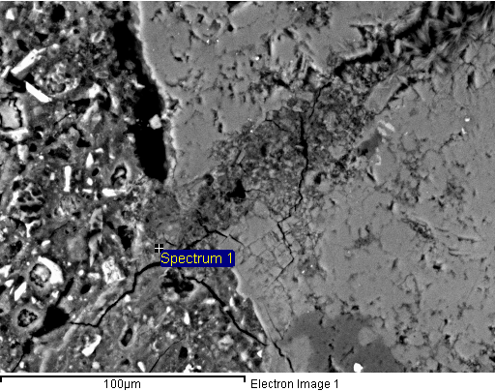
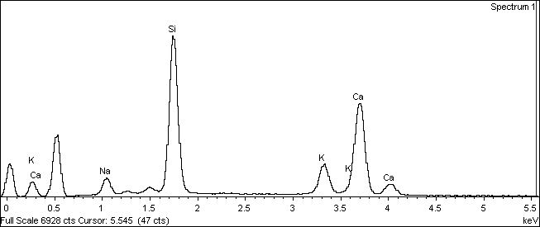
SEM and EDX Analysis of Spratt Specimen
scanning electron microscope Image
Energy-dispersive X-ray spectroscopy

Slide 6
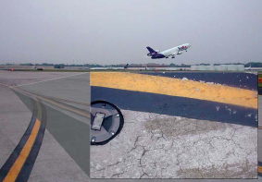
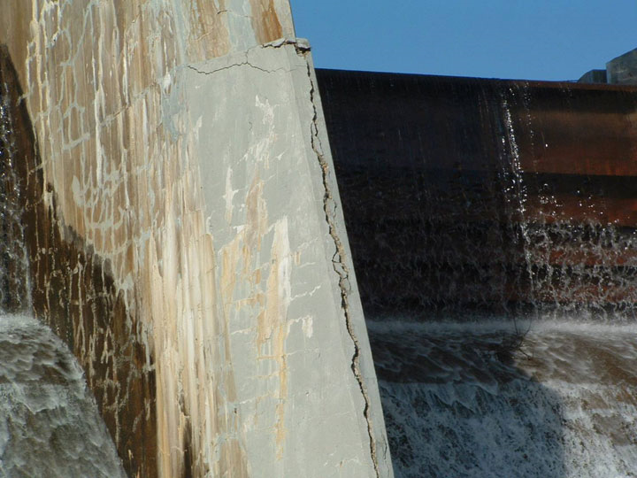
Alkali-Silica Reaction Distresses in the field
Notes:
Delete

Slide 7
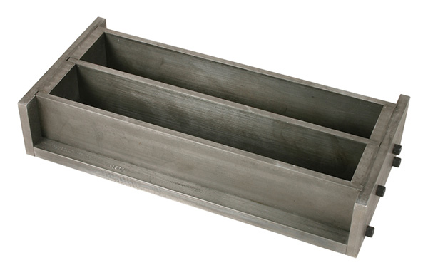
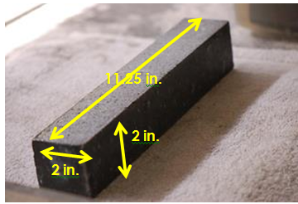
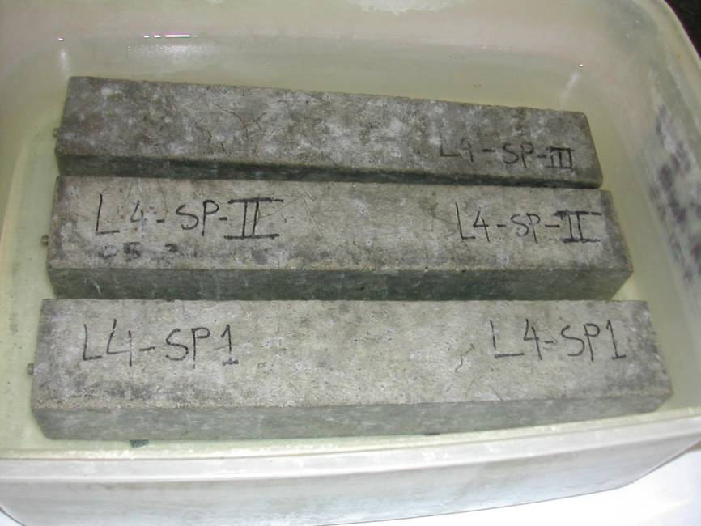
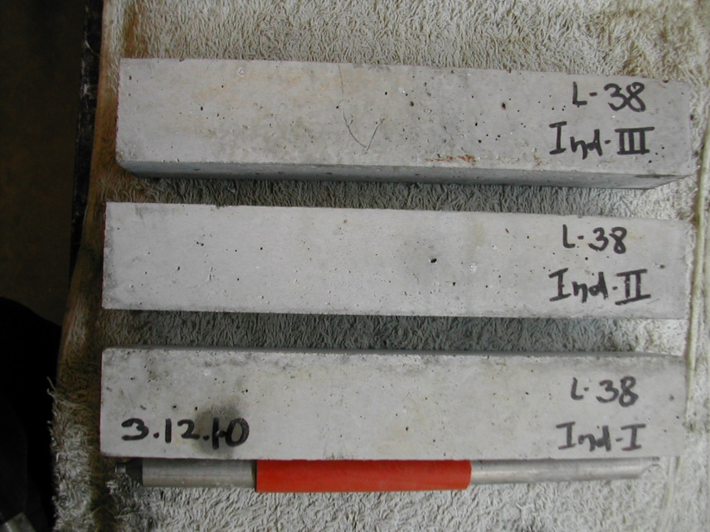
MCPT Samples

Slide 8
Materials

Slide 9
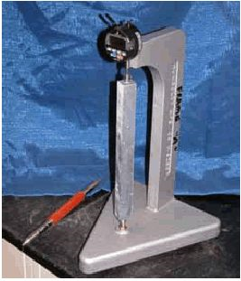
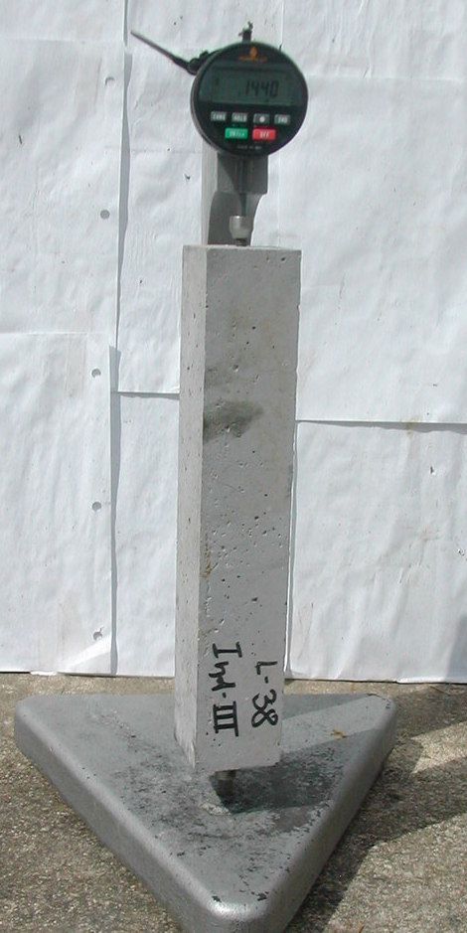
Reference bar and MCPT specimen reading in the comparator

Slide 10
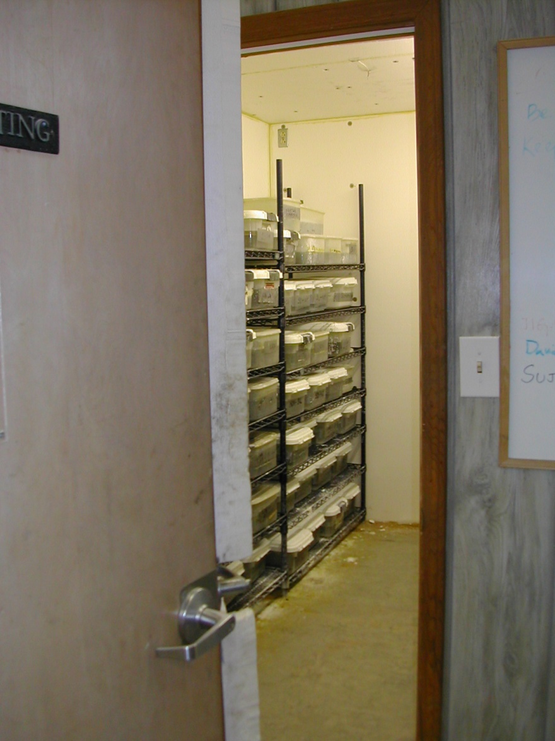
Storage Condition
60 deg. C Storage Room
1N NaOH Soak Solution
10

Slide 11
Different Alkali Cements and Soak-solutions- Internal/Pore solution
Cement alkali of 0.82% boosted to 1.25% Na₂O_{eq} and 1 N NaOHCement soak solution matching pore solution
Cement alkali of 0.82% Na₂Oeq and 0.7 N NaOH soak solution matching pore solution
Cement alkali of 0.49% Na₂O_{eq} and 0.45 N NaOH soak solution matching pore solution
The pore solution composition of the concrete mixtures was predicted based on the equation
[OH-] = 0.339 Na₂O_{eq}%/(w/c) + 0.022 +/- 0.06 mol/L
-Stark and Diamond (1993)

Slide 12
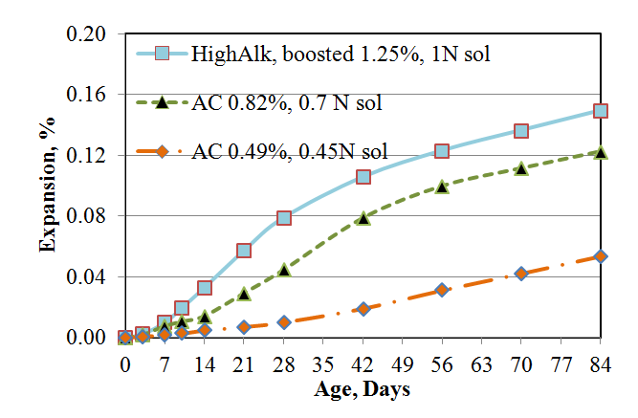
Expansion curves of different cement alkalinity and soak solution alkalinity concrete prisms in the MCPT

Slide 13
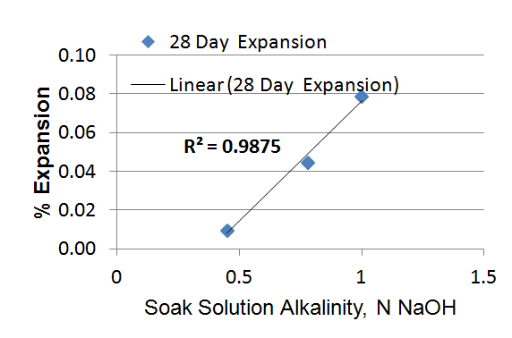
Figure: 28-day % expansion vs. Soak solution alkalinity
Figure: 56-day % expansion vs. Soak solution alkalinity

Slide 14
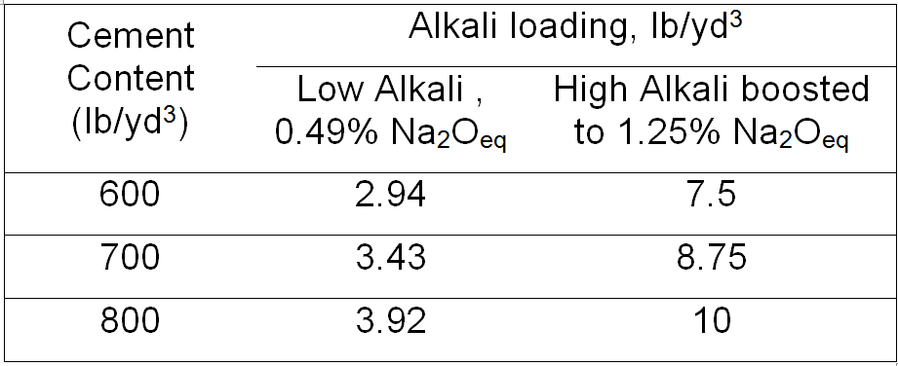
Alkali loading of different MCPT specimens
Alkali loading, kg/m³ (lb/yd³) = Cement content, kg/m³ (lb/yd³) x Cement Alkalinity (Na₂O_{eq} %).

Slide 15
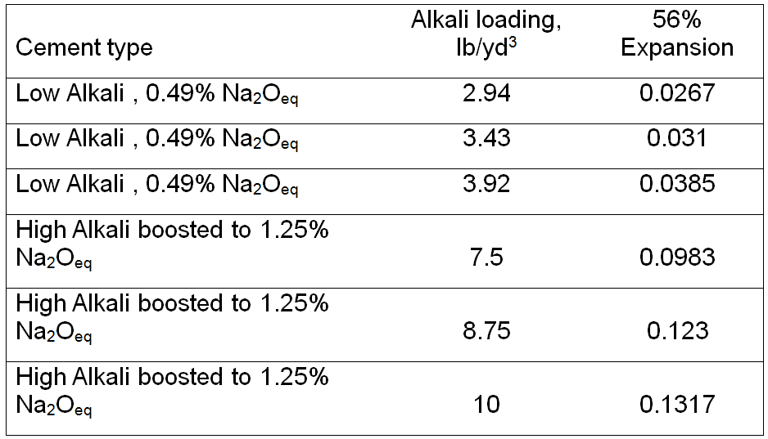
Alkali loading and corresponding 56-day expansions of MCPT specimens

Slide 16
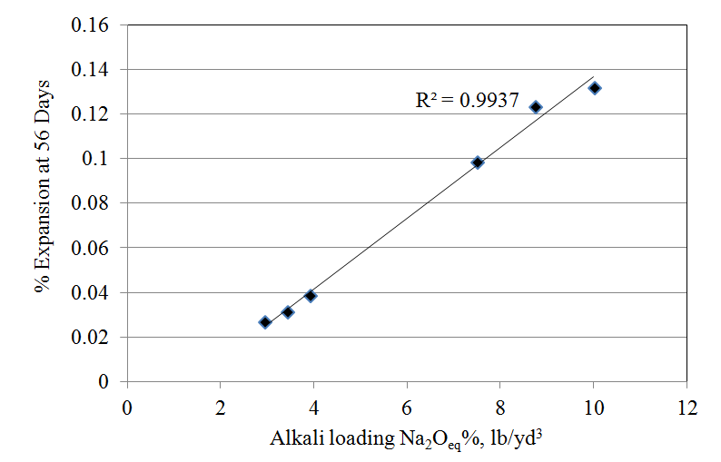
Comparison between alkali loading(lb/yd³) &
56-day % expansion

Slide 17
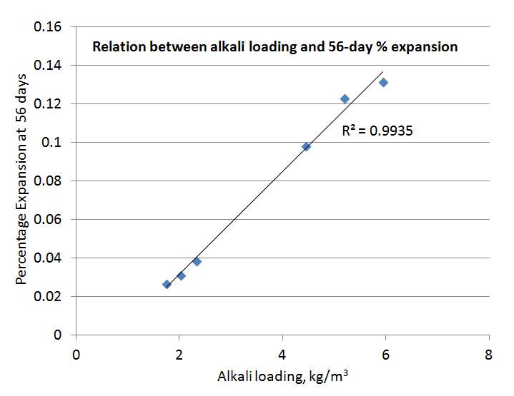
Comparison between alkali loading(kg/m³) &
56-day % expansion

Slide 18
Implementation of MCPT Method and AASHTO Code
Round Robin Testing of MCPT -conducted across six labs:
Nebraska DOT( Department of Transportation)
Delaware DOT
Turner-Fairbanks Highway Research Center, FHWA
Purdue University
Bowser Morner, Inc.
Clemson University
AASHTO adopted Miniature Concrete Prism Test as a provisional test standard AASHTO TP 111 in 2014.
Questions?
ERLATIFEE@GMAIL.COM

