Slide 1
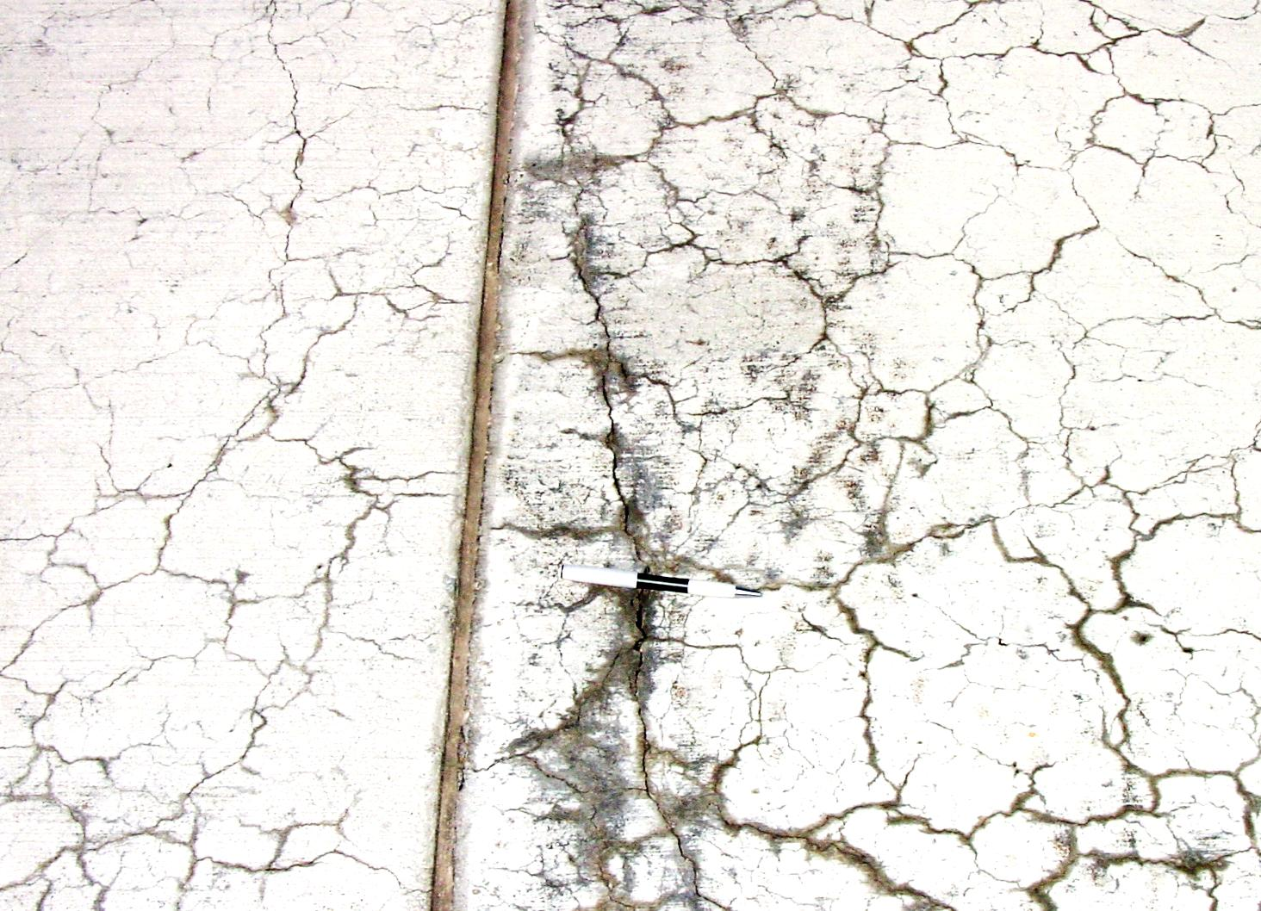
Evaluating the ASR Potential of Aggregates and Effectiveness of ASR Mitigation Measures in Miniature Concrete Prism Test
Enamur R Latifee, Graduate Student
Glenn Department of Civil Engineering
Clemson University
Concrete Materials Seminar
February 17, 2012

Slide 2
Acknowledgement
Dr. Prasad Rangaraju,
Associate Professor,
Glenn Department of Civil Engineering Clemson University
Dr. Paul Virmani, FHWA

Slide 3
Presentation Outline
ASR review
Introduction to Miniature Concrete Prism Test (MCPT)
Evaluation of Effectiveness of SCMs for ASR Mitigation in the MCPT
Effect of Prolonged Curing of Test Specimens on the Performance of Fly Ashes in MCPT Test Method

Slide 4
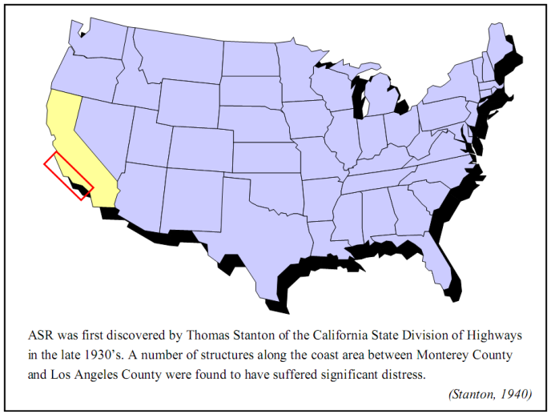
Beginning of ASR Research

Slide 5
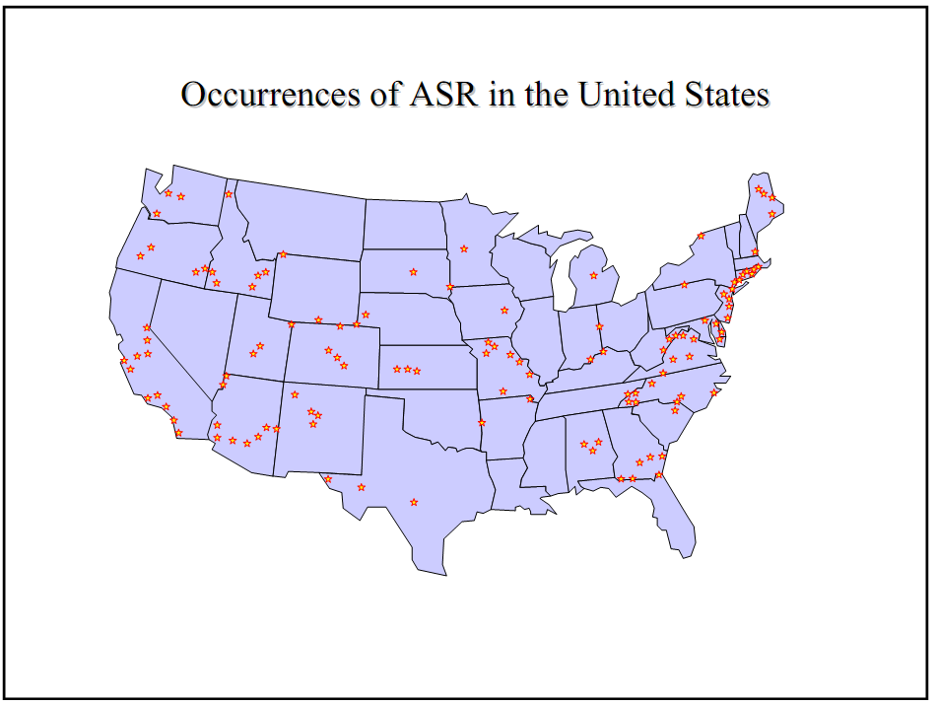

Slide 6
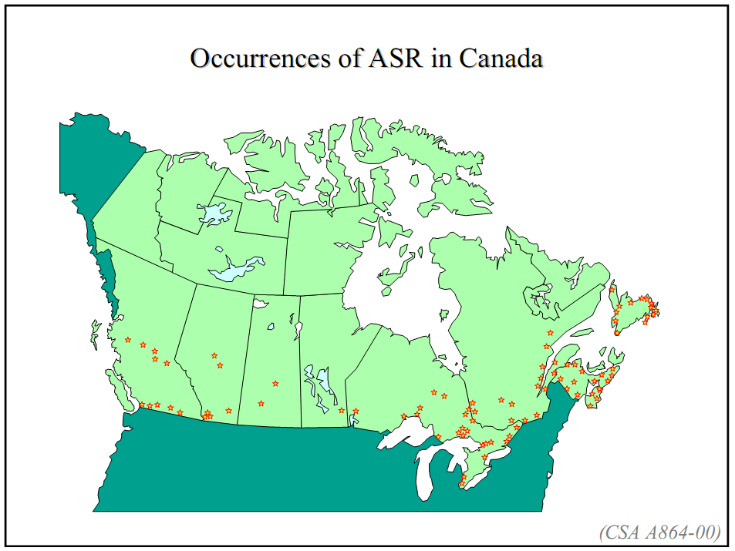

Slide 7
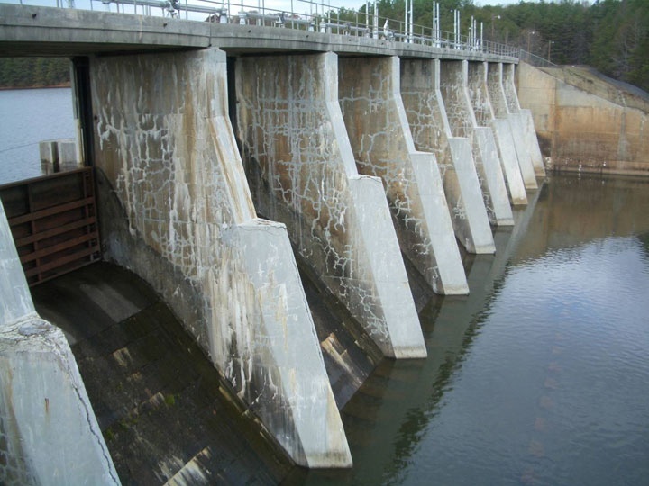
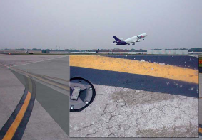
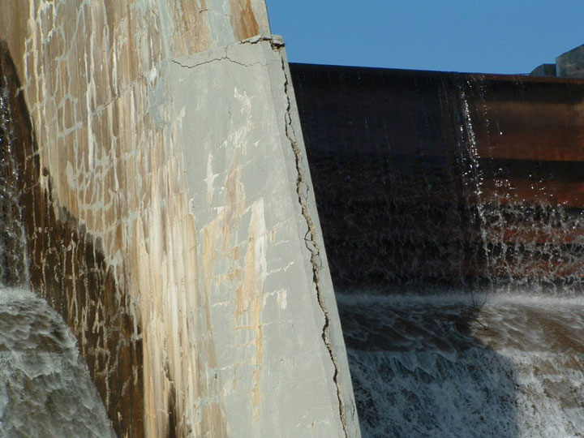
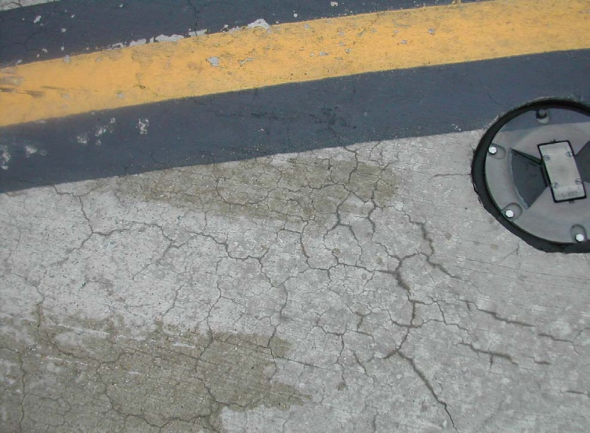
Alkali-Silica Reaction Distresses in the field
Notes:
Delete

Slide 8
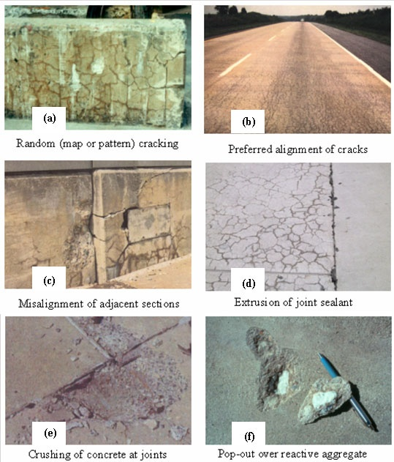
Field symptoms of ASR in concrete structures

Slide 9
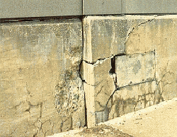
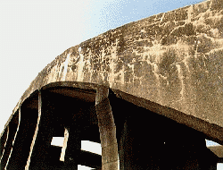
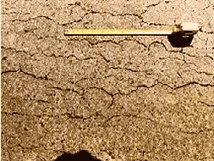
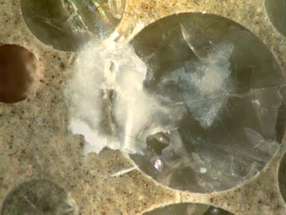
More ASR Distress

Slide 10
Some Case Histories
Buck Hydroelectric plant on New River (Virginia, US)
Arch dam in California
  crown deflection of 127 mm in 9 years
Railroad Canyon Dam
Morrow Point Dam, Colorado, USA
Stewart Mountain Dam, Arizona
Parker Dam (Arizona)
  expansion in excess of 0.1 percent

Slide 11
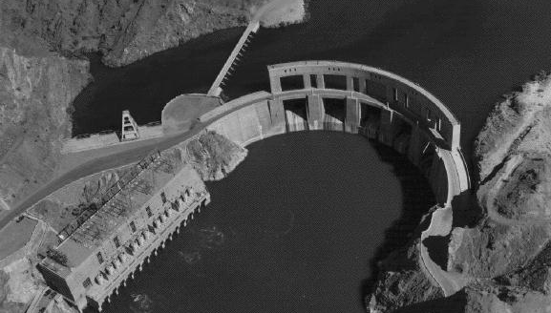
Case Study: Parker Dam, California
Alkali-Aggregate Reactions in Hydroelectric Plants and Dams:
http://www.acres.com/aar/
Hydroelectric dam built in 1938
180 mm of arch deflection due to alkali silica gel expansion
Cracking and gel flow in concrete

Slide 12
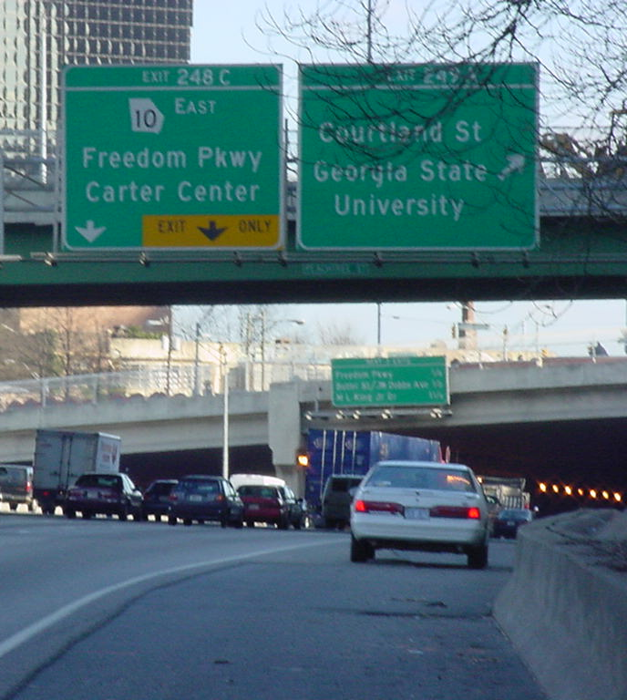
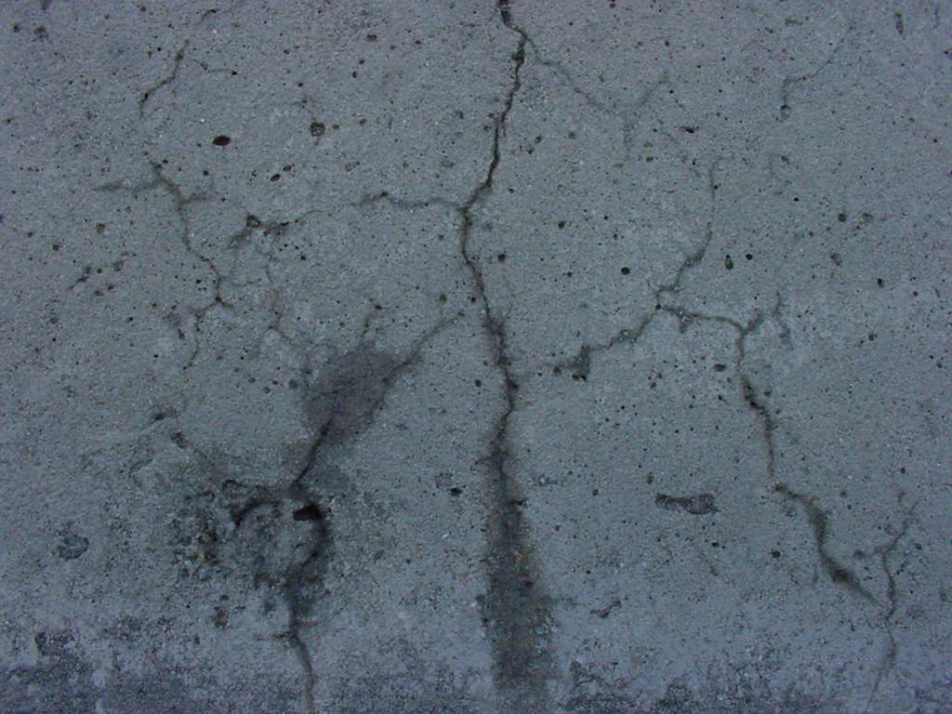
Case Study: I-85 - Atlanta, Georgia
Possible ASR damage on concrete retaining wall

Slide 13
Typical Distress Observed in Concrete Pavement Exposed to Airfield Deicing Chemicals

Slide 14
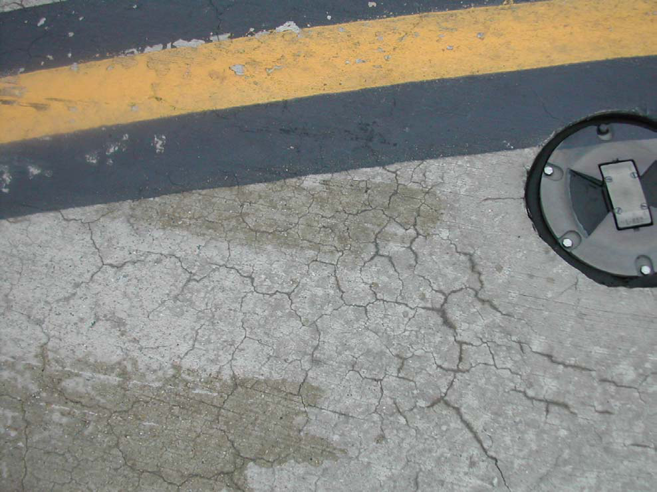
Typical Distress Observed in Concrete Pavement Exposed to Airfield Deicing Chemicals

Slide 15
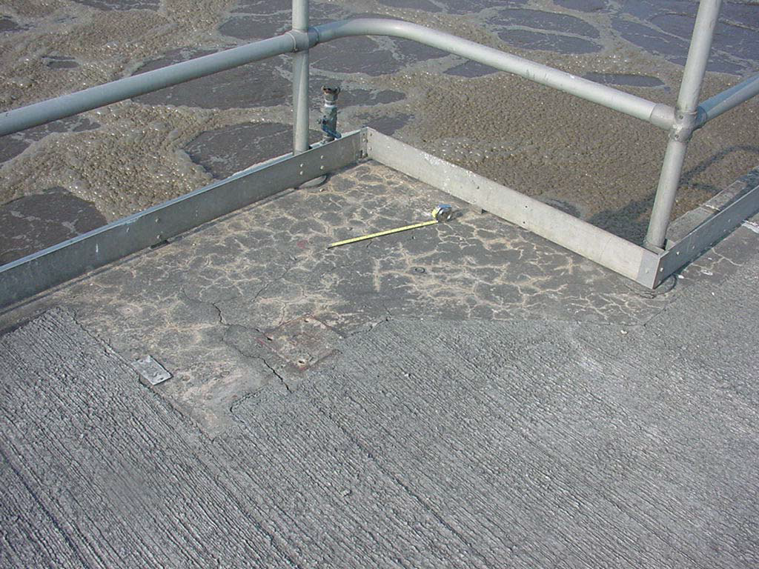
Example: Shek Wu Hui Treatment plant, Hong Kong

Slide 16
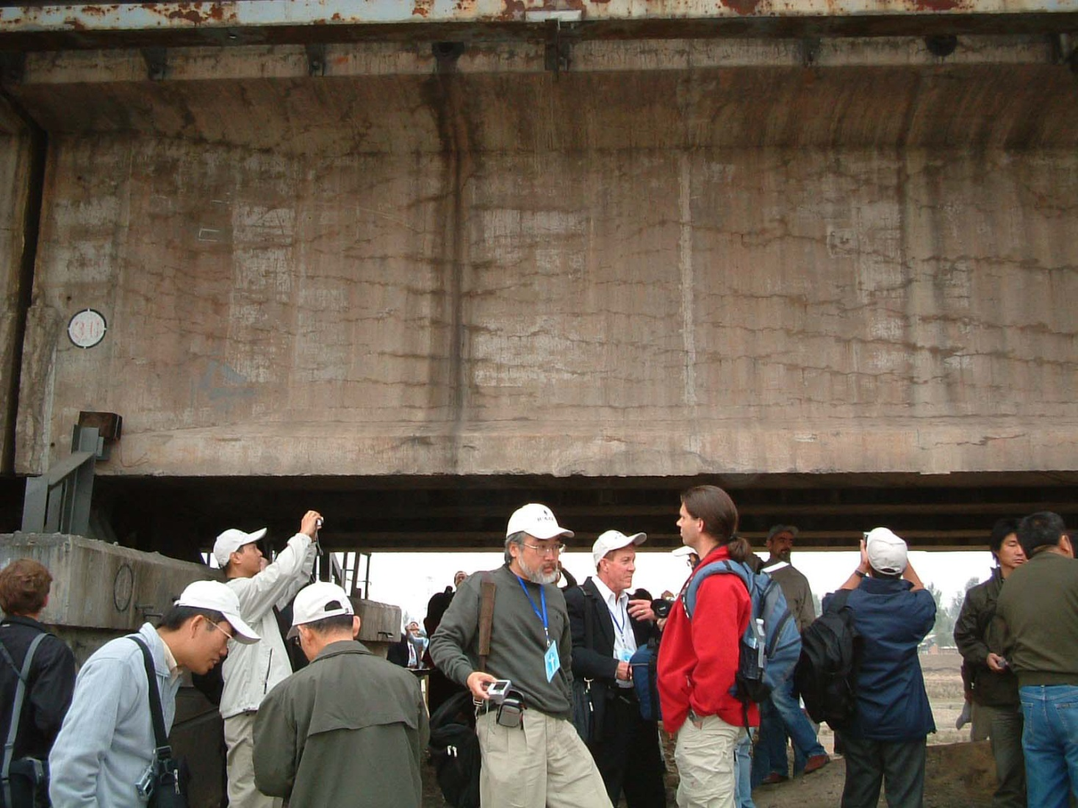
Example: Daqing Railway Bridge, China

Slide 17
Countries reported ASR problems
1 | AUSTRALIA
2 | CANADA
3 | CHINA
4 | DENMARK
5 | FRANCE
6 | HONG KONG
7 | ICELAND
8 | ITALY
9 | JAPAN
10 | KOREA
11 | NETHERLANDS
12 | NEW ZEALAND
13 | NORWAY
14 | ROMANIA
15 | RUSSIA
16 | PORTUGAL
17 | SOUTH AFRICA
18 | SWITZERLAND
19 | TAIWAN
20 | UNITED KINGDOM
21 | UNITED STATES OF AMERICA

Slide 18

ASR reported locations around the globe

Slide 19
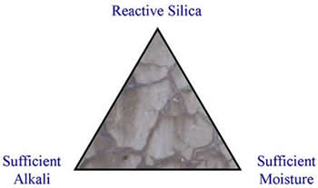
ASR
ASR is the most common form of alkali-aggregate reaction (AAR) in concrete; the other, much less common, form is alkali-carbonate reaction (ACR).
For damaging reaction to take place the following need to be present in sufficient quantities.
High alkali cement
Reactive aggregate
Moisture [above 75%RH within the concrete]

Slide 20
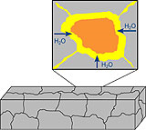
ASR
Aggregate reactivity depends directly on the alkalinity (typically expressed as pH) of the solution in the concrete pores. This alkalinity generally primarily reflects the level of water-soluble alkalis (sodium and potassium) in the concrete. These alkalis are typically derived from the Portland cement.

Slide 21
Chemistry of Alkali Silica Reaction
Cement production involves raw materials that contain alkalis in the range of 0.2 to 1.5 percent of Na₂O
This generates a pore fluid with high pH (12.5 to 13.5)
Strong alkalinity causes the acidic siliceous material to react

Slide 22
ASTM specification
ASTM C150 designates cements with more than 0.6 percent of Na₂O as high-alkali cements
Even with low alkali content, but sufficient amount of cement, alkali-silica reactions can occur
Investigations show that if total alkali content is less than 3 kg/m3, alkali-silica reactions will not occur (ASTM 1293, 1.25% alkali of 420kg/m3 =5.25kg/m3)

Slide 23
Other sources of alkali
Even if alkali content is small, there is a chance of alkali-silica reaction due to
  alkaline admixtures
  aggregates that are contaminated
  penetration of seawater
  deicing solutions

Slide 24
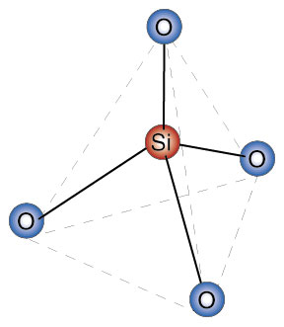
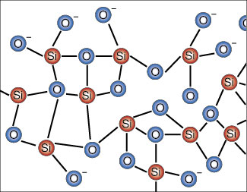
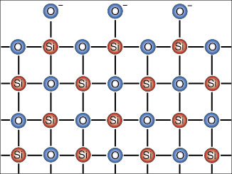
Creation of alkali-silica gel
Reactive Silica
Silica tetrahedron:
Amorphous Silica
Crystalline Silica

Slide 25
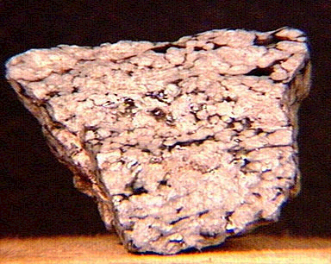
Creation of alkali-silica gel
Reactive Silica
Amorphous or disordered silica = most chemically reactive
Common reactive minerals:
strained quartz
opal
obsidian
cristobalite
tridymite
chelcedony
cherts
cryptocrystalline volcanic rocks

Slide 26
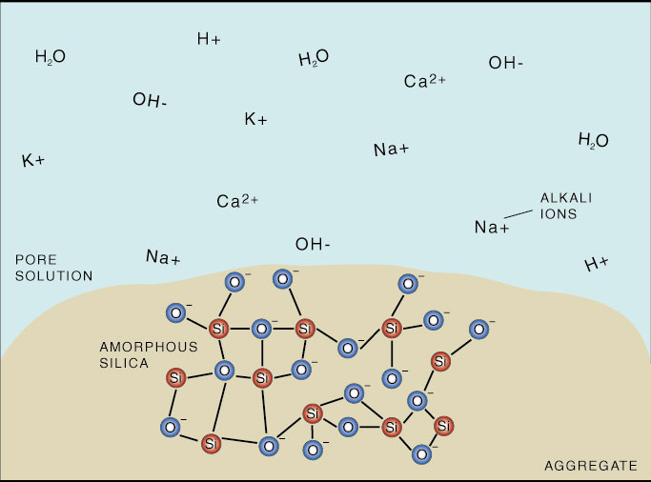
Creation of alkali-silica gel
1. Siliceous aggregate in solution

Slide 27
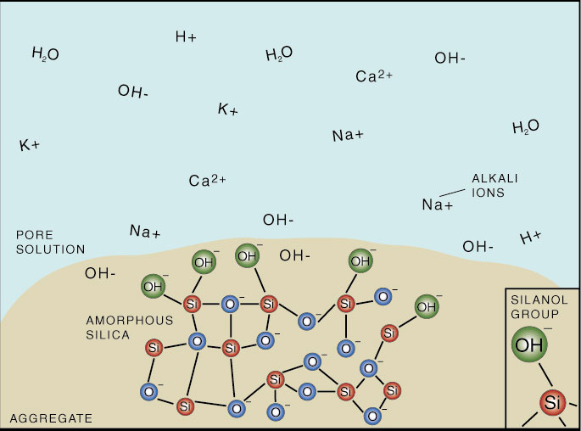
Creation of alkali-silica gel
2. Surface of aggregate is attacked by OH⁻
H₂0 + Si-O-Si
Si-OH…OH-Si

Slide 28
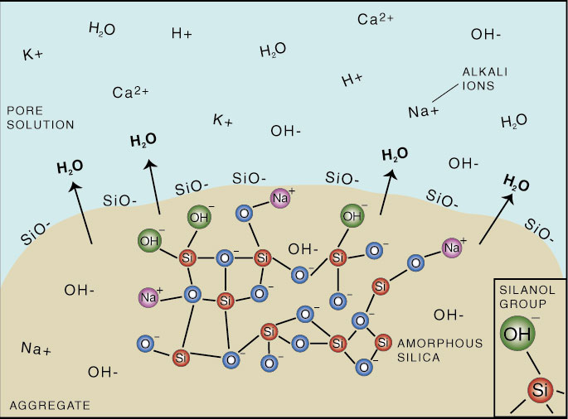
Creation of alkali-silica gel
3. Silanol groups (Si-OH) on surface are broken
down by OH⁻ into SiO⁻ molecules
Si-OH + OH⁻
SiO⁻ + H₂0

Slide 29
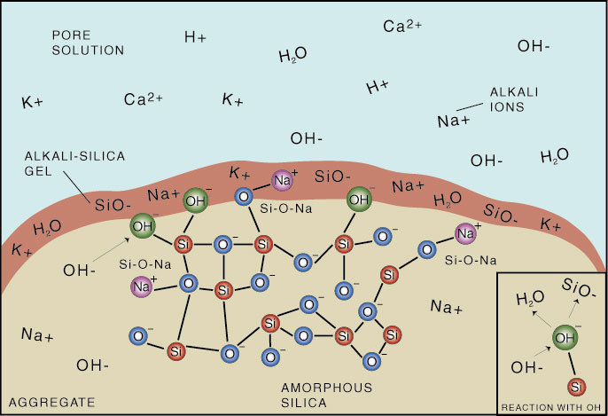
Creation of alkali-silica gel
4. Released SiO⁻ molecules attract alkali cations in pore solution, forming an alkali-silica gel around the aggregate.
Si-OH + Na⁺ + OH⁻
Si-O-Na + H₂0

Slide 30
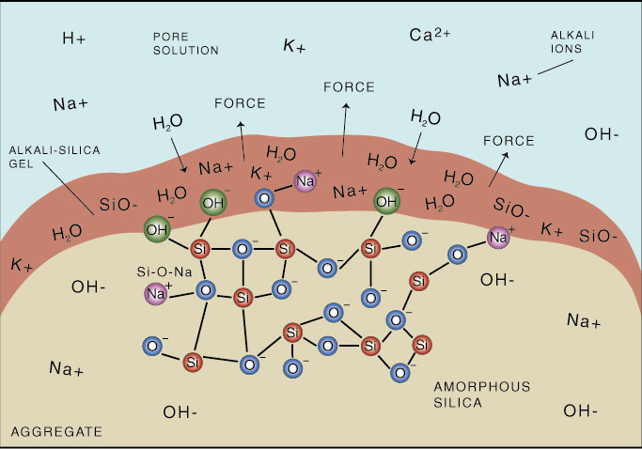
Creation of alkali-silica gel
5. Alkali-silica gel takes in water, expanding and exerting an osmotic pressure against the surrounding paste or aggregate.

Slide 31
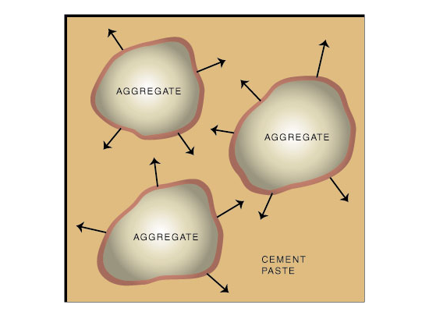
Creation of alkali-silica gel
6. When the expansionary pressure exceeds the tensile strength of the concrete, the concrete cracks.

Slide 32
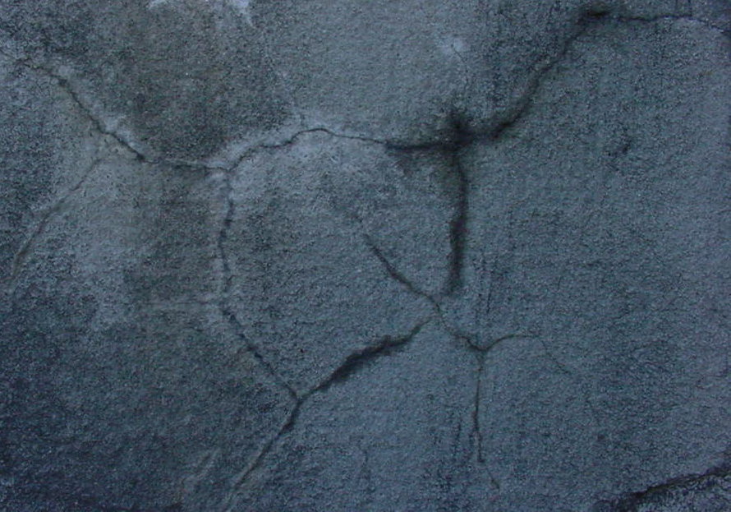
Creation of alkali-silica gel
7. When cracks reach the surface of a structure, “map cracking” results. Other symptoms of ASR damage includes the presence of gel and staining.

Slide 33
Creation of alkali-silica gel
8. Once ASR damage has begun:
Expansion and cracking of concrete
Increased permeability
More water and external alkalis penetrate concrete
Increased ASR damage

Slide 34
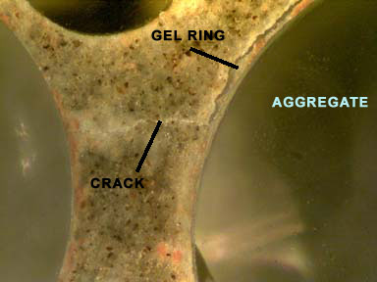
Images of ASR damage

Slide 35
SILICA MINERALS IN ORDER OF DECREASING REACTIVITY
# Amorphous silica: sedimentary or volcanic glass (a volcanic glass that is devitrified and/or mostly recrystallized may still be reactive)
# Opal
# Unstable crystalline silica (tridymite and cristobalite)
# Chert
# Chalcedony
# Other cryptocrystalline forms of silica
# Metamorphically granulated and distorted quartz
# Stressed quartz
# Imperfectly crystallized quartz
# Pure quartz occurring in perfect crystals

Slide 36
ROCKS IN ORDER OF DECREASING REACTIVITY
# Volcanic glasses, including tuffs (especially highly siliceous ones)
# Metaquartzites metamorphosed sandstones)
# Highly granulated granite gneisses
# Highly stressed granite gneisses
# Other silica-bearing metamorphic rocks
# Siliceous and micaceous schists and phyllites
# Well-crystallized igneous rock
# Pegmatitic (coarsely crystallized) igneous rock
# Nonsiliceous rock

Slide 37

ASR Research Time Line

Slide 38

1940-1960
1. Stanton, 1940, California Division of Highway
2. Mather, 1941, Concrete Laboratory of the Corps of Engineers
3. ASTM C 227-10, 1950, Standard Test Method for Potential Alkali Reactivity of Cement-Aggregate Combinations
4. ASTM C 289, Quick chemical method, 1952
5. The Conrow test, 1952, ASTM C 342, 1954- withdrawn -2001
6. ASTM C 295, Petrographic Examination of Aggregates, 1954
7. ASTM C1293, Concrete Prism Test, 1950s, Swenson and Gillott,
8. Gel pat test, Jones and Tarleton, 1958

Slide 39
1960 -1990
9. ROCK CYLINDER METHOD, 1966
10. Nordtest accelerated alkali-silica reactivity test, Saturated NaCl bath method Chatterji , 1978
11. JIS A1146, Mortar bar test method, Japanese Industrial Standard (JIS)
12. Accelerated Danish mortar bar test, Jensen 1982
13. Evaluation of the state of alkali-silica reactivity in hardened concrete, Stark, 1985
14. ASTM C 1260, Accelerated mortar bar test (AMBT); South African mortar-bar test- Oberholster and Davies, 1986,
15. Uranyl acetate gel fluorescence test, Natesaiyer and Hover, 1988

Slide 40
1991 -2010
16. Autoclave mortar bar test, Fournier et al. (1991)
17. Accelerated concrete prism test, Ranc and Debray, 1992
18. Modified gel pat test, Fournier, 1993
19. Chinese concrete microbar test (RILEM AAR-5)
20. Chinese autoclave test (CES 48:93), Japanese autoclave test, JIS A 1804
21. Chinese accelerated mortar bar method—CAMBT, 1998
22. Chinese concrete microbar test (RILEM AAR-5), 1999
23. Modified versions of ASTM C 1260 and ASTM C 1293,Gress, 2001
24. Universal accelerated test for alkali-silica and alkali-carbonate reactivity of concrete aggregates, modified CAMBT, Duyou et al., 2008

Slide 41
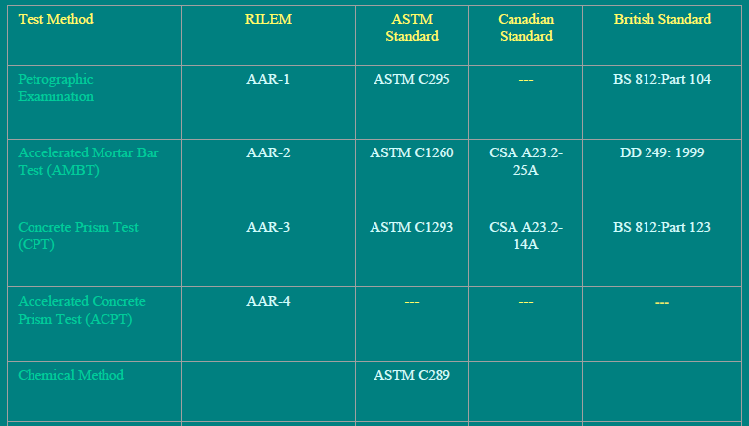
Common Test Methods to assess ASR

Slide 42
RILEM SURVEY (Nixon And Sims 1996)
Reunion Internationale des Laboratoires et Experts des Materiaux, Systemes de Construction et Ouvrages (French: International Union of Laboratories and Experts in Construction Materials, Systems, and Structures)

Slide 43
All countries, reported that no one test is capable of providing a comprehensive assessment of aggregates for their alkali-aggregate reactivity.

Slide 44
Part 2:
Introduction to MCPT

Slide 45
Introduction to MCPT
MCPT has been developed to determine aggregate reactivity, with:
- Similar reliability as ASTM C 1293 test but shorter test duration
(56 days vs. 1 year)
- Less aggressive exposure conditions than ASTM C 1260 test but better reliability

Slide 46
Variables
Variable test conditions
  Storage environment
    Exposure condition
      1N NaOH
      100% RH
      100% RH (Towel Wrapped)
    Temperature
      38 °C
      60 °C
      80 °C
  Sample Shape
    Prism (2” x 2” x 11.25”)
    Cylinder (2” dia x 11.25” long)
  Soak Solution Alkalinity (0.5N, 1.0N, and 1.5N NaOH solutions)

Slide 47
Aggregates used in the Variables
Four known different reactive aggregates were used for these variables. These are as follows:
  Spratt Limestone of Ontario, Canada,
  New Mexico, Las Placitas-Rhyolite,
  North Carolina, Gold Hill -Argillite,
  South Dakota, Dell Rapids – Quartzite

Slide 48
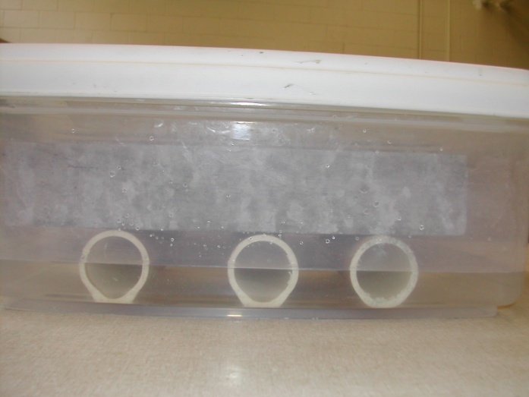
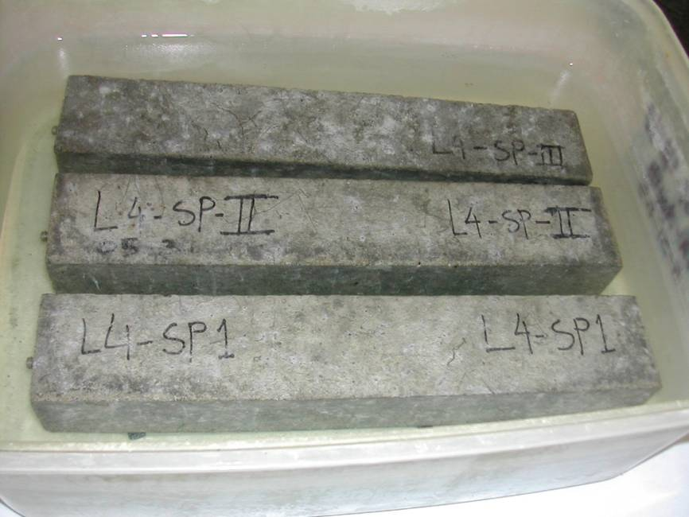
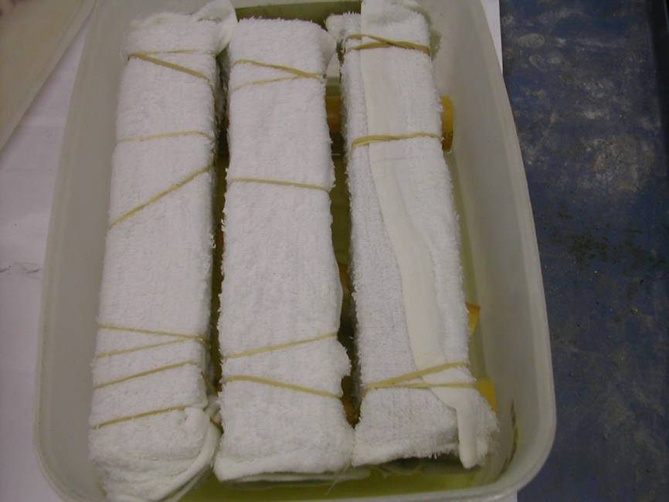
Effect of Storage Condition
100% RH, Free standing
1N NaOH Soak Solution
100% RH, Towel Wrapped

Slide 49
Effect of Storage Condition on Expansion in MCPT

Slide 50
Soak Solution Alkalinity
(0.5N, 1.0N, and 1.5N NaOH solutions)

Slide 51
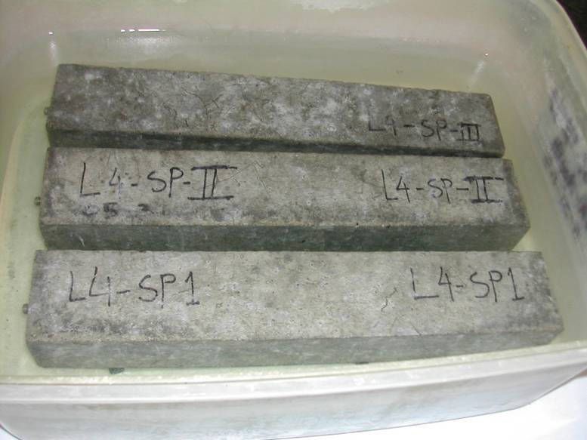
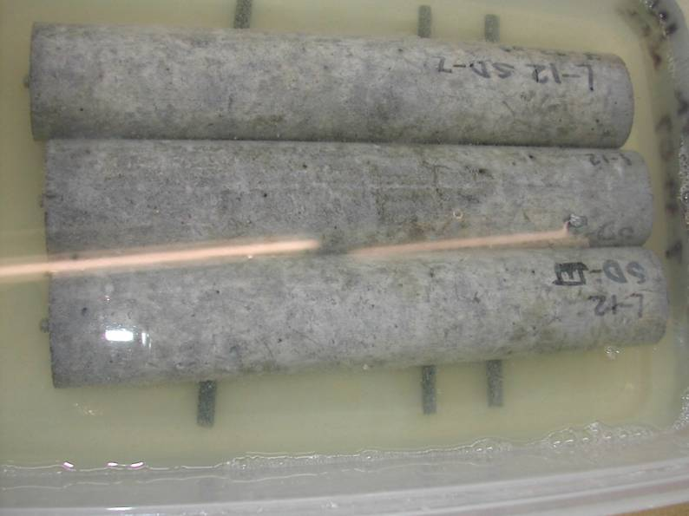
Prisms vs. Cylinders

Slide 52
Effect of Sample Shape on Expansion in MCPT
Spratt Limestone

Slide 53
Effect of Temperature on Expansion in MCPT
Spratt Limestone

Slide 54
MCPT Method Parameters
Mixture Proportions and Specimen Dimensions
  Specimen size = 2 in. x 2 in. x 11.25 in.
  Max. Size of Aggregate = ½ in. (12.5 mm)
  Volume Fraction of = 0.65
  Dry Rodded Coarse Aggregate
  in Unit Volume of Concrete
  Coarse Aggregate Grading Requirement:
Sieve Size, mm |  | Mass, %
Passing | Retained
12.5 | 9.5 | 57.5
9.5 | 4.75 | 42.5

Slide 55
MCPT Method (continued)
Test Procedure
  Cement Content (same as C1293) = 420 kg/m³
  Cement Alkali Content = 0.9% ± 0.1% Na₂O_{eq.}
  Alkali Boost, (Total Alkali Content) = 1.25% Na₂O_{eq.} by mass of cement
  Water-to-cement ratio = 0.45
  Storage Environment = 1N NaOH Solution
  Storage Temperature = 60⁰C
  Initial Pass/Fail Criteria = Exp. limit of 0.04% at 56 days
  Use non-reactive fine aggregate, when evaluating coarse aggregate
  Use non-reactive coarse aggregate, when evaluating fine aggregate
  Specimens are cured in 60⁰C water for 1 day after demolding
  before the specimens are immersed in 1N NaOH solution.

Slide 56
Expansion Data of Test Specimens Containing Selected Aggregates in Different Test Methods
(Note: red:- reactive, green:- non-reactive)
Aggregate Identity | % Expansion
 | MCPT, 56 Days | ASTM C 1293, 365 days | ASTM C 1260, 14 days
L4-SP | 0.149 | 0.181 | 0.350
L11-SD | 0.099 | 0.109 | 0.220
L15-NM | 0.185 | 0.251 | 0.900
L19-NC | 0.149 | 0.192 | 0.530
L23-BB | 0.017 | 0.032 | 0.042
L54-Galena-IL | 0.046 | 0.050 | 0.235
L32-QP | 0.070 | 0.070 | 0.080*
L34-SLC | 0.039 | 0.030 | 0.190**
L59-MSP | 0.023 | 0.030 | 0.100**
L56-TX | 0.440 | 0.590 | 0.640
L35-GI | 0.091 | 0.090 | 0.260
L36-SB | 0.115 | 0.150 | 0.460

Slide 57
Proposed criteria for characterizing aggregate reactivity in MCPT protocol
Degree of Reactivity | % Expansion at 56 Days | Rate of Expansion from 8 to 10 weeks
Non-reactive | < 0.040 % | < 0.010% per two weeks
Low | 0.035% – 0.060% | > 0.010% per two weeks
Moderate | 0.060% – 0.120% | N/A
High | > 0.120% | N/A

Slide 58
Comparison of MCPT-56 with CPT-365
MCPT
0.04% limit at 56 days
CPT
0.04% limit at 365 days

Slide 59
Part 3: Evaluation of Effectiveness of SCMs for ASR Mitigation in the MCPT

Slide 60
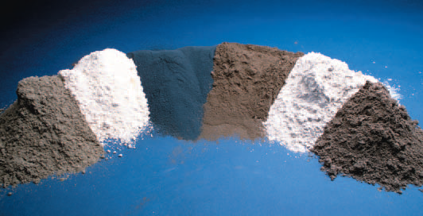
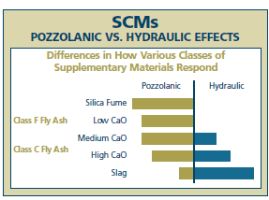
Supplementary Cementing Materials (SCMs)

Slide 61
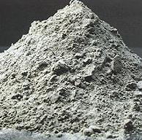
Fly Ashes for ASR Mitigation in the MCPT
Three fly ashes
  Low-lime fly ash
  intermediate-lime fly ash, and
  high-lime fly ash
All were used at a dosage of 25% by mass replacement of cement

Slide 62
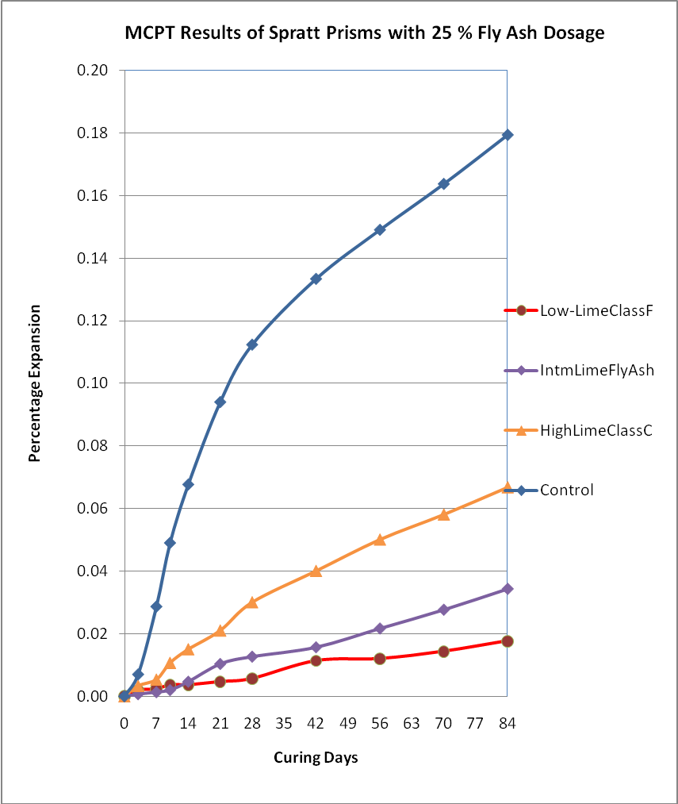
Effectiveness of low-lime, intermediate-lime and high-lime fly ashes in mitigating ASR in MCPT method using Spratt limestone as reactive aggregate

Slide 63
Later nine different fly ashes (3 high-lime -HL, 3 low-lime-LL and 3 intermediate-lime- IL fly ashes) at 25% cement replacement levels were investigated

Slide 64
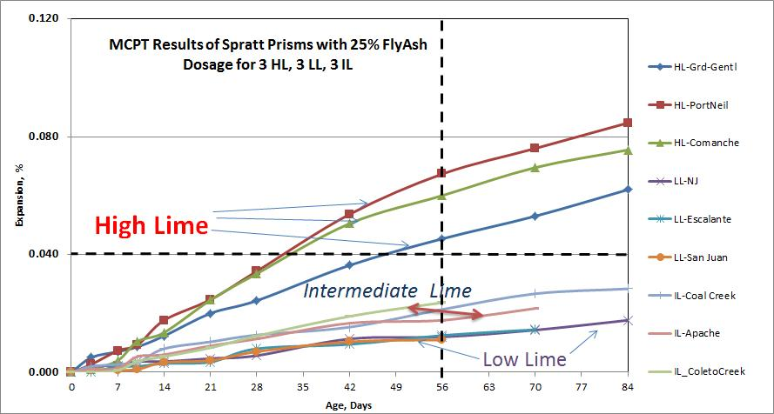
Nine different fly ashes (3 high-lime, 3 low-lime and 3 intermediate-lime fly ashes) at 25% cement replacement levels

Slide 65
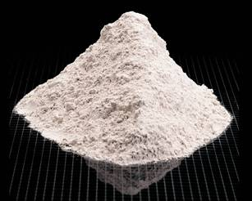
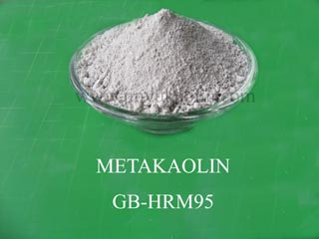
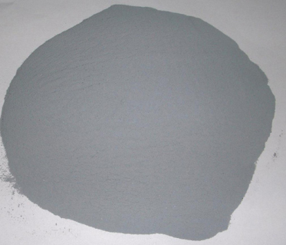
Effectiveness of Slag, Meta-kaolin, Silica fume and LiNO₃ in mitigating ASR
Spratt limestone as reactive aggregate
Mass replacement of cement
Slag was used at a dosage of 40%
Metakaolin was used at a dosage of 10%
Silica Fume was used at a dosage of 10%
Additionally LiNO₃ was used at a dosage of 100%

Slide 66
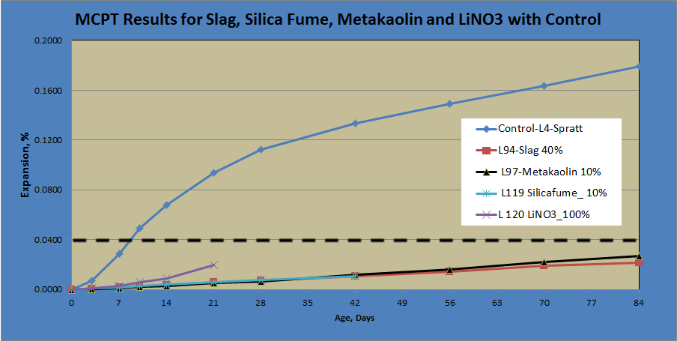
Effectiveness of Slag, Meta-kaolin, Silica fume and LiNO₃ in mitigating ASR in MCPT method using Spratt limestone as reactive aggregate

Slide 67
Part 3: Effect of Prolonged Curing of Test Specimens on the Performance of Fly Ashes in MCPT Test Method

Slide 68
Effect of Prolonged Curing of Test Specimens on the Performance of Fly Ashes in MCPT Test Method
MCPT test specimens cured for varying lengths of time Days:
1 day, 7 days, 14 days and 28 days ; before they were exposed to 1N NaOH solution
Three fly ashes of significantly different chemical composition (Low-lime fly ash, intermediate-lime fly ash and high-lime fly ash) were selected.

Slide 69
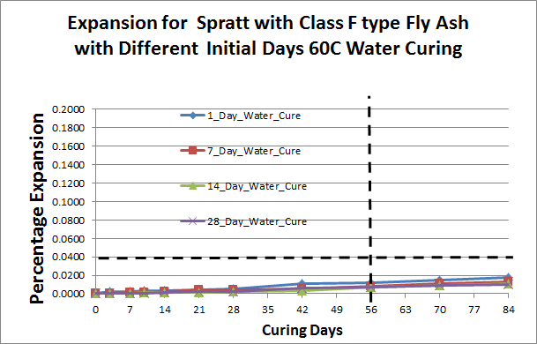
Low Lime-Class F fly ash at 25% cement replacement

Slide 70
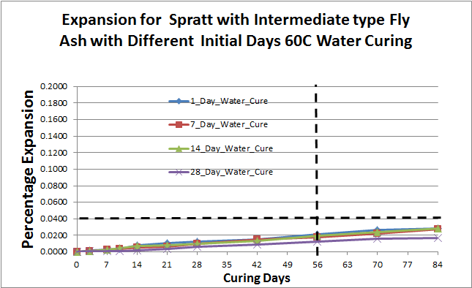
Intermediate Lime fly ash at 25% cement replacement

Slide 71

High Lime-Class C fly ash at 25% cement replacement

Slide 72
Conclusions
The findings from the extended initial curing of test specimens in MCPT showed that there is no added benefit in increasing the duration of initial curing in assessing the effectiveness of ASR mitigation measures such as supplementary cementitious materials.
Based on the results, MCPT appears to be a viable test method that can potentially replace both AMBT (ASTM C 1260) and CPT (ASTM C 1293) for routine ASR-related testing.

Slide 73
Future Steps
Develop a protocol for evaluation of Job Mixtures for Potential ASR

Slide 74
Questions?
elatife@clemson.edu

