Slide 1
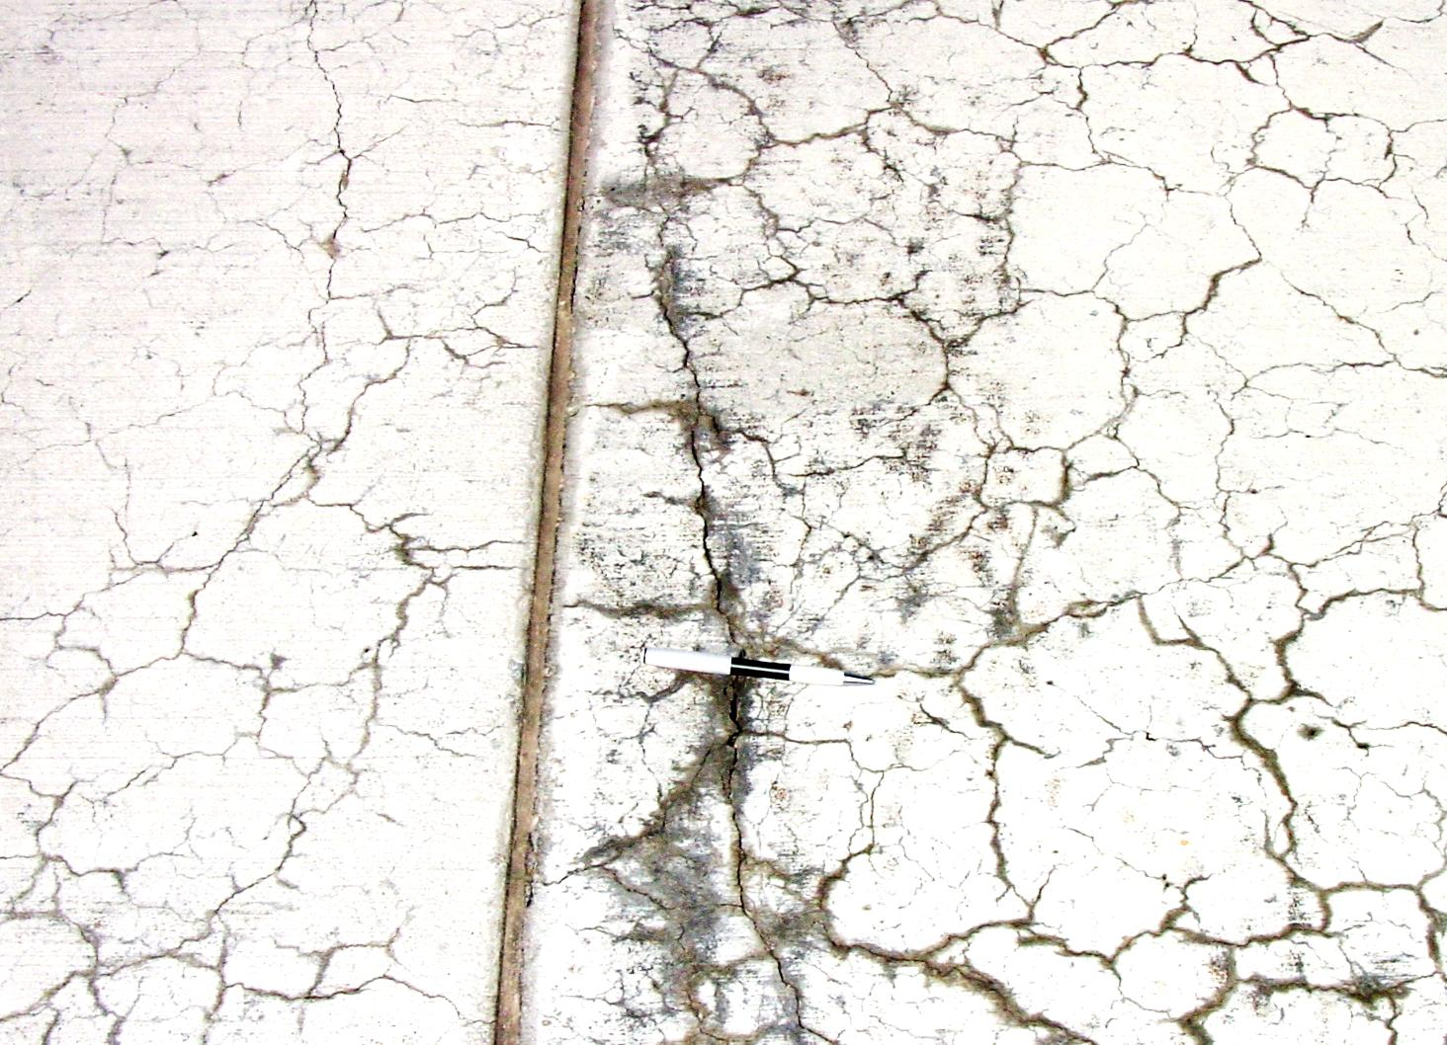
Evaluating the Efficacy of ASR Mitigation Measures in Miniature Concrete Prism Test
Enamur R Latifee, Graduate Student
Prasad Rangaraju, Associate Professor
Department of Civil Engineering
Clemson University
ACI Fall 2011 Convention
Cincinnati, Ohio
October 17, 2011

Slide 2
Acknowledgement
Dr. Paul Virmani, FHWA

Slide 3
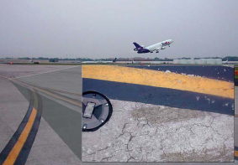
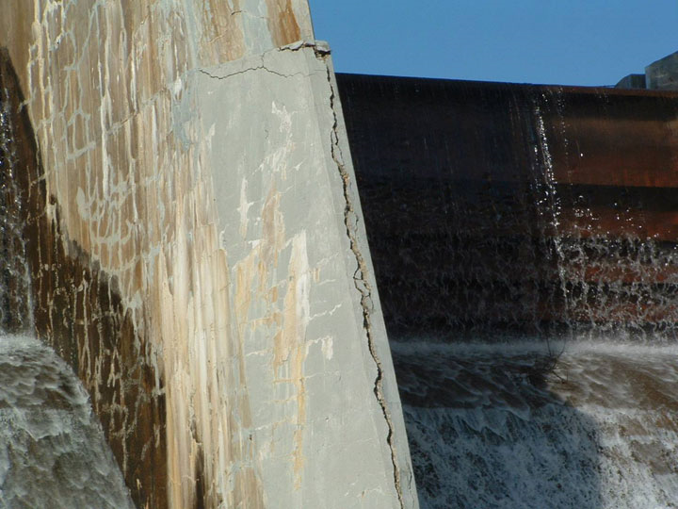
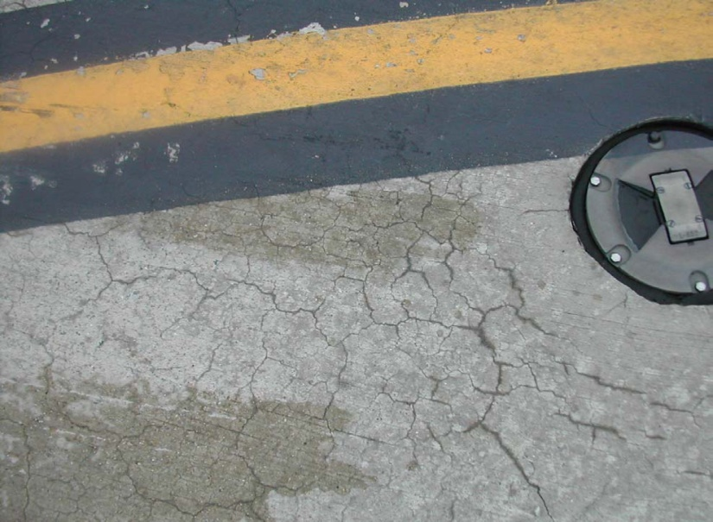
Alkali-Silica Reaction Distresses in the field
Notes:
Delete

Slide 4
Presentation Outline
Introduction to Miniature Concrete Prism Test (MCPT)
Evaluation of Effectiveness of SCMs for ASR Mitigation in the MCPT
Effect of Prolonged Curing of Test Specimens on the Performance of Fly Ashes in MCPT Test Method

Slide 5
Part 1:
Introduction to MCPT

Slide 6
Introduction to MCPT
MCPT has been developed to determine aggregate reactivity, with:
- Similar reliability as ASTM C 1293 test but shorter test duration
(56 days vs. 1 year)
- Less aggressive exposure conditions than ASTM C 1260 test but better reliability

Slide 7
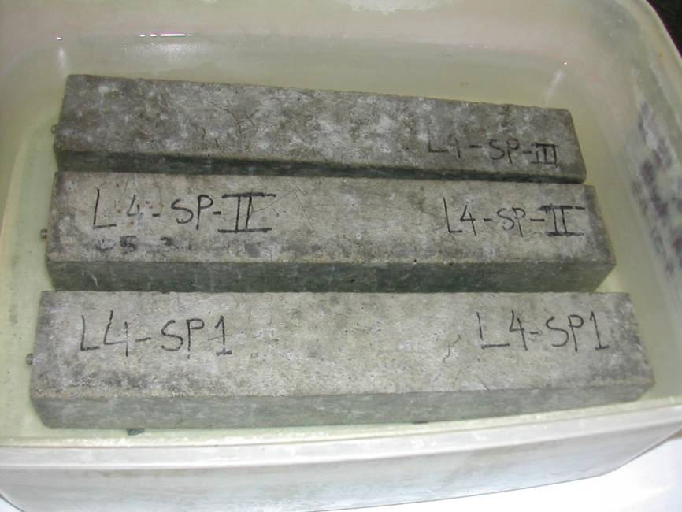
MCPT Method Parameters
Mixture Proportions and Specimen Dimensions
Specimen size = 2 in. x 2 in. x 11.25 in.
Max. Size of Aggregate = ½ in. (12.5 mm)
Volume Fraction of = 0.70
Dry Rodded Coarse Aggregate
in Unit Volume of Concrete
Coarse Aggregate Grading Requirement:
Sieve Size, mm |  | Mass, %
Passing | Retained
12.5 | 9.5 | 57.5
9.5 | 4.75 | 42.5

Slide 8
MCPT Method (continued)
Test Procedure
Cement Content (same as C1293) = 420 kg/m³
Cement Alkali Content = 0.9% ± 0.1% Na₂O_{eq.}
Alkali Boost, (Total Alkali Content) = 1.25% Na₂O_{eq.} by mass of cement
Water-to-cement ratio = 0.45
Storage Environment = 1N NaOH Solution
Storage Temperature = 60⁰C
Pass/Fail Criteria = Exp. limit of 0.040% at 56 days
Use non-reactive fine aggregate, when evaluating coarse aggregate
Use non-reactive coarse aggregate, when evaluating fine aggregate
Specimens are cured in 60⁰C water for 1 day after demolding
before the specimens are immersed in 1N NaOH solution.

Slide 9
Expansion Data of Test Specimens Containing Selected Aggregates in Different Test Methods (Note: red:- reactive, green:- non-reactive)
Aggregate Identity | % Expansion
 | MCPT, 56 Days | ASTM C 1293, 365 days | ASTM C 1260, 14 days
L4-SP | 0.149 | 0.181 | 0.350
L11-SD | 0.099 | 0.109 | 0.220
L15-NM | 0.185 | 0.251 | 0.900
L19-NC | 0.149 | 0.192 | 0.530
L23-BB | 0.017 | 0.032 | 0.042
L54-Galena-IL | 0.046 | 0.050 | 0.235
L32-QP | 0.070 | 0.070 | 0.080*
L34-SLC | 0.039 | 0.030 | 0.190**
L59-MSP | 0.023 | 0.030 | 0.100**
L56-TX | 0.440 | 0.590 | 0.640
L35-GI | 0.091 | 0.090 | 0.260
L36-SB | 0.115 | 0.150 | 0.460

Slide 10
Proposed criteria for characterizing aggregate reactivity in MCPT protocol
Degree of Reactivity | % Expansion at 56 Days | Rate of Expansion from 8 to 10 weeks
Non-reactive | < 0.040 % | < 0.010% per two weeks
Low | 0.035% – 0.060% | > 0.010% per two weeks
Moderate | 0.060% – 0.120% | N/A
High | > 0.120% | N/A

Slide 11
Part 2: Evaluation of Effectiveness of SCMs for ASR Mitigation in the MCPT

Slide 12
Fly Ashes for ASR Mitigation in the MCPT
PRELIMINARY STUDY
Three fly ashes
Low-lime fly ash (Class F, CaO content = 1%)
intermediate-lime fly ash (Inter-Class, CaO content = 15% )
high-lime fly ash (Class C, CaO content =29%)
All fly ashes were used at a dosage of 25% by mass replacement of cement

Slide 13
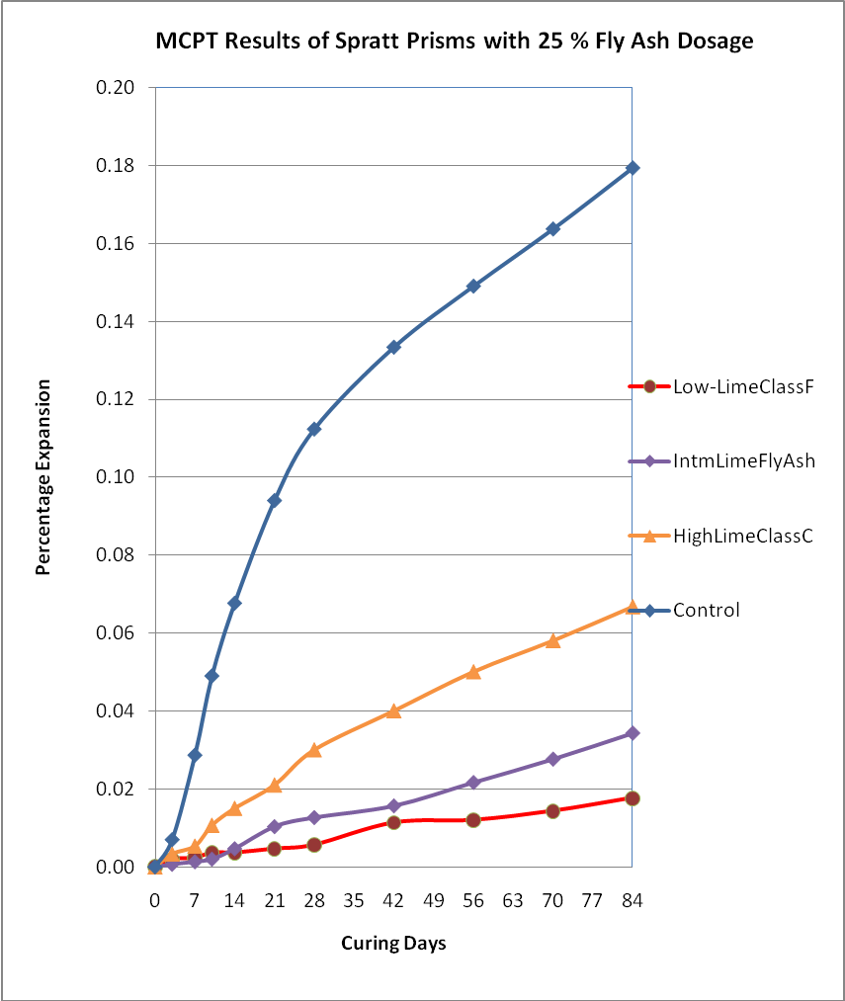
Effectiveness of low-lime, intermediate-lime and high-lime fly ashes in mitigating ASR in MCPT method using Spratt limestone as reactive aggregate

Slide 14
Fly Ashes for ASR Mitigation in the MCPT
COMPREHENSIVE STUDY
3 High-lime fly ashes – HL_{GG}, HL_{PN} and HL_{CO}
3 Low-lime fly ashes – LL_{NJ}, LL_{ES}, and LL_{SJ}
3 Intermediate-lime– IL_{Coalcrk}, IL_{AP}, and IL_{Colettocrk}
Fly ash dosage @ 25% by mass replacement of cement

Slide 15
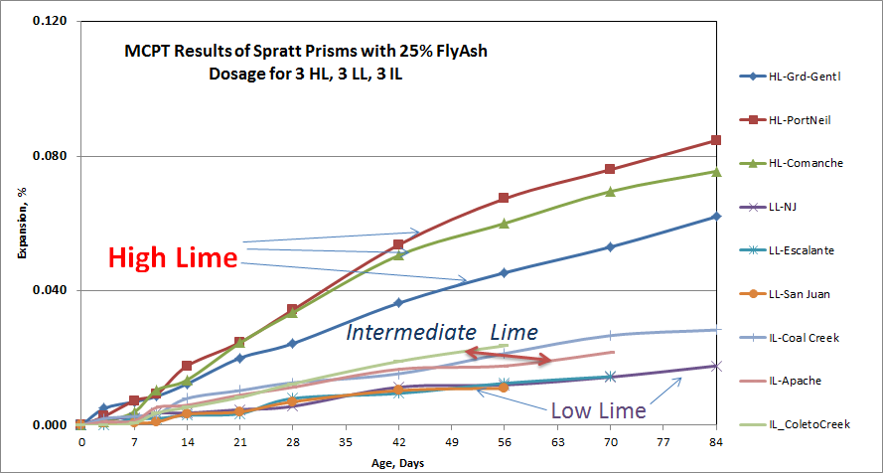
Nine different fly ashes (3 high-lime, 3 low-lime and 3 intermediate-lime fly ashes) at 25% cement replacement levels

Slide 16
Effectiveness of Slag, Meta-kaolin, Silica fume and LiNO₃ in mitigating ASR
Spratt limestone as reactive aggregate
Dosage - Mass replacement of cement
Slag was used at a dosage of 40%
Metakaolin was used at a dosage of 10%
Silica Fume was used at a dosage of 10%
Additionally LiNO₃ was used at a dosage of 100% in Bar, and 50% in Soak Solution.

Slide 17
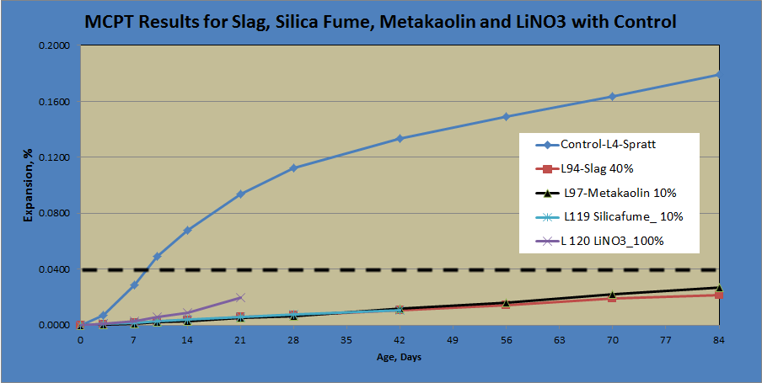
Effectiveness of Slag, Meta-kaolin, Silica fume and LiNO₃ in mitigating ASR in MCPT method using Spratt limestone as reactive aggregate

Slide 18
Part 3: Effect of Prolonged Curing of Test Specimens on the Performance of Fly Ashes in MCPT Test Method

Slide 19
Effect of Prolonged Curing of Test Specimens on the Performance of Fly Ashes in MCPT Test Method
MCPT test specimens cured in water @ 60˚C for varying ages:
1 day, 7 days, 14 days and 28 days ; before they were exposed to 1N NaOH solution
Three fly ashes of significantly different chemical composition (Low-lime fly ash, intermediate-lime fly ash and high-lime fly ash) were selected.

Slide 20
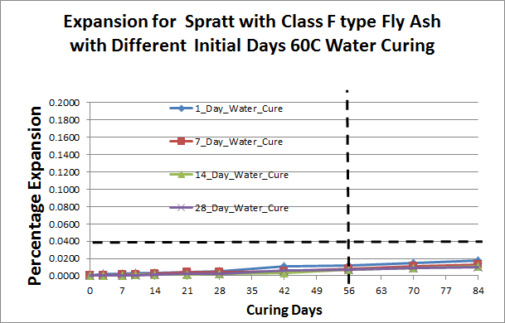
Low Lime-Class F fly ash at 25% cement replacement

Slide 21
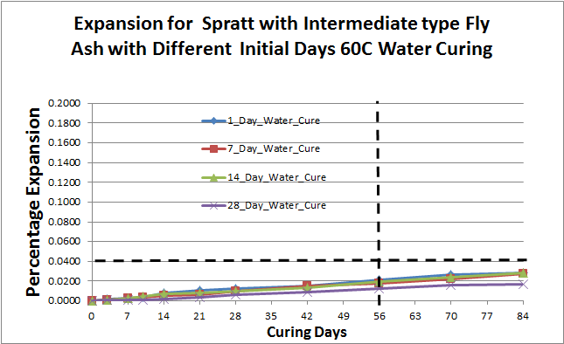
Intermediate Lime fly ash at 25% cement replacement

Slide 22
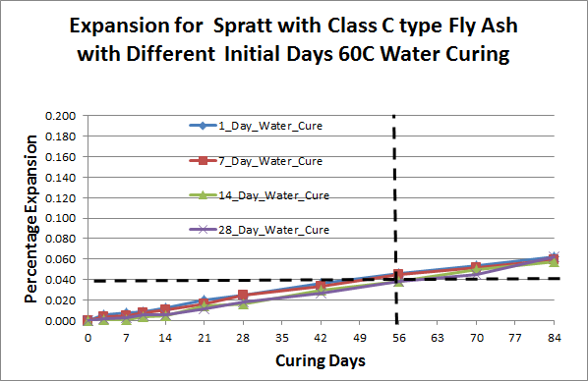
High Lime-Class C fly ash at 25% cement replacement

Slide 23
Conclusions
The findings from the extended initial curing of test specimens in MCPT showed that there is no added benefit in increasing the duration of initial curing in assessing the effectiveness of ASR mitigation measures such as supplementary cementitious materials.
Based on the results, MCPT appears to be a viable test method that can potentially replace both AMBT (ASTM C 1260) and CPT (ASTM C 1293) for routine ASR-related testing.

Slide 24
Future Steps
Develop a protocol for evaluation of Job Mixtures for Potential ASR

Slide 25
Questions?
PRANGAR@clemson.edu
elatife@clemson.edu

