Slide 1

Miniature Concrete Prism Test - A Rapid and Reliable Test Method for Assessing Potential Reactivity of Aggregates
Enamur R Latifee, Graduate Student
Prasad Rangaraju, Associate Professor
Department of Civil Engineering
Clemson University
ACI Fall 2010 Convention,
Pittsburgh, PA
October, 2010

Slide 2
Acknowledgement
Dr. Paul Virmani, FHWA

Slide 3
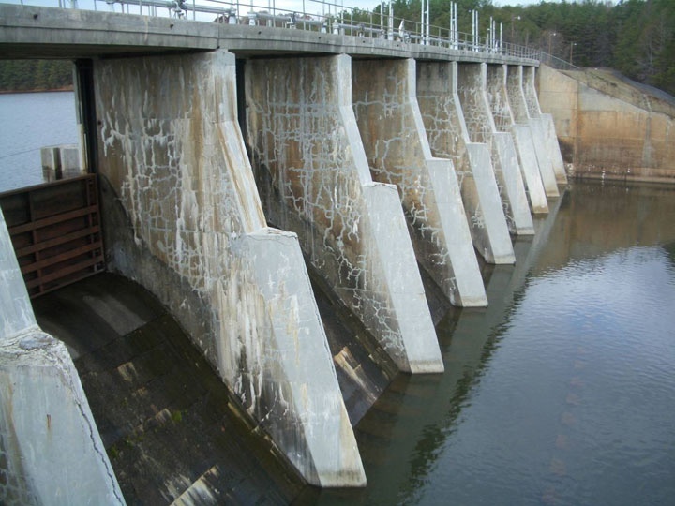
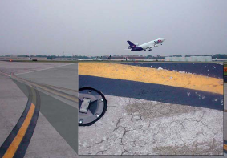

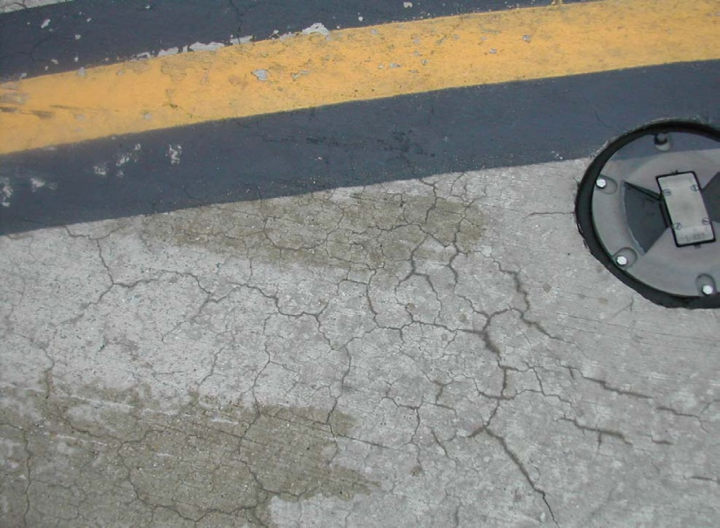
Alkali-Silica Reaction
Notes:
Delete

Slide 4
Drawbacks of ASTM C1260 and C1293 Test Methods
ASTM C1260
Excessive manipulation of aggregate in this study (crushing)
Aggressive exposure conditions in the test:
  1N NaOH soak solution at 80°C
Significant number of false-positive and false-negative cases
ASTM C1293
Long testing duration
  1 yr for Aggregate Characterization
  2 yrs for ASR Mitigation Evaluation
Another deficiency is that alkalis in concrete can potentially leach out during the test.

Slide 5
Objectives of the MCPT Method
Shorter test duration than required for ASTM C1293 method.
No excessive crushing of the aggregates
Less aggressive exposure conditions than ASTM C 1260

Slide 6
Miniature Concrete Prism Test (MCPT)
Variable test conditions
  Storage environment
    Exposure condition
      1N NaOH
      100% RH
      100% RH (Towel Wrapped)
    Temperature
      38 °C
      60 °C
      80 °C
  Sample Shape
    Prism (2” x 2” x 11.25”)
    Cylinder (2” dia x 11.25” long)
  Soak Solution Alkalinity (0.5N, 1.0N, and 1.5N NaOH solutions)

Slide 7
Aggregates used in the Variables
Four known different reactive aggregates were used for these variables. These are as follows:
  Spratt Limestone of Ontario, Canada,
  New Mexico, Las Placitas-Rhyolite,
  North Carolina, Gold Hill -Argillite,
  South Dakota, Dell Rapids – Quartzite

Slide 8
Proposed MCPT Method
Mixture Proportions and Specimen Dimensions
  Specimen size = 2 in. x 2 in. x 11.25 in.
  Max. Size of Aggregate = ½ in. (12.5 mm)
  Volume Fraction of = 0.70
  Dry Rodded Coarse Aggregate
  in Unit Volume of Concrete
  Coarse Aggregate Grading Requirement:
Sieve Size, mm |  | Mass, %
Passing | Retained
12.5 | 9.5 | 57.5
9.5 | 4.75 | 42.5

Slide 9
Proposed MCPT Method
Test Procedure
  Cement Content (same as C1293) = 420 kg/m³
  Cement Alkali Content = 0.9% ± 0.1% Na₂O_{eq.}
  Alkali Boost, (Total Alkali Content) = 1.25% Na₂O_{eq.} by mass of cement
  Water-to-cement ratio = 0.45
  Storage Environment = 1N NaOH Solution
  Storage Temperature = 60⁰C
  Use non-reactive fine aggregate, when evaluating coarse aggregate
  Use non-reactive coarse aggregate, when evaluating fine aggregate
  Specimens are cured in 60⁰C water for 1 day after demolding
  before the specimens are immersed in 1N NaOH solution.

Slide 10
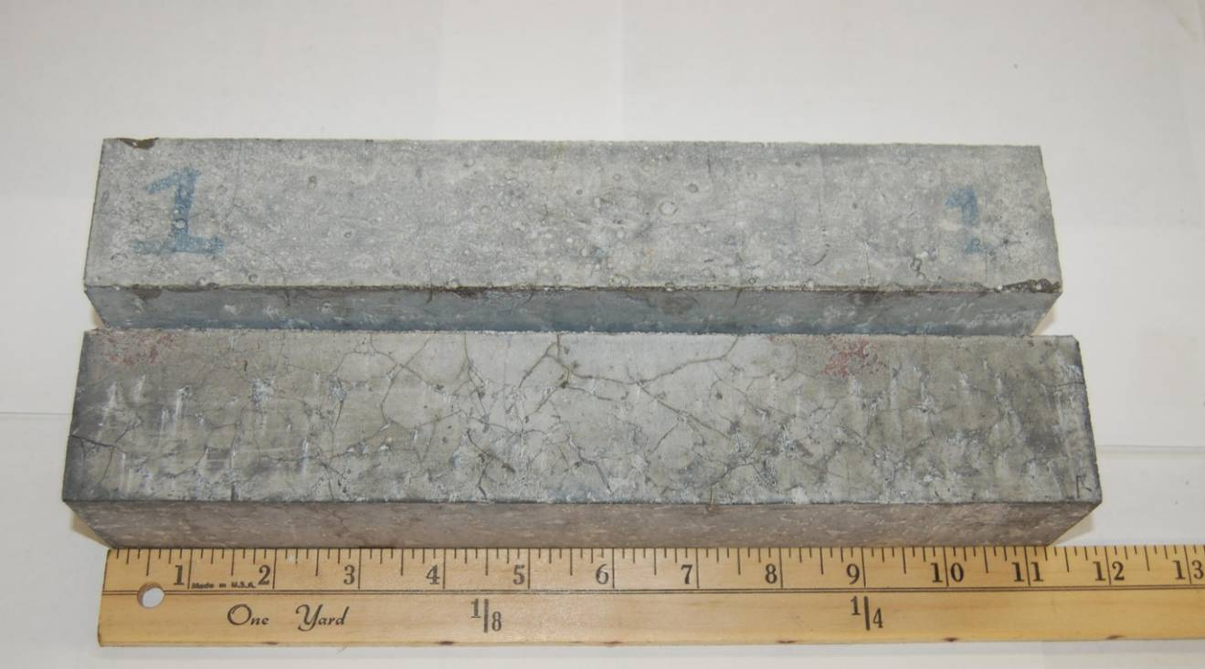
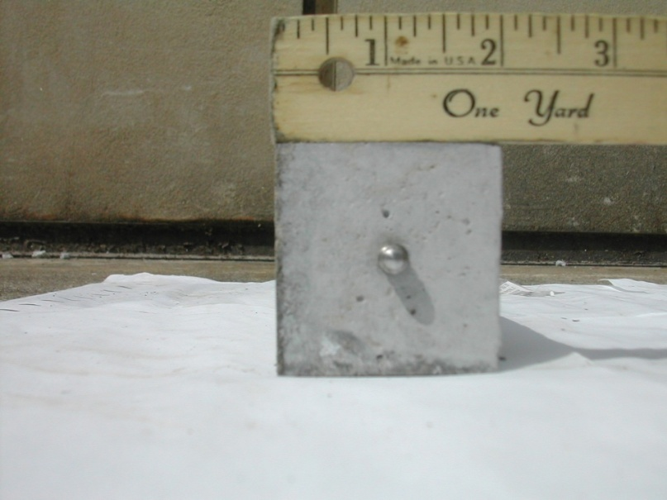
MCPT Samples

Slide 11
MCPT Coarse Aggregates List
Sl No. | Name | ASTM C 1260- 14Days Expansion | MCPT -56 Days Expansion
1 | New Mexico | 0.9000 | 0.1853
2 | North Carolina | 0.5000 | 0.1490
3 | Taunton, MA | 0.4100 | --
4 | New Jersey(CA), NJ | 0.4100 | --
5 | Spratt, CANADA | 0.3700 | 0.1490
6 | South Dakota | 0.1900 | 0.0995
7 | Oxford Quarry, MA | 0.1900 | ---
8 | Salt Lake City (CA), UT | 0.1900 | 0.0387
9 | Minneapolis, MN | 0.1000 | 0.0220
10 | Quality Princeton , PA | 0.0800 | 0.0705
11 | Swampscott, MA | 0.0600
12 | Liberty, SC | 0.0600 | 0.0827
13 | Big Bend, PA | 0.0200 | 0.0177
14 | Adairsville, GA | --- | 0.0173
15 | Dolomite, IL | --- | ----

Slide 12
Coarse Aggregates Expansion Curves

Slide 13
MCPT Fine Aggregates List
Sl No. | Name | ASTM C 1260- 14Days Expansion | MCPT -56 Days Expansion
1 | Jobe ,TX | --- | 0.1557(10 Day)
2 | New Jersey, NJ | 0.38
3 | Scotts Bluff, NE | 0.31 | 0.1150
4 | Cullom, NE | 0.31 | 0.0817
5 | Stocker, PA | 0.28
6 | Indianola, NE | 0.25 | 0.1417
7 | Georgetown, PA | 0.25
8 | Grand Island, NE | 0.23 | 0.0913
9 | Galena , IL | 0.17
10 | CemexSand, SC | 0.04 | 0.0173

Slide 14
Fine Aggregates Expansion Curves

Slide 15
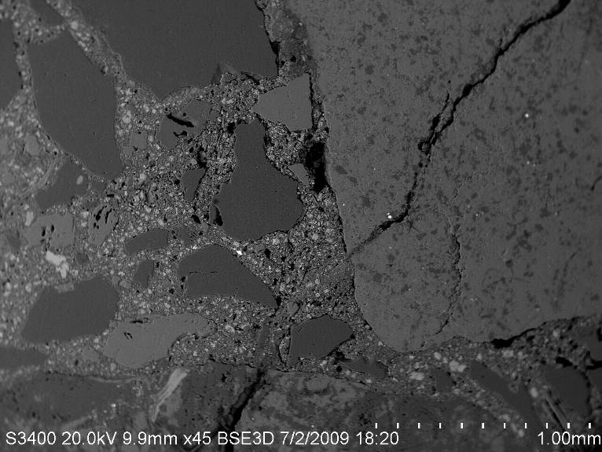
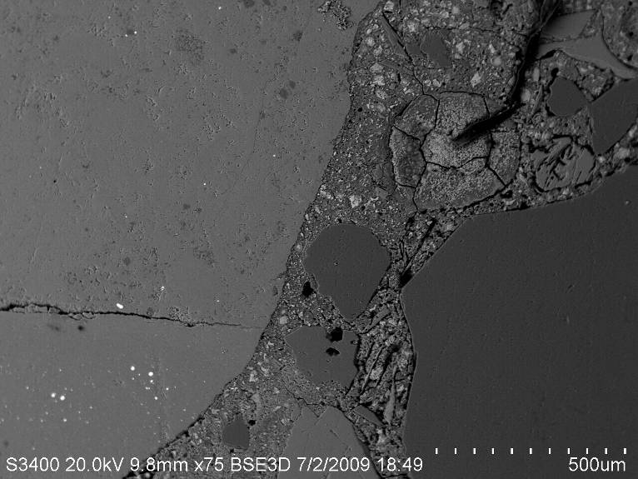
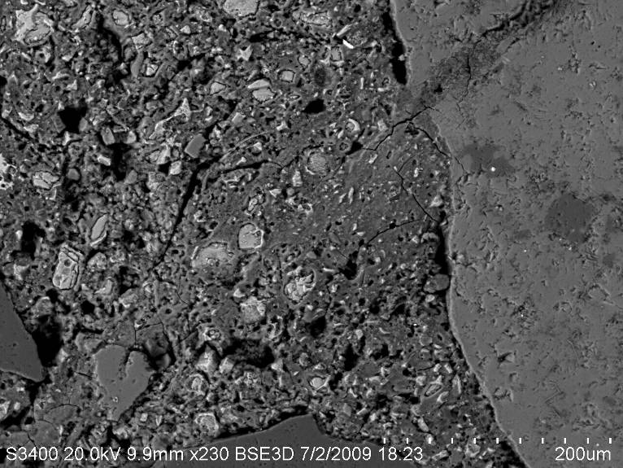
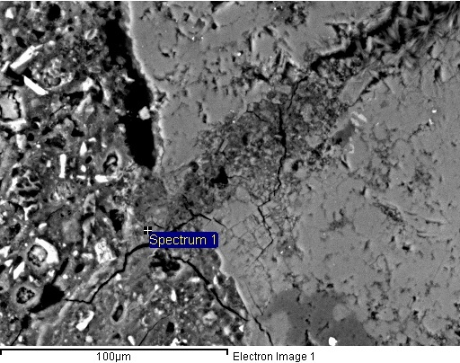
Microstructure of Spratt MCPT Specimen at 56 days

Slide 16
Comparison of MCPT-56 Days with CPT (ASTM C1293)

Slide 18
Comparison of MCPT-56 with AMBT (ASTM C1260)

Slide 20
Comparison of ASTM C 1260 with ASTM C 1293

Slide 21
Conclusions
Based on the limited test data, it appears that MCPT method is able to clearly identify reactive and non-reactive aggregates, based on a limit of 0.040% expansion at 56 days.
The MCPT method is neither as aggressive as ASTM C 1260, nor as slow as ASTM C 1293 method.

Slide 22
Advantages of Miniature Concrete Prism Test (MCPT)
No need to wait for one year (ASTM C1293)
Do not have to significantly crush and grind the aggregates, which can change the aggregate reactivity (ASTM C1260)
Not as aggressive as ASTM C1260 exposure conditions, but potentially as reliable as ASTM C1293

Slide 23
Future Steps
Calibrate the expansion criterion for assessing aggregate reactivity.
ASR Mitigation assessment through MCPT
Develop a protocol for evaluation of Job Mixtures for Potential ASR
Evaluate Impact of Deicing Chemicals on ASR

Slide 24
Questions?
PRANGAR@clemson.edu
elatife@clemson.edu

