Slide 1
Simplified Web based Design and Estimation for Reinforced Concrete Buildings of Moderate Size & Height
11th Global Engineering, Science
and Technology Conference
Dr. E. R. Latifee Md. Aminul Islam DebasisH Sen Rashedul Kabir

Slide 2
Simplified Web based Design and Estimation for Reinforced Concrete Buildings of Moderate Size & Height
11th Global Engineering, Science
and Technology Conference
Presented By Md. Aminul Islam Lecturer, Dhaka International University Department of Civil Engineering

Slide 3
Simplified
WHY
?

Slide 8
Web Based Design
WHY
?
Simplified

Slide 9
Internet users
Bangladesh
Media | Subscriber (Millions)
Mobile Internet | 52.331
WiMAX | 0.159
ISP + PSTN | 2.168
Total | 54.658
Source: BTRC, 14 December 2015

Slide 10
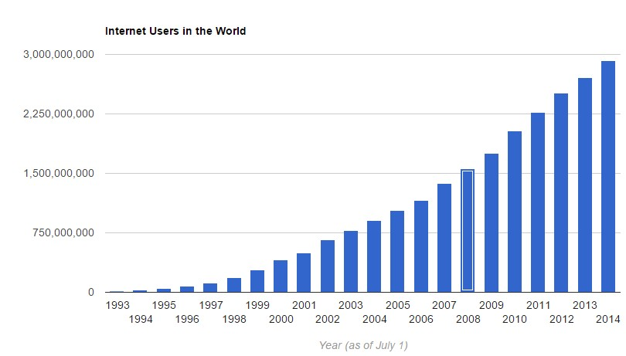
Internet users
3,266,661,000
3.2 Billion
Source: Internet Live Stats, 14 December 2015

Slide 11
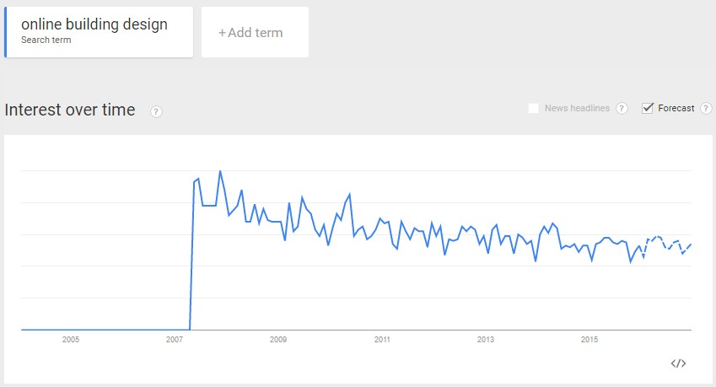
Google Keyword Search Report Source: Google Trends, 14 December 2015

Slide 12
Scopes
To offer simplified designs to the general people who have access to the internet
To offer estimates of materials prior to the work
To offer a preliminary idea of sections and check of designs to the engineers
To offer inspiration to the engineering students

Slide 13
Codes Used for programming the design
ACI 318-11 (American Concrete Institute)
BNBC (Bangladesh National Building Code)

Slide 14
Programming Language Used for Coding the Design
Javascript (A web based scripting language)

Slide 15
Where the design can be found?
http://drlatifee.weebly.com
http://simplifieddesignofconcretestructures.weebly.com/

Slide 16
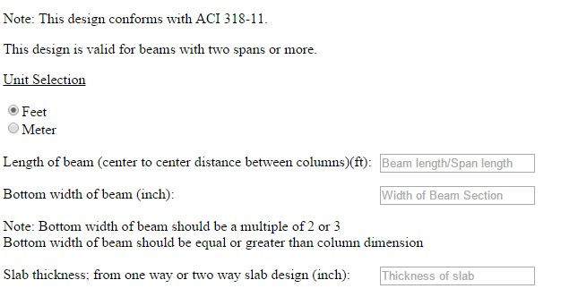
Basic Informations

Slide 17
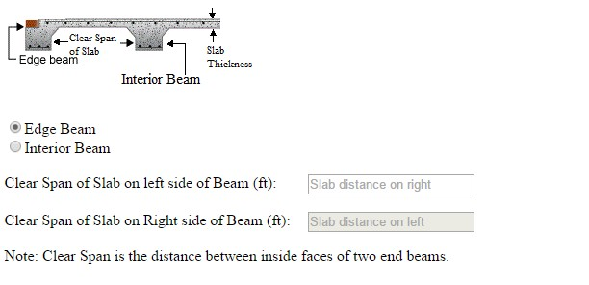
Position and Support Condition

Slide 18
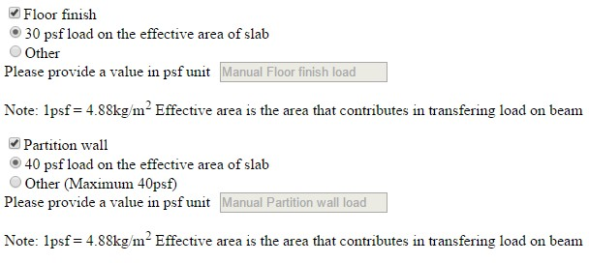
Extra load coming form slab in excess of Live load and self weights

Slide 19
Intended Use of Building

Slide 20
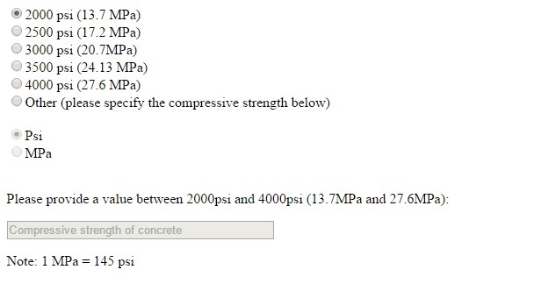
Compressive Strength of Concrete

Slide 21
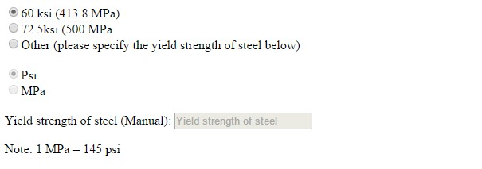
Tensile Strength of steel

Slide 22
Concrete estimation

Slide 23
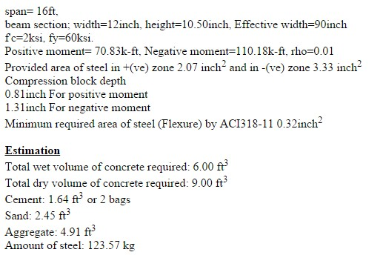
Design output

Slide 24
On the other hand If we wanted to do the same thing in ETABS

Slide 25
Defining Grids

Slide 26
Defining Materials

Slide 27
Defining Sections Beam/Slab

Slide 28
Design output of Two Way Slab

Slide 30
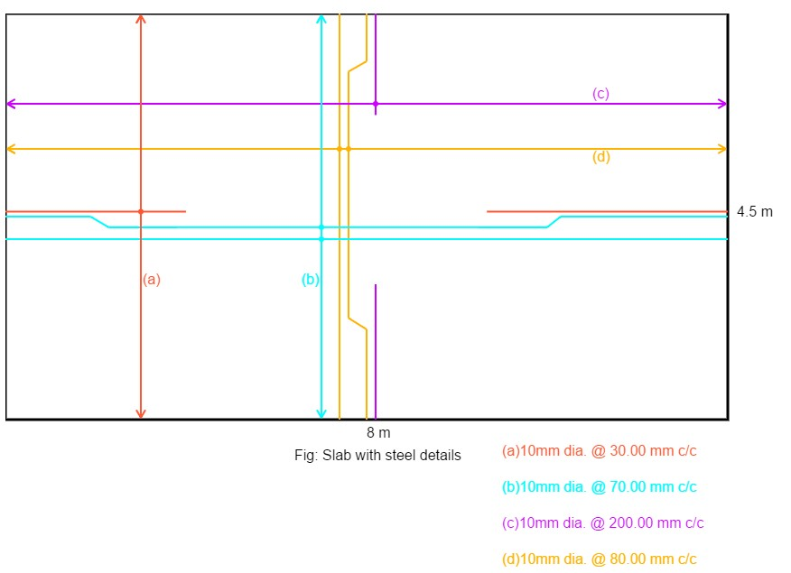

Slide 31
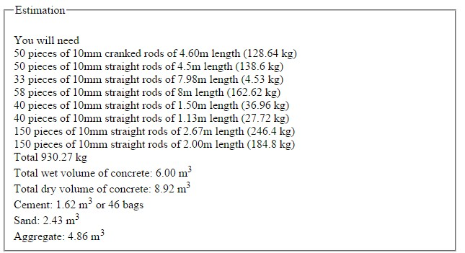

Slide 32
o
e
y
u
s
s
Q
t
n
n
A
i

